Slide 2
打破常规思考问题
创新性思维

Slide 3
把

Slide 4
把把把把把把把把把把把把把把把把把把把把把把把把把把把把把把把把把把把把把把把把把把把把把把把把把把把把把把把把把把把把把把把把把把把把把把把把把把把把把把把把把把把把把把把把把把把把把把把把把把把把把把把把把把把把

Slide 5
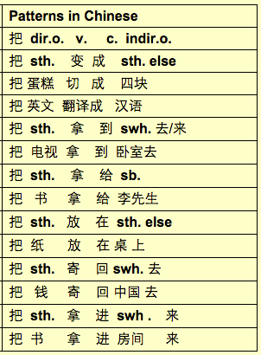

Slide 6
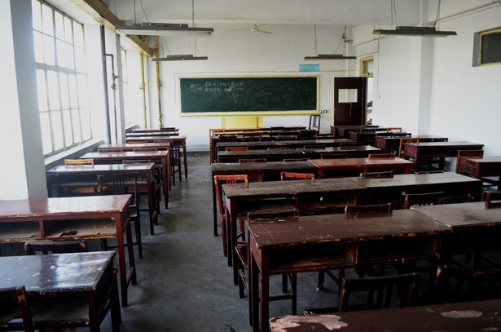
这是我中文课堂的样子
Notes:
Let me take you through my experience of learning Chinese.
This is the type of classroom I went to in Nanjing Normal University.
Teacher-focused. Students passive.
I did not get out of my seat once.
Obviously this is an old classroom, but the set up remains in many language classrooms.

Slide 7
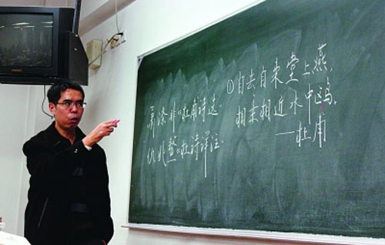
Repeat
Read
Write
这是我中文老师的样子
Notes:
This what my teacher looked like. He would stand at the chalkboard and we had to copy Chinese characters over and over again.
We repeated what he said.
We read.
We wrote was he wrote.

Slide 8
这是我们学习中文的样子
Notes:
This is what I looked like in class. Very little interaction with anyone.
Memorization.
Drill.

Slide 9
“That’s the way we have always done it!”
我们一直都是这么教的！
Notes:
If I was to go back to Nanjing and ask my teacher…why didn’t you use songs, or put us in groups, or watch a video.
And of course…Chinese is a difficult language, so we must study hard.
I agree. It is a difficult language, but it can be learnt in a variety of ways.

Slide 10
I teach the
whole class
together.
I assess all
students
the
same way.
I use the same
strategies
to teach.
I assess at
the end of
a unit.
Notes:
So back to the box. The way it has always been done.
for the next 2 days Want us to think outside this box and be open to anything that will help students learn more effectively.

Slide 12
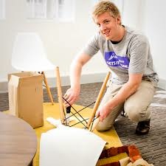
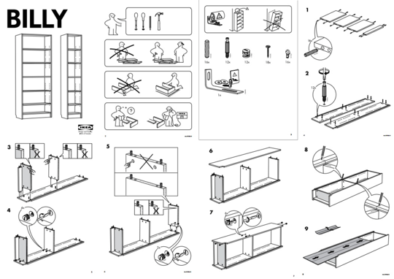
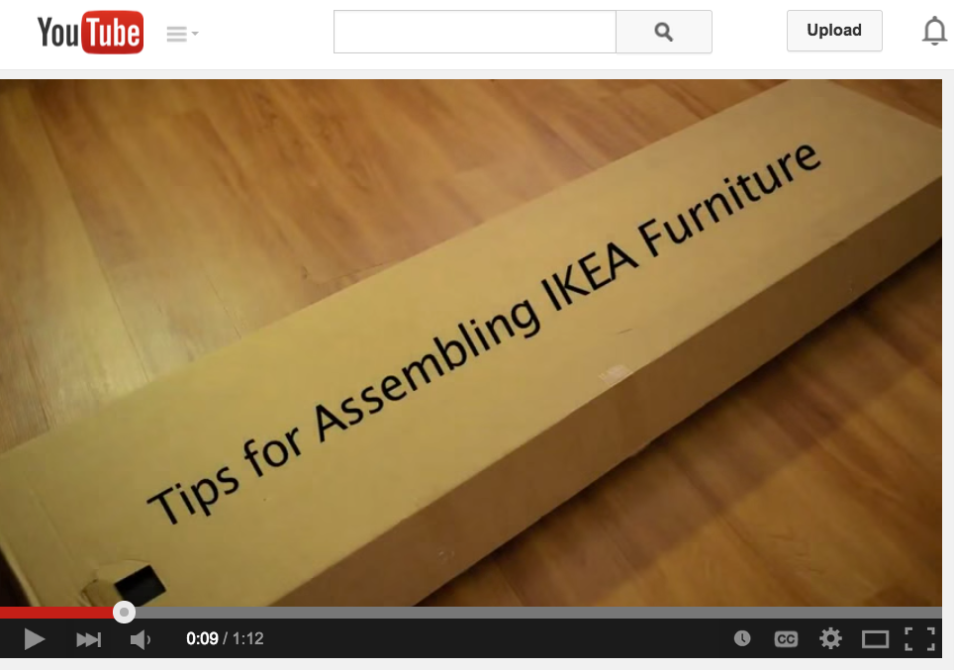
1
2
I can do it all by myself.
I like to follow the images.
3
4
I get someone to help me.
I watch a video
Notes:
So if you had to learn something new, like putting furniture together, what is your preference? raise your hand.

Slide 13
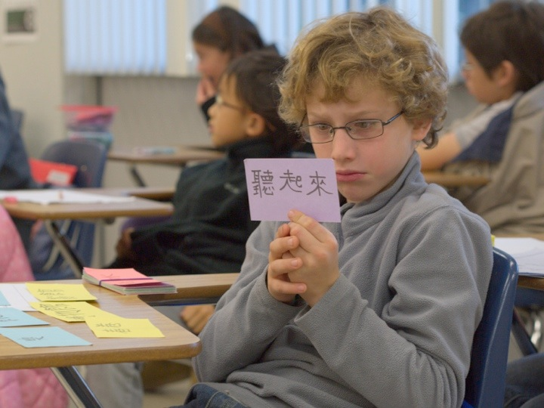
Different learning styles
Notes:
Each student enters your classroom with a unique set of strengths and weaknesses.

Slide 14
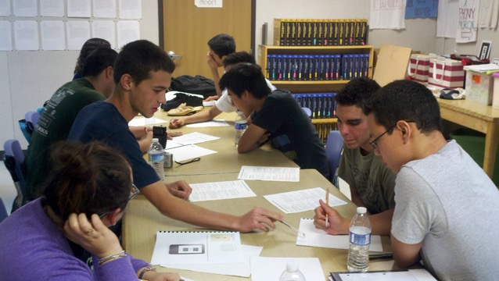
Work Stations
Learning Contracts

Slide 15
Learning Contracts

Slide 16
Learning Contracts are Agreements between a teacher and a student.
Notes:
One thing about Secondary students...they are independent. They like choice.
Whenever I gave a task, you would hear this..collective sigh...
And one day, a student said...Can I make a song instead of presentation.
For me...that was a light-bulb moment.

Slide 17
2 Types of Learning Contracts
The Teacher sets the Learning Objectives
The Student thinks about their learning needs and negotiates the Learning Objectives with the Teacher

Slide 18
Teacher-Directed Learning Contracts

Slide 19
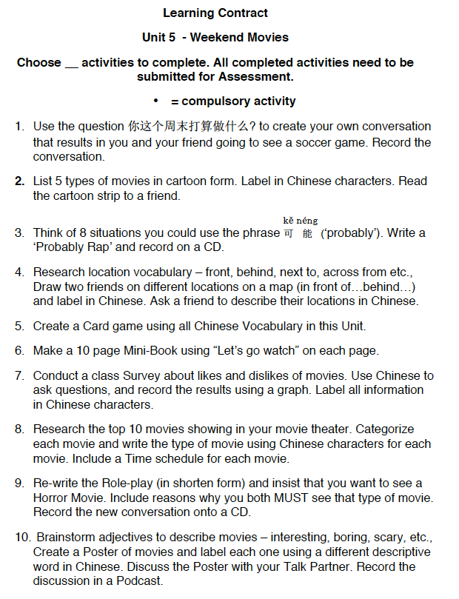
= You must complete
THEME
Let’s Go Watch A
Movie!

Slide 20
Theme: “What! No Bathroom?”
Learning Outcomes
1. I Can describe the rooms in my house.
2. I Can design a home plan with furniture labeled.
3. I Can record a virtual tour (audio) around my home.
4. I Can read a ‘For Sale’ advertisement for houses.
5. I Can give directions to move furniture around the house.
Notes:
** Example Contract - What? No Bathroom!!

Slide 21
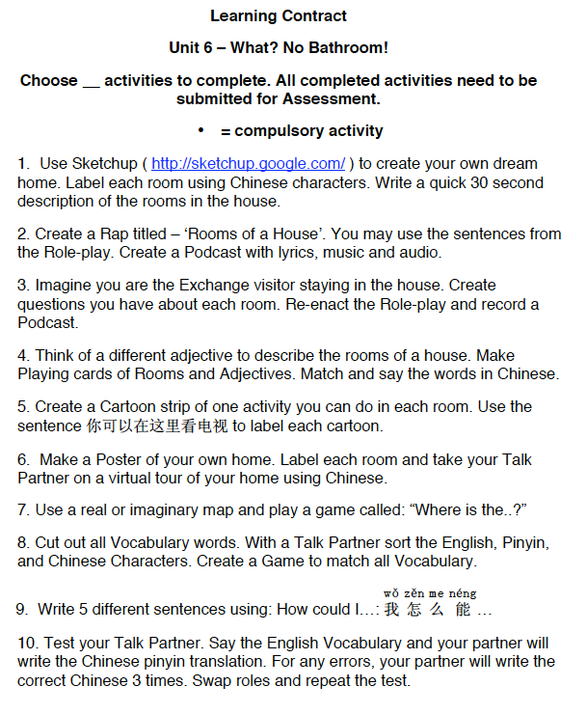
Technology
Rap
Role-play
Card game
Cartoon
Poster
Map
Vocab. game
Notes:
** Example Contract - What? No Bathroom!!

Slide 22
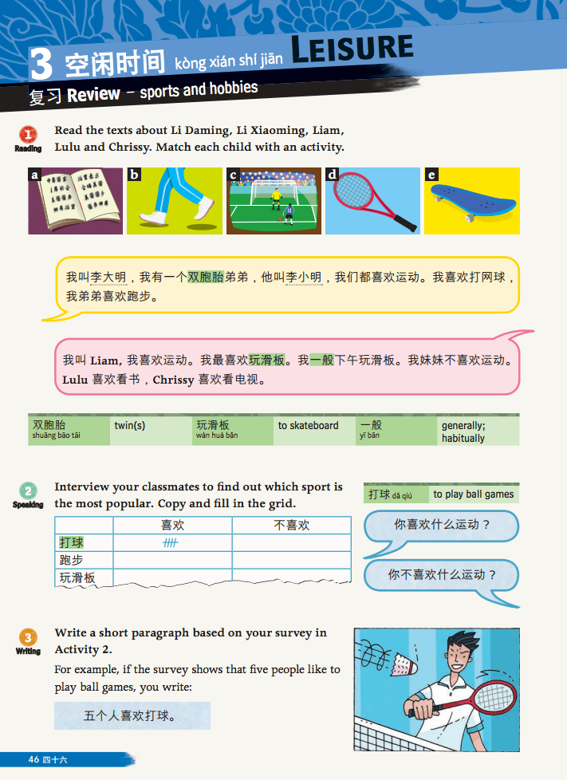
READING TASK 1
Make a Matching card Game with sentences and images.
SPEAKING TASK 2
Conduct a Survey about which sports and hobbies your classmates like.
WRITING TASK 2
With your Talk Partner make a Poster of the results of the Hobbies Survey.

Slide 23
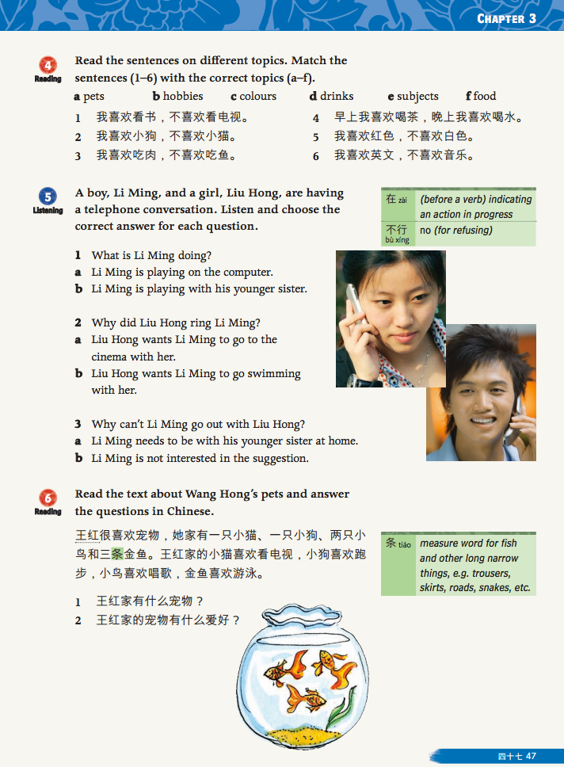
SPEAKING TASK 4
Write a script about a telephone conversation.
Rehearse the conversation with your Talk Partner.
CREATING TASK 5 Write a script about a telephone conversation.
Rehearse the conversation with your Talk Partner.

Slide 24
Student-Directed Learning Contracts

Slide 25
My Goals | How I plan to achieve the goals | When I will do the work | What resources I will use | How I will demonstrate my learning
I want to read popular Chinese food on a menu. | I will use the Textbook to learn new food. | Classroom | Online menus | I will perform a restaurant roleplay
I want to be able to ask for more information if I can’t read the menu | I will watch videos about Chinese menus | Visit Chinese restaurants | Restaurant menus
 | I will use a mini whiteboard to learn new characters |  | Chinese/ English Dictionary
 | I will collect Chinese menus online and at restaurants

Slide 26
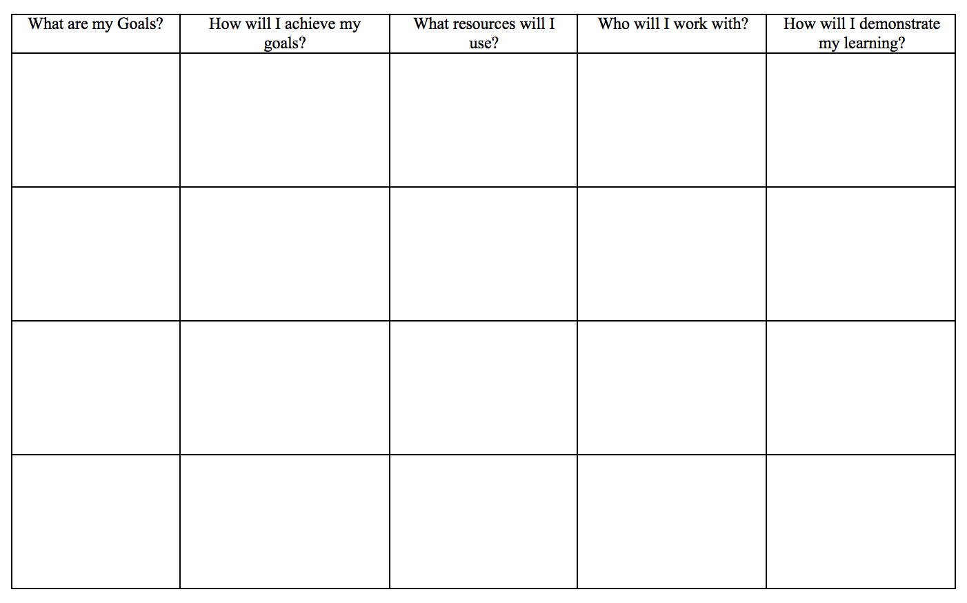
You are a student.
Plan Your Own Learning Contract

Slide 27
Learning Centers
Work Stations

Slide 28
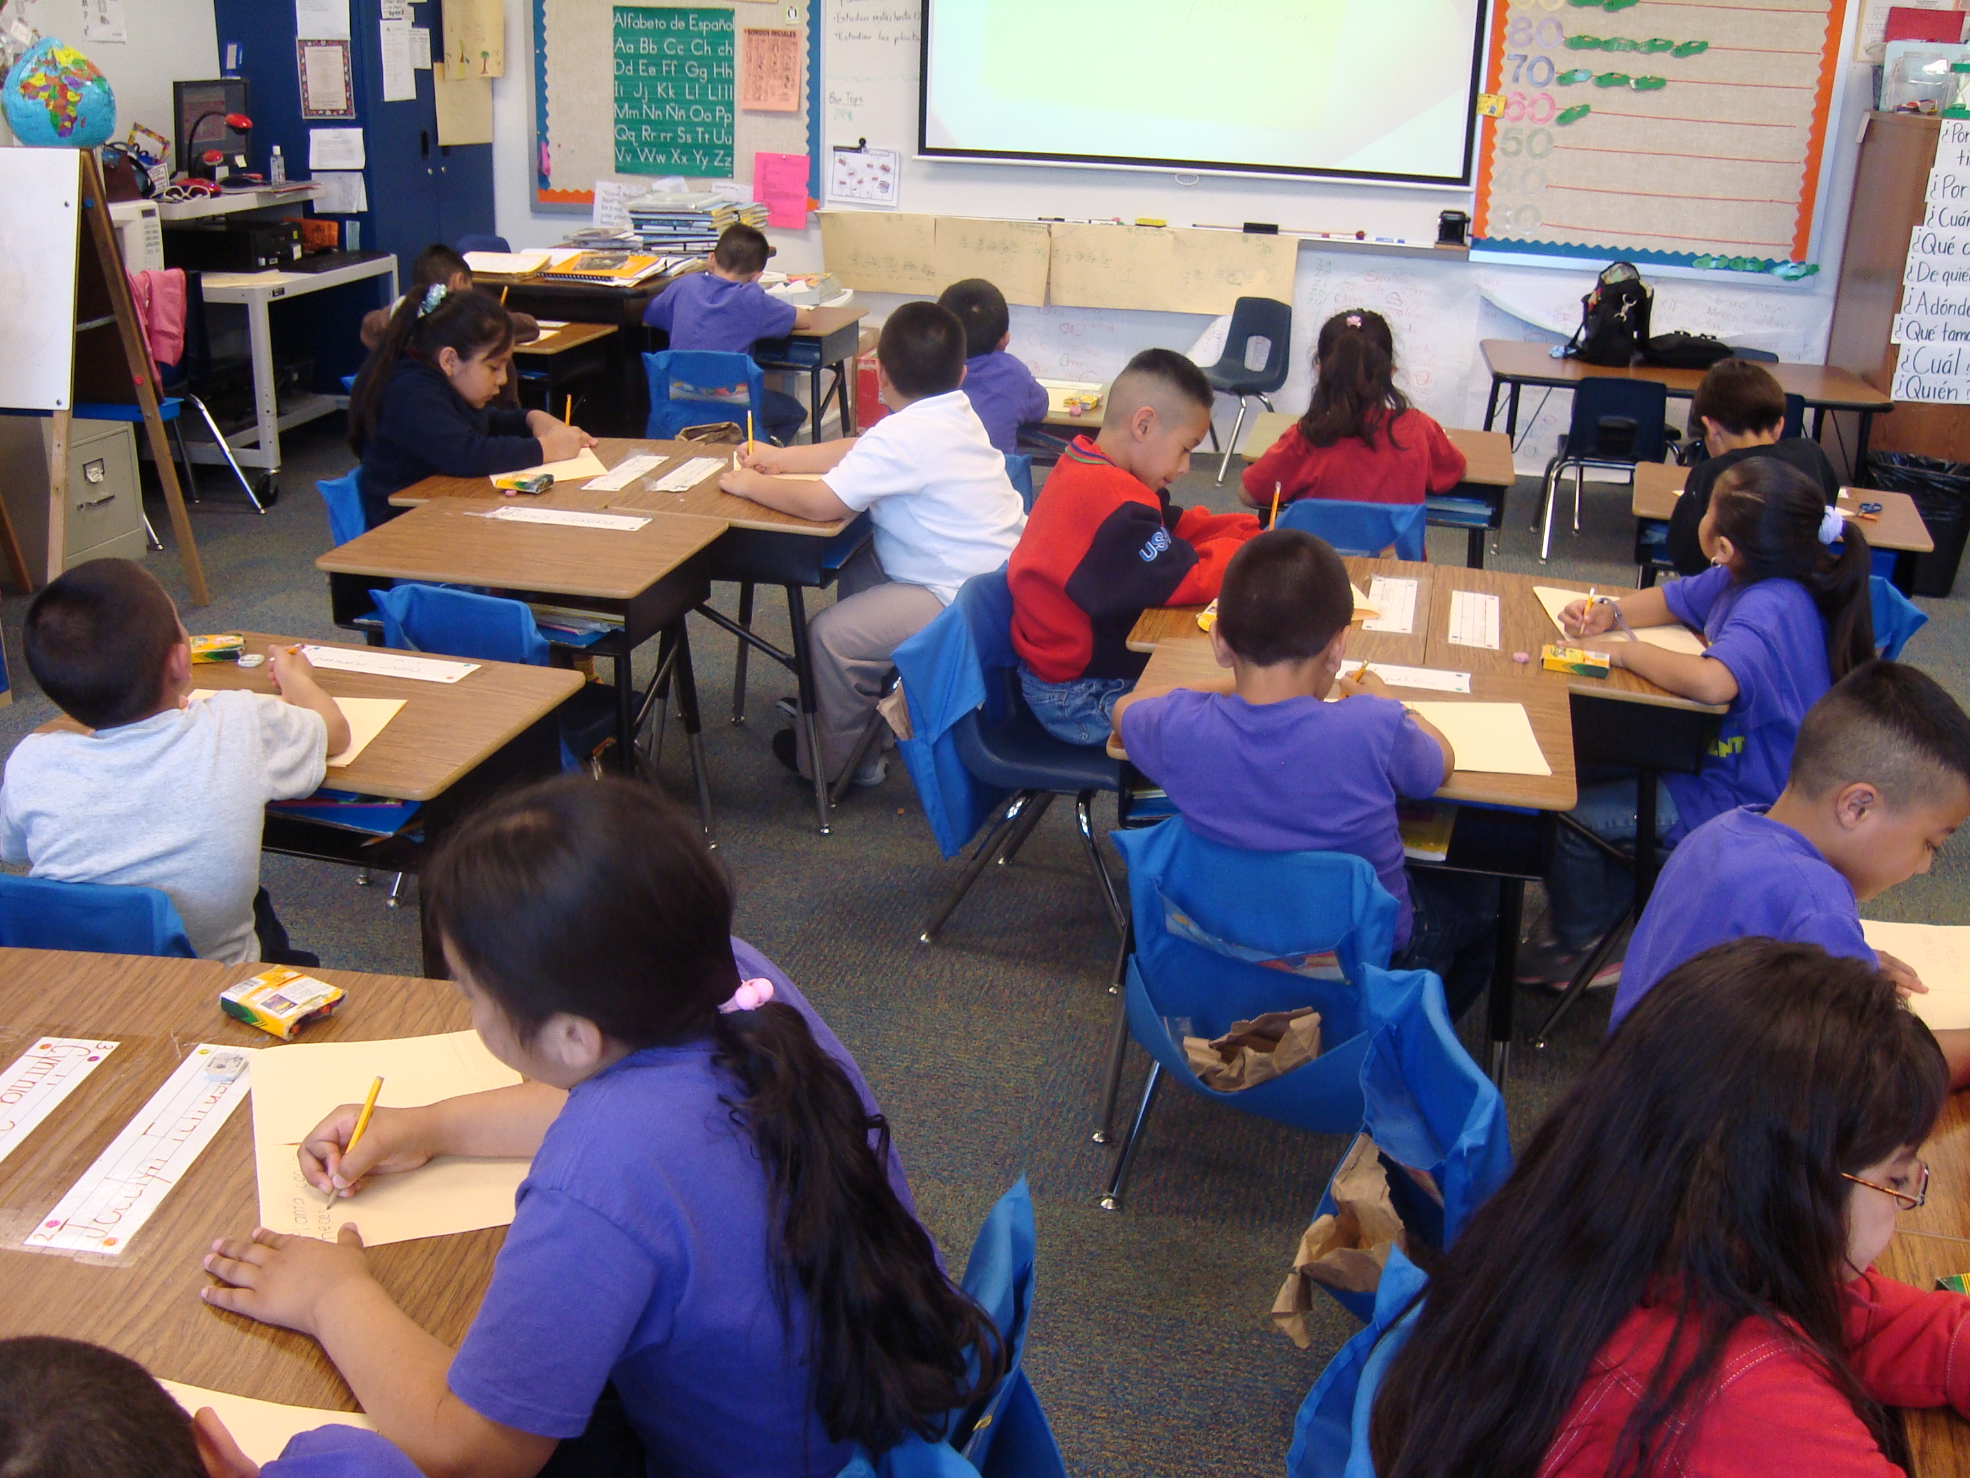
3
4
2
5
1

Slide 29
Themes
The Olympics
topic
likes
dislikes
sports
topic
My
Passport
locations
Notes:
A theme acts as an umbrella..it gives topics a CONTEXT
The theme groups topics together so learning is meaningful and related to real world situations.

Slide 30
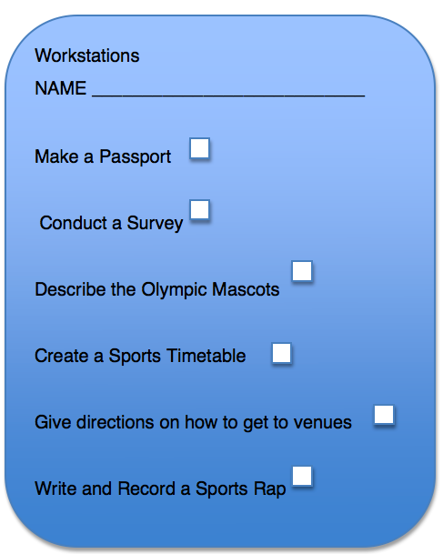
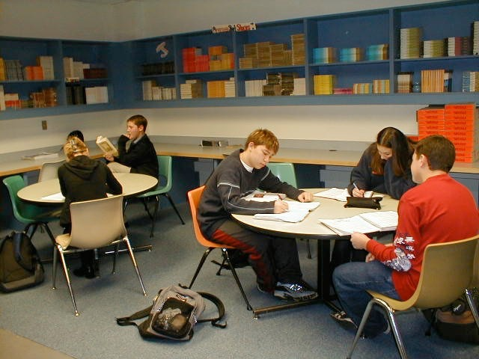
The Olympics - Work Stations
在教室里设立工作站。活动之间学生轮流

Slide 31
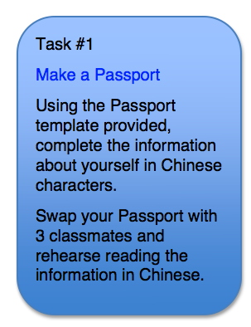
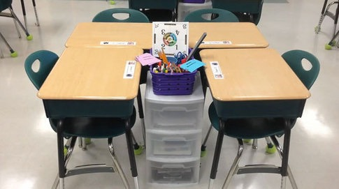
#1 The Making Station
Materials needed:
Passport template
Vocabulary Cards
Pencils
Scissors
Photo

Slide 32
Make your own Passport with 8 pieces of information about yourself.
(Use Vocabulary Cards)

Slide 33
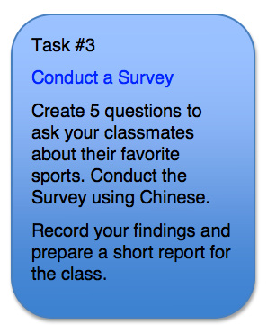
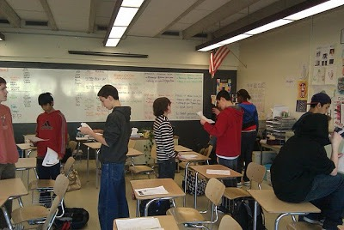
#2 Take a Survey Station
Materials needed:
Graph paper
Sport Vocabulary Cards

Slide 34
#3 The Blogging Station
Materials needed:
Mascot Images for 2016 Olympics
Laptop
Class Blog site
Task #2
The Olympic Mascots
Using the images provided,
write a brief description
of each Olympic Mascot
using Chinese characters.
Include the description
on a poster for the 2016
Olympic Games.

Slide 35
TASK: Describe the color, size, body of each Mascot.
In the description include at least 3 actions/sport each Mascot is able to do.

Slide 36
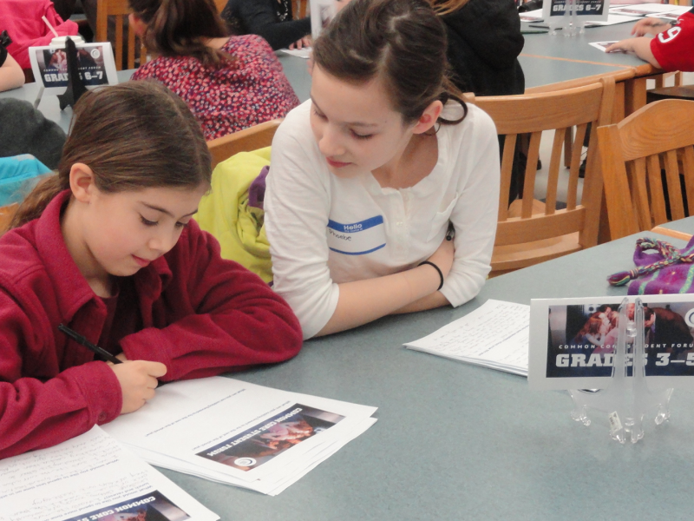
#4 The Role-play Station
Materials needed:
Olympic venues Map
Writing paper
A partner
Pencil

Slide 37
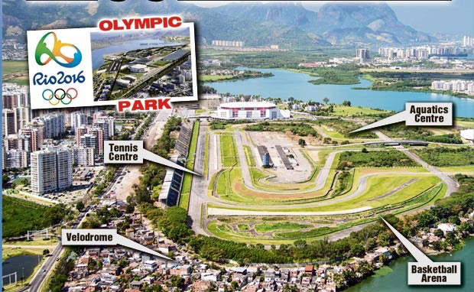

Slide 38
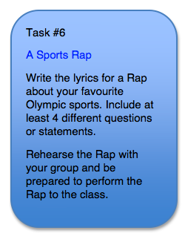
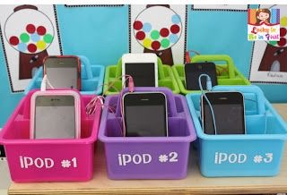
#5 The Rap Station
Materials needed:
Paper
Pencil
Ipods

Slide 40
Let’s Try It!
THEME: I Need New Clothes

Slide 41
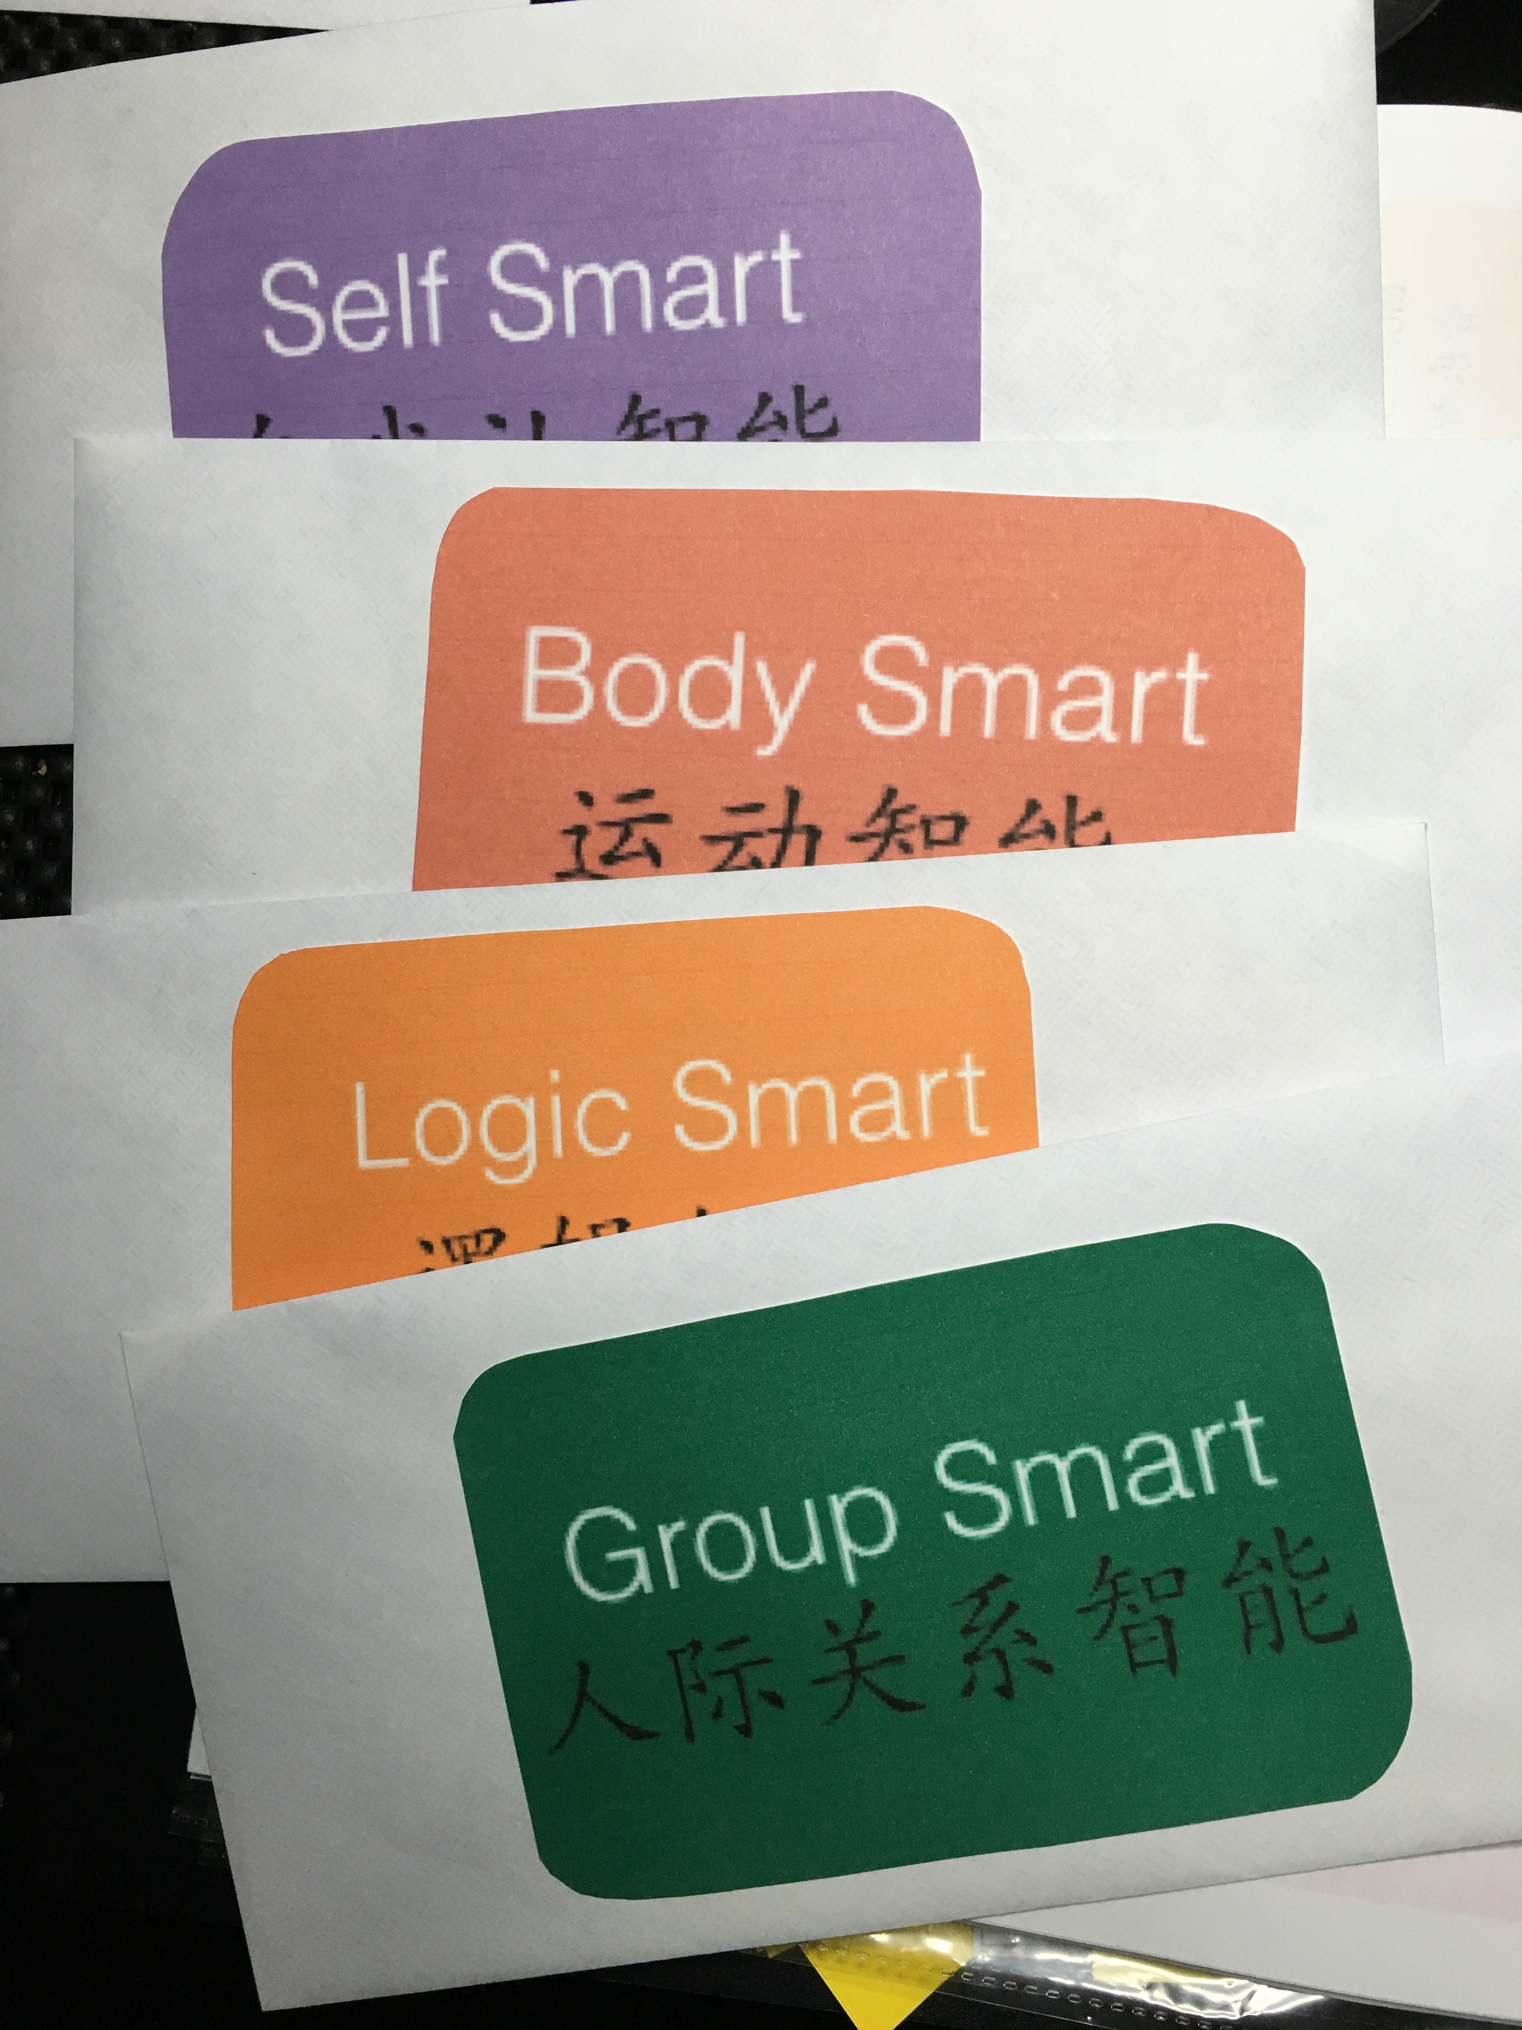
There are 6
Work Stations

Slide 42
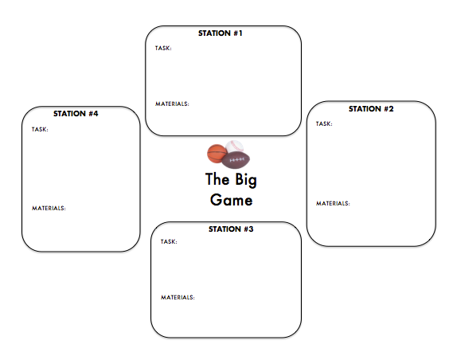

Slide 43
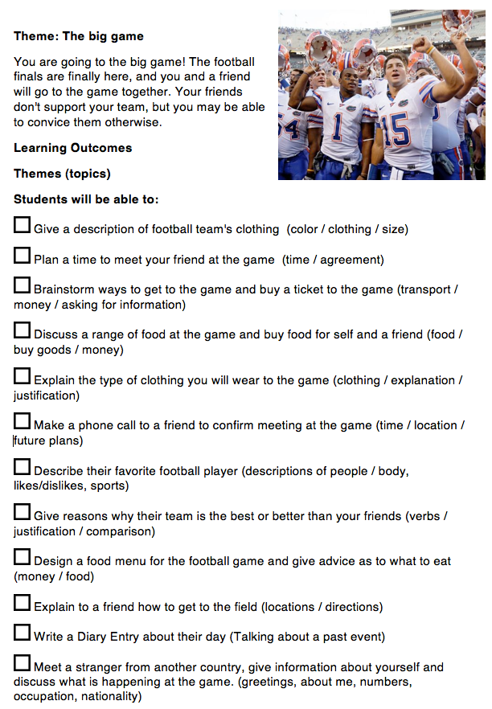
It’s Your Turn!

Slide 44
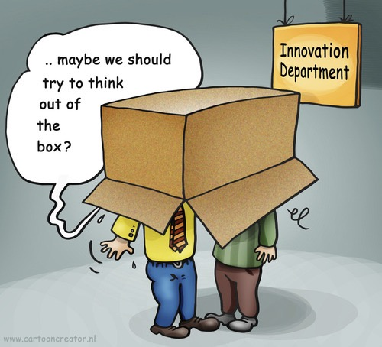

Slide 45
Learning Contracts
Students work at their own pace on activities.
Work Stations
Students rotate at different stations in the classroom

