Slide 1
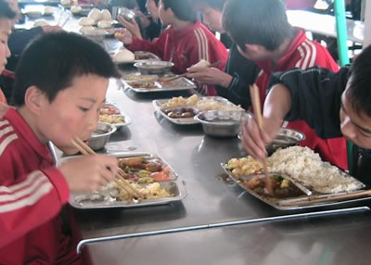
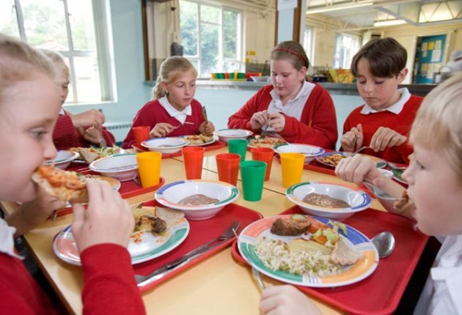
Language
Culture
Express likes and dislikes
Eating out at a restaurant
Ordering food
My favourite food
+
Compare school lunches
Celebrations and food
History of chopsticks
Design menus
Notes:
When doing a food topic..as well as language content..
Compare school lunches, chopsticks, celebrations and food, real menus

Slide 3
PLAN

Slide 4
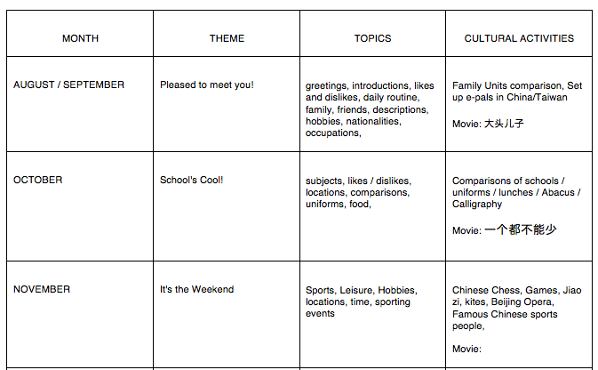
12 Month Planner
Notes:
For a new school year…I go through month by month….and put in Festivals..
I then plan what units I am teaching and plan cultural experiences for students that are embedded and infused into language.

Slide 5
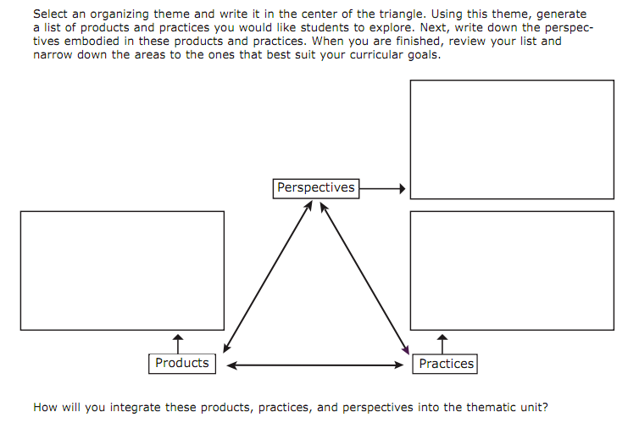
Choose a Theme
Getting Around

Slide 6
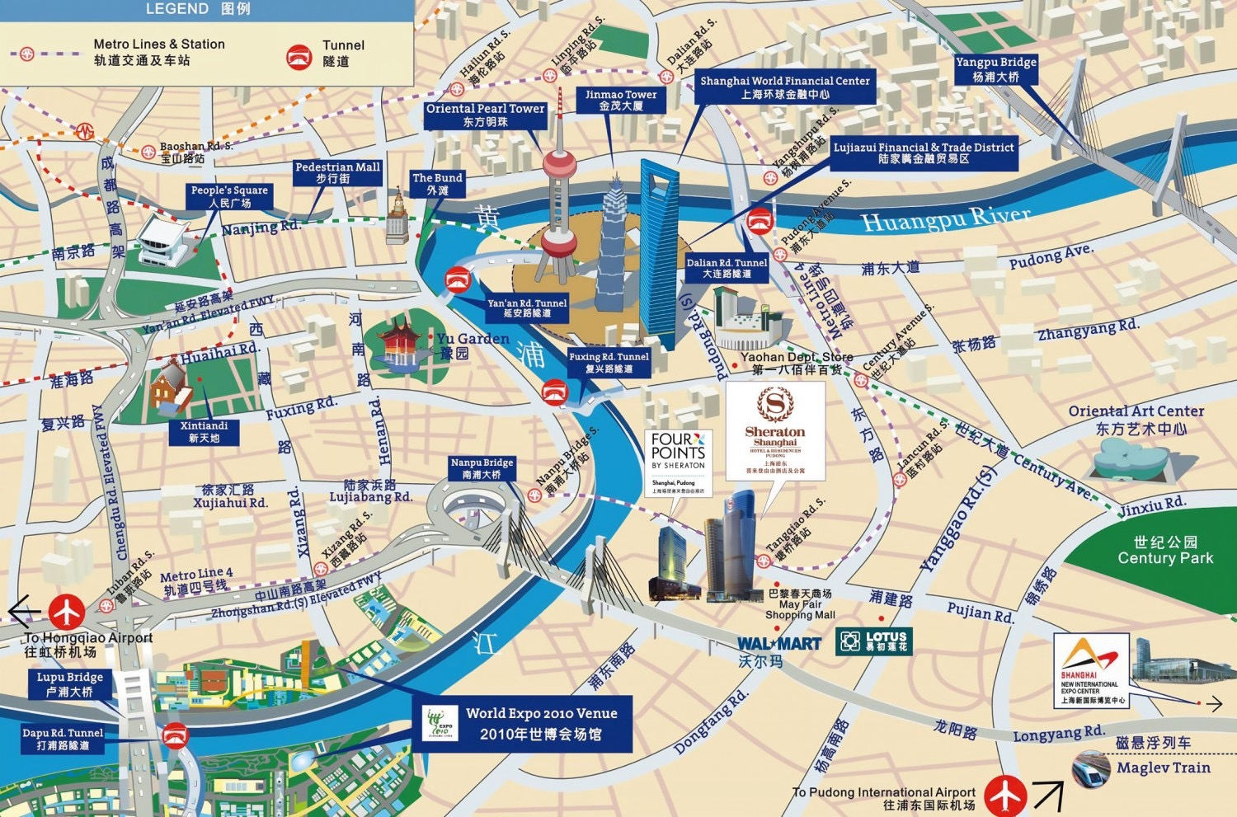
Theme: Getting Around

Slide 7
LANGUAGE
I can choose appropriate form of transport
I can give directions
on a map.
I can conduct a survey of transport use
I can buy a train ticket.
CULTURE
What are some landmarks in Shanghai?
How did different types of transport help Shanghai develop?
How does transport contribute to environmental problems?
What would you include in a 3 day itinerary in Shanghai for a tourist?
PRODUCTS
PERSPECTIVE
PRACTISE

Slide 8
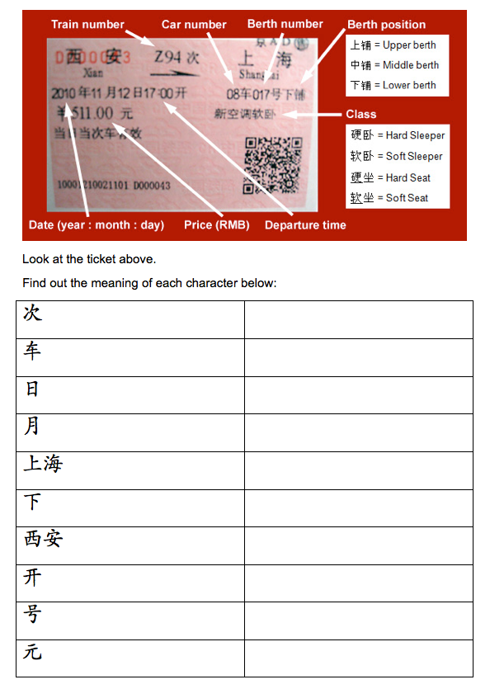
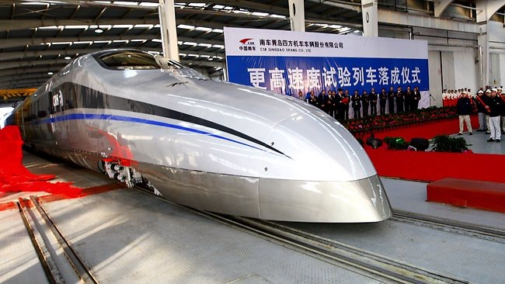
Authentic
Materials

Slide 9
The Great Wall Trek
Your Power
source

Slide 10
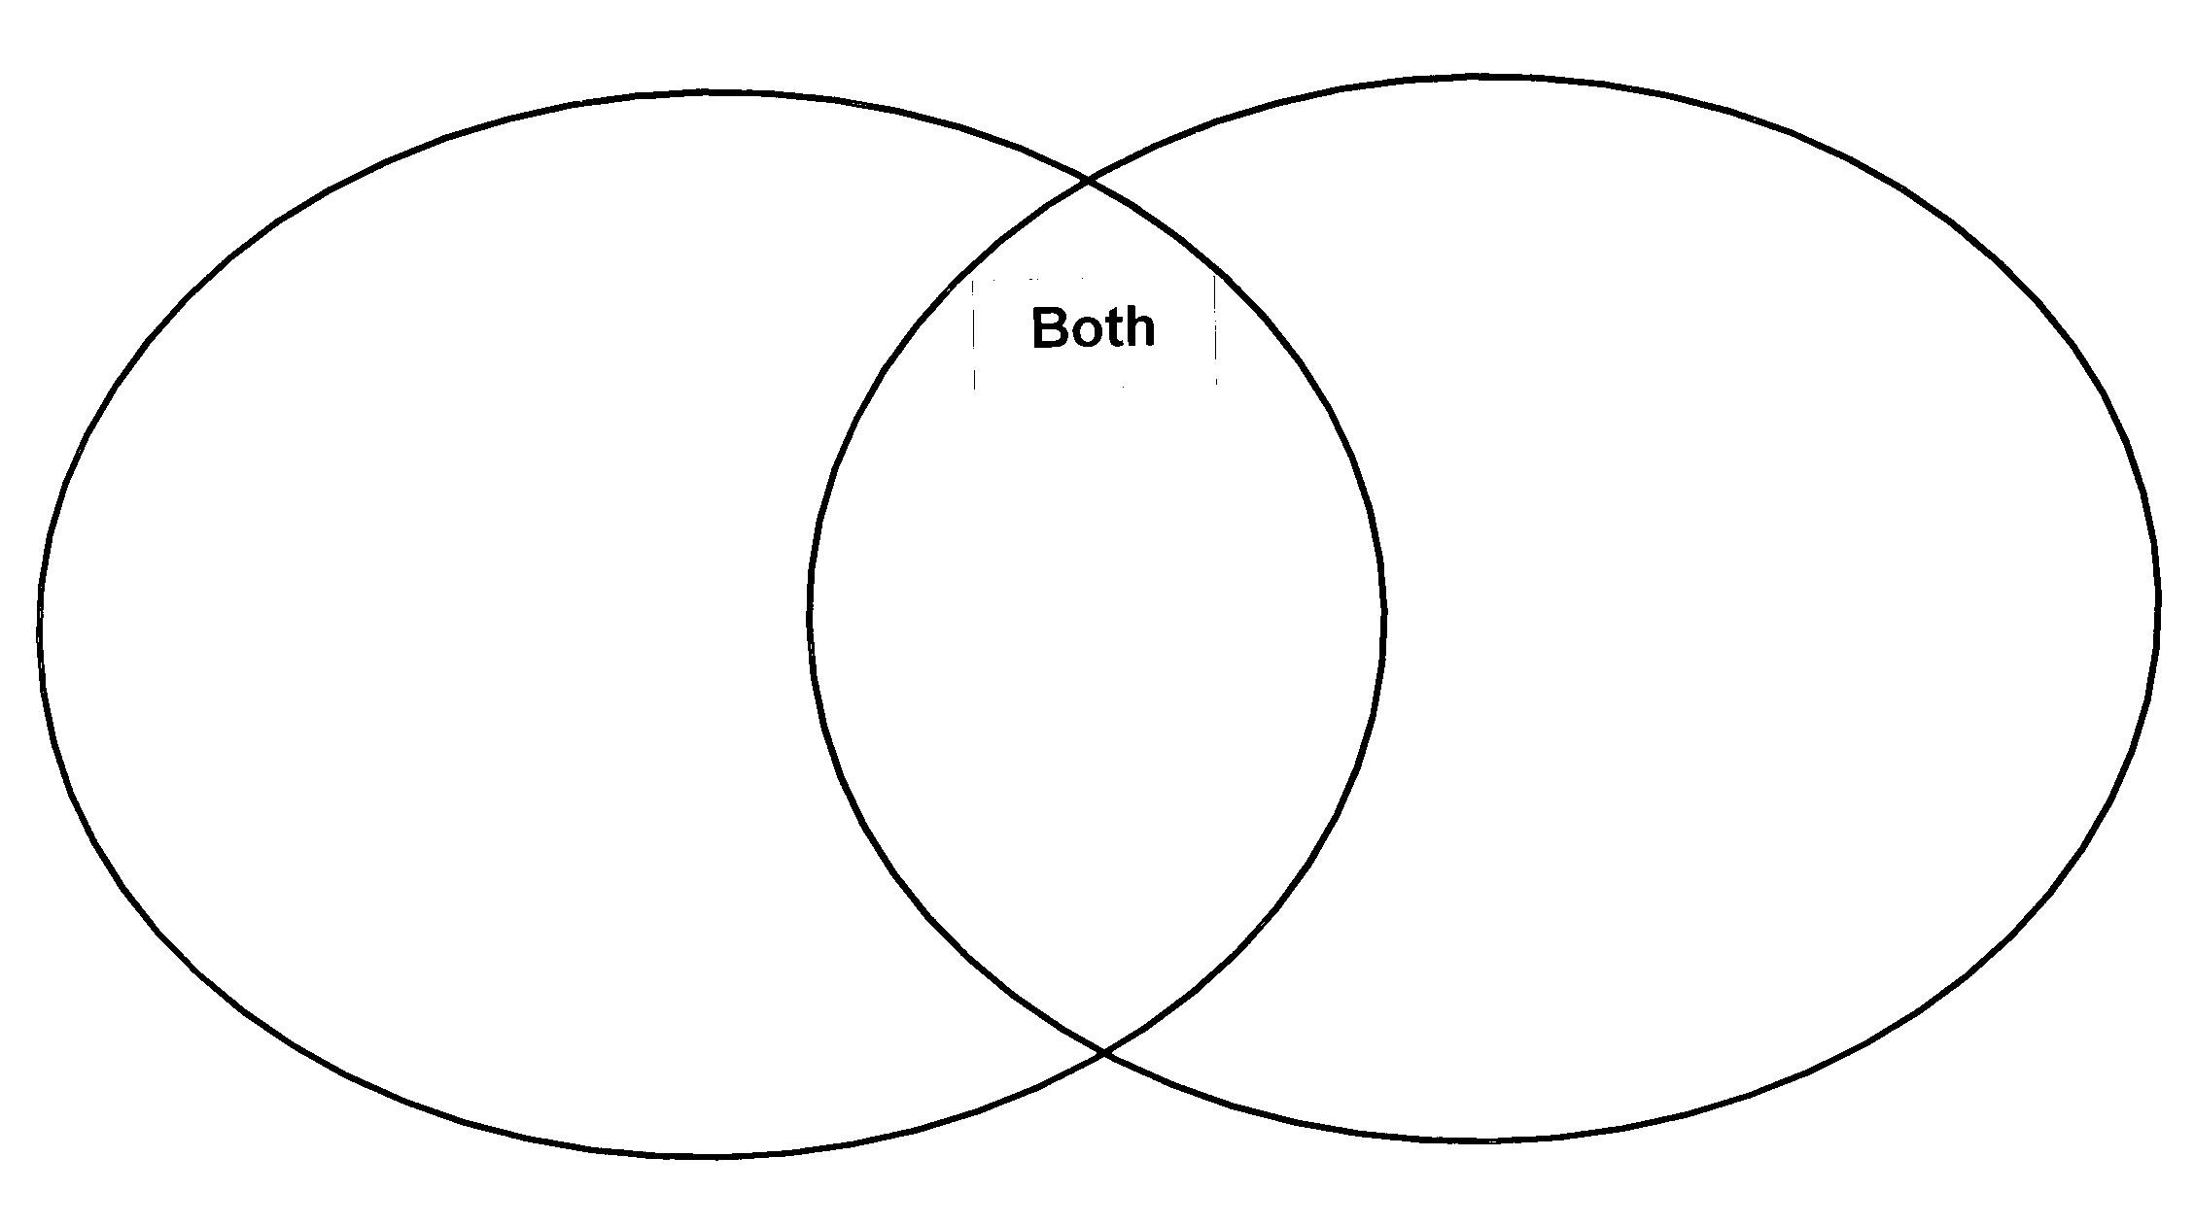
Theme: Getting Around
COMPARE AND CONTRAST
上海
伦敦

Slide 11
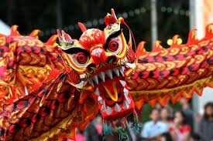
CHINESE NEW YEAR
Chinese New Year

Slide 12
How will you engage students in learning the language and culture of
Chinese New Year?
过新年
产品
观点
做法
PRODUCTS
PERSPECTIVE
PRACTICE
10 minutes

Slide 13
Inquiry

Slide 14
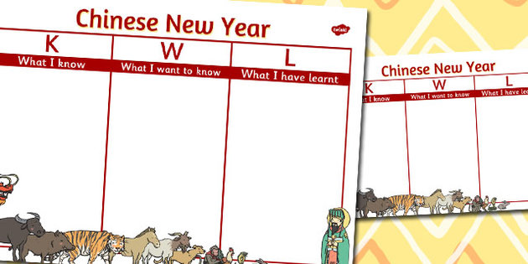
What Questions do you have about Chinese New Year?

Slide 15
Theme: Chinese New Year
LANGUAGE
I can identify the animals of the Chinese Zodiac
I can express likes/dislikes
I can sing 恭喜恭喜
I can greet appropriately
CULTURE
What are red envelopes?
Why are there fireworks?
Why do I bow?
Why is fish eaten?
Who pays the bill?
Why are there only 12 animals?
Who is Nian?
How is food served?
How to show gratitude?
PRODUCTS
PERSPECTIVE
PRACTISE

Slide 16
CULTURE
产品
观点
做法
PRODUCTS
PERSPECTIVE
PRACTISE
Red Envelopes
Good Luck / Bad luck
How is food served?
Fireworks
Prosperity
Why is fish eaten?
Lanterns
Evil spirits
Dragon Dance
Chinese Zodiac
Family
Family Gatherings
New Clothes
Children
Cleaning
Red signs/decorations
Color red
Travel
Lunar calendar
Personalities
Debts
Food / Cooking
Etiquette

Slide 17
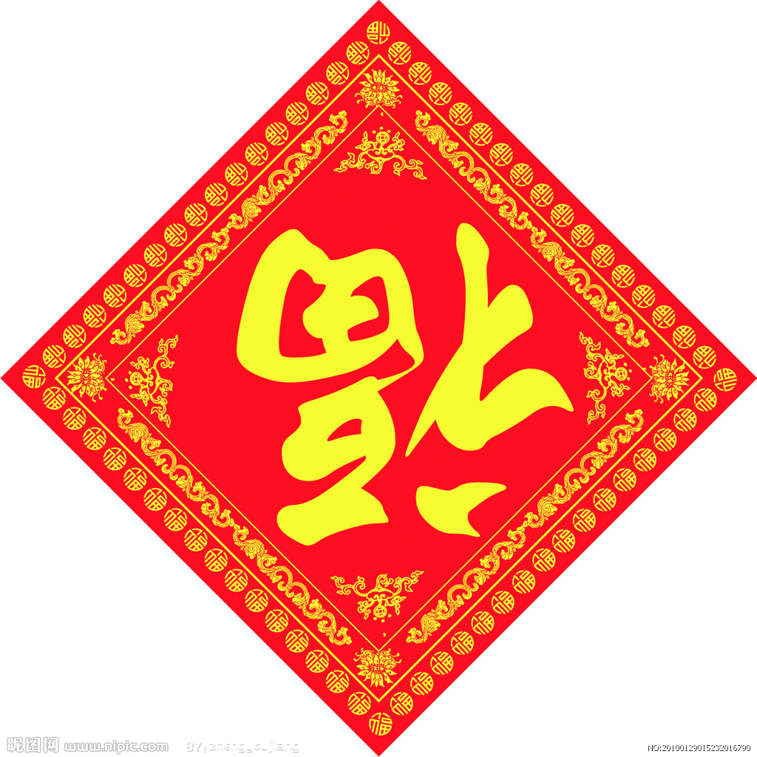
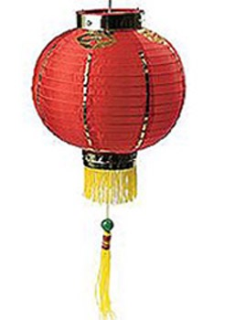
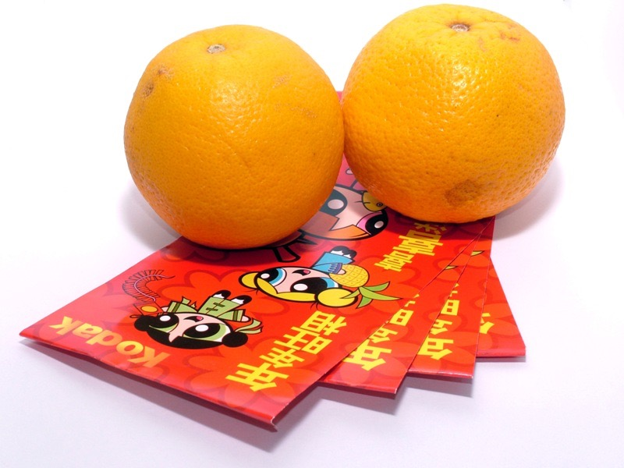
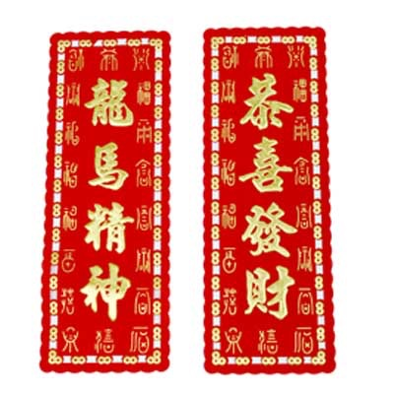
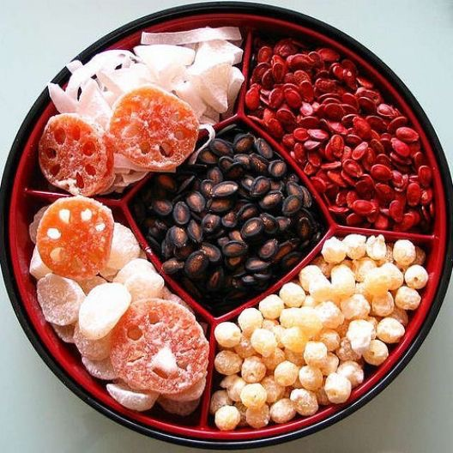
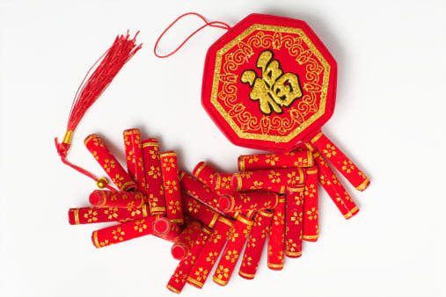
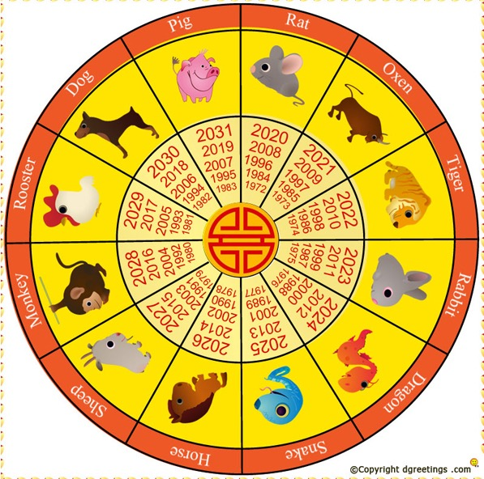
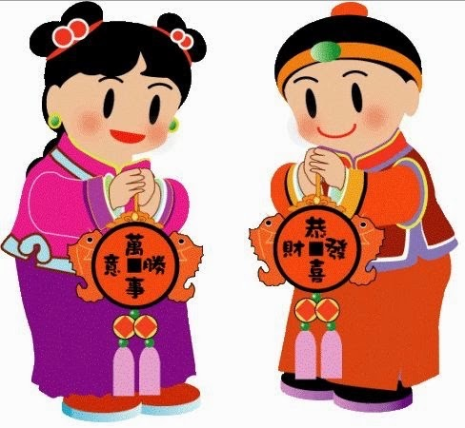
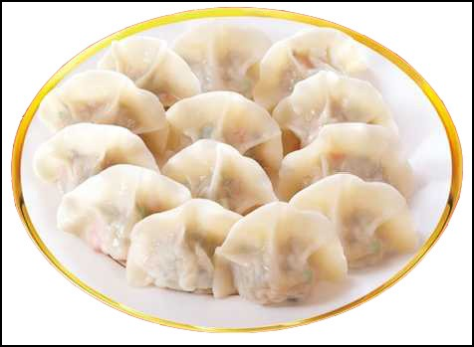
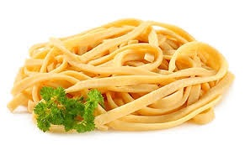
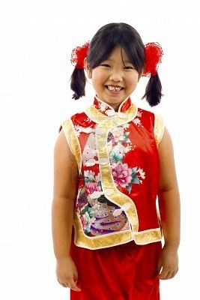
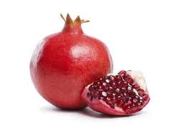
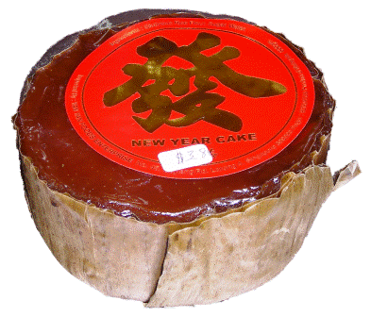
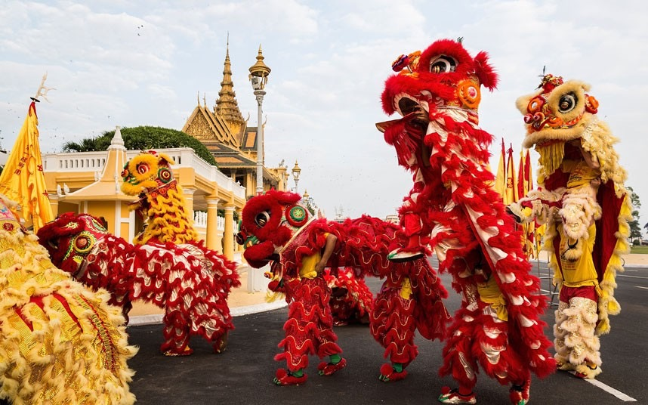
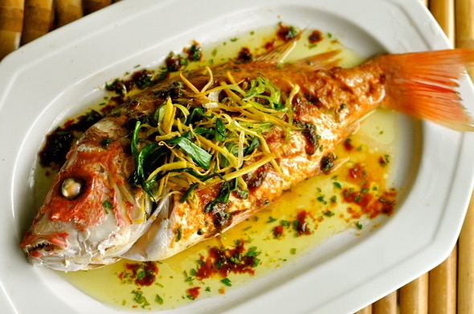
Chinese New Year
Products
女+子=好
Notes:
I generally start with a product…something concrete students can touch or see..
For example – red envelopes…touch, make…hold…see..
Practices

Slide 18
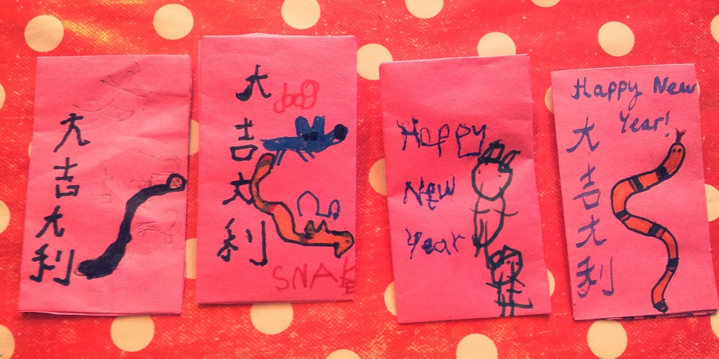
Questions I have about 红吧
Why the color red?
What is inside?
What do I say?
What words are written?
Why do people give 红包？

Slide 19
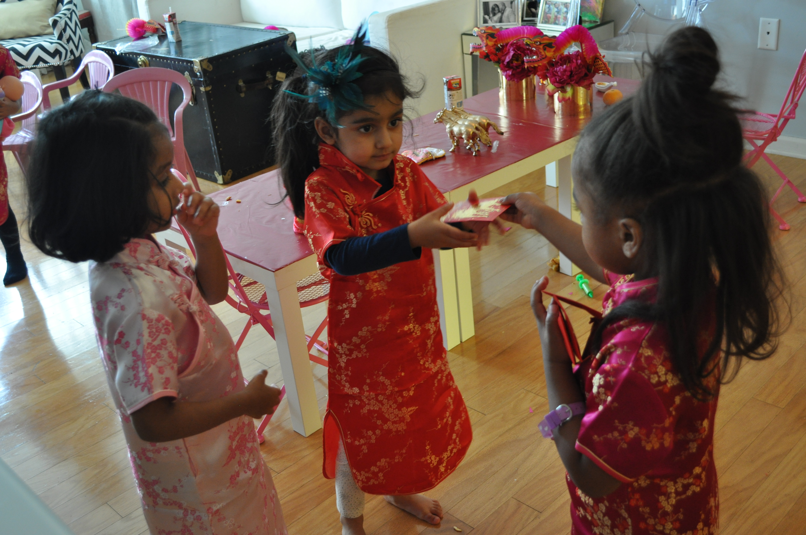
Role-play Etiquette giving and receiving 红包
你好
恭喜恭喜
谢谢
新年快乐！

Slide 20
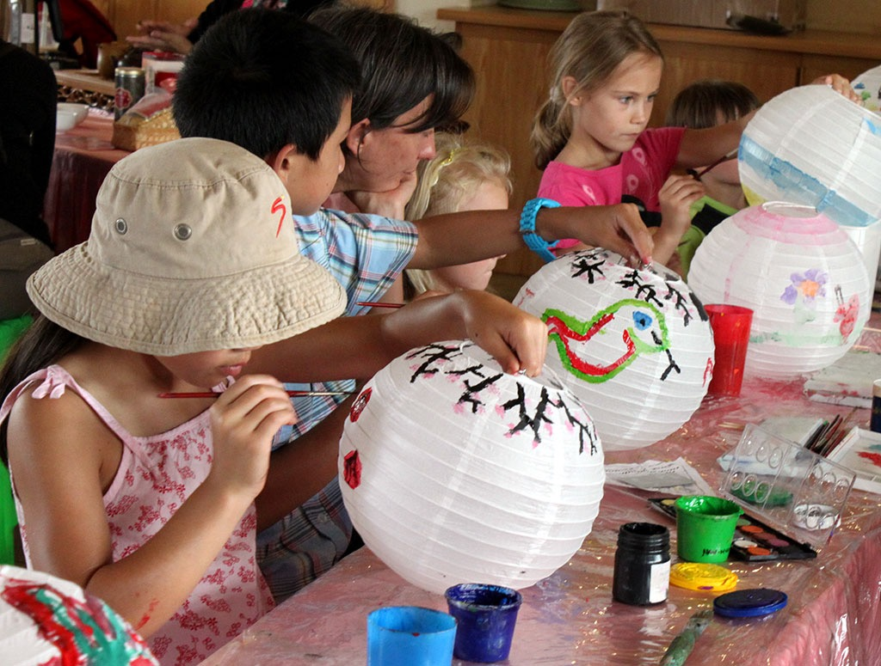
Why do you think lanterns are used during Chinese New Year?

Slide 21
Compare And Contrast

Slide 22
Compare And Contrast Celebrations
Chinese New Year
Christmas
Red envelopes
Christmas Tree
Fireworks
Gifts
Christmas Tree
Special food
Lion dance
Family time
Fixed date
No school/work
Lunar calendar
Decorations
Santa
Lanterns

Slide 23
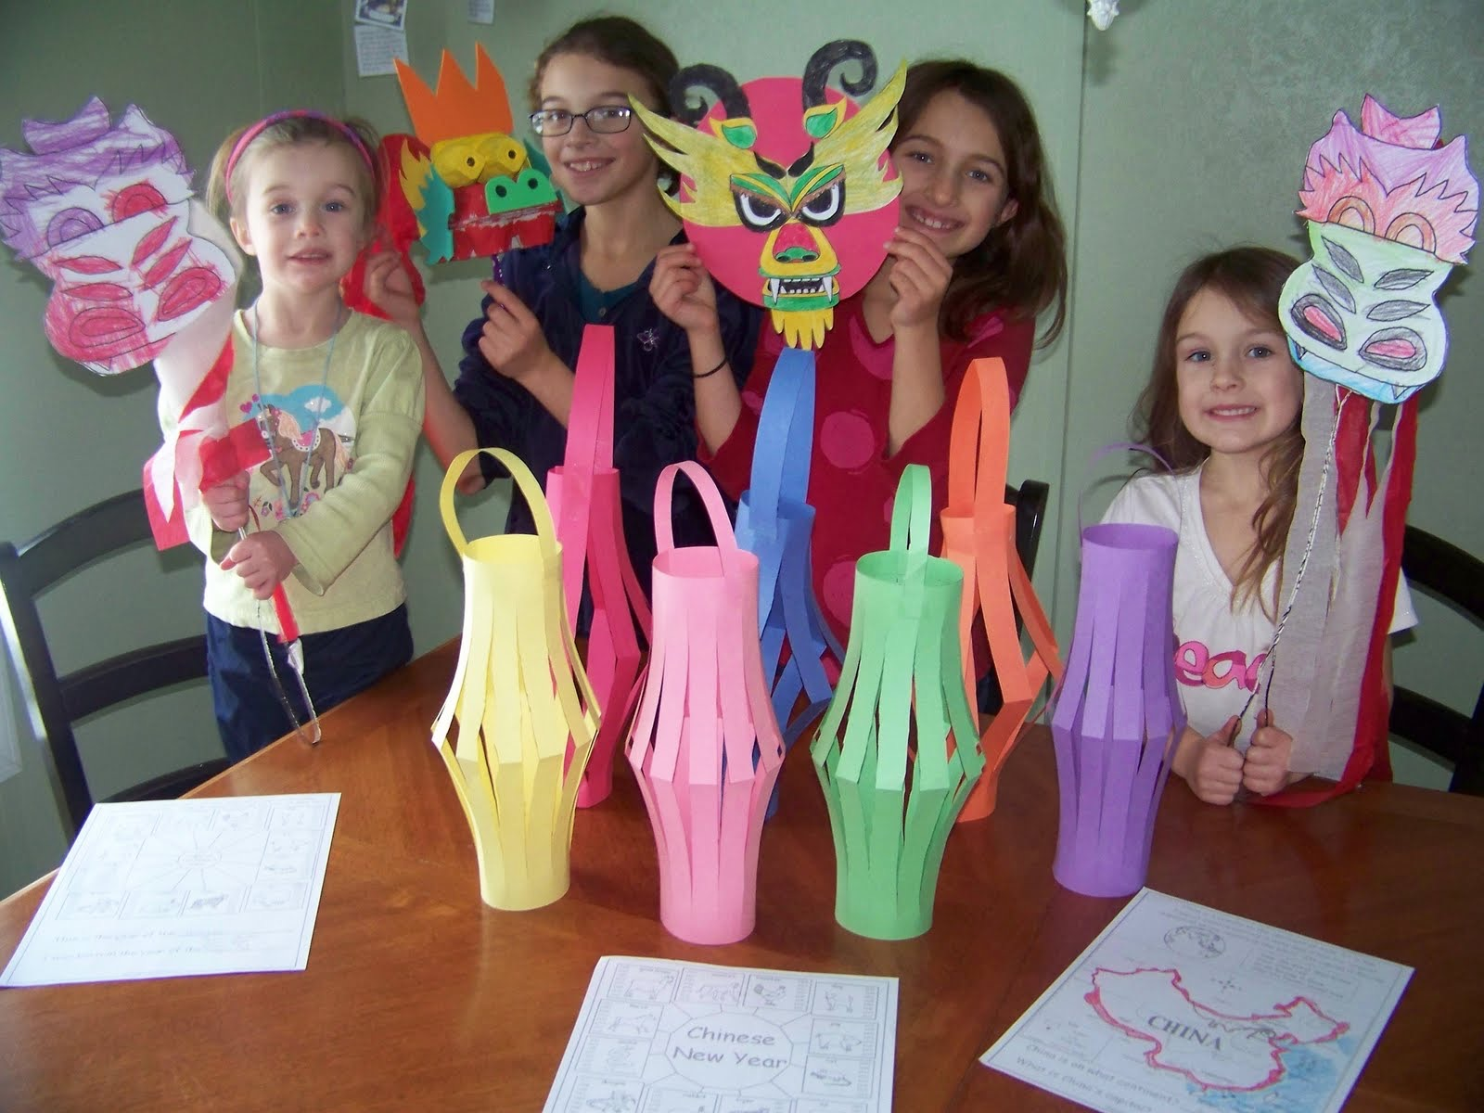

Slide 24
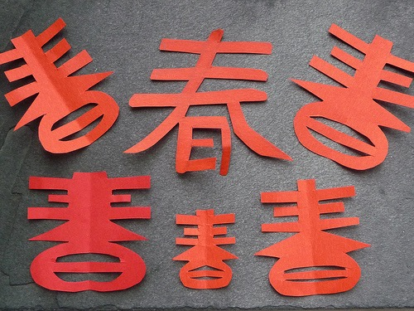
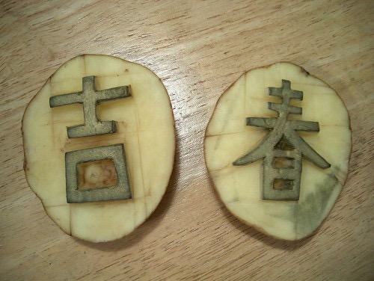

Slide 25
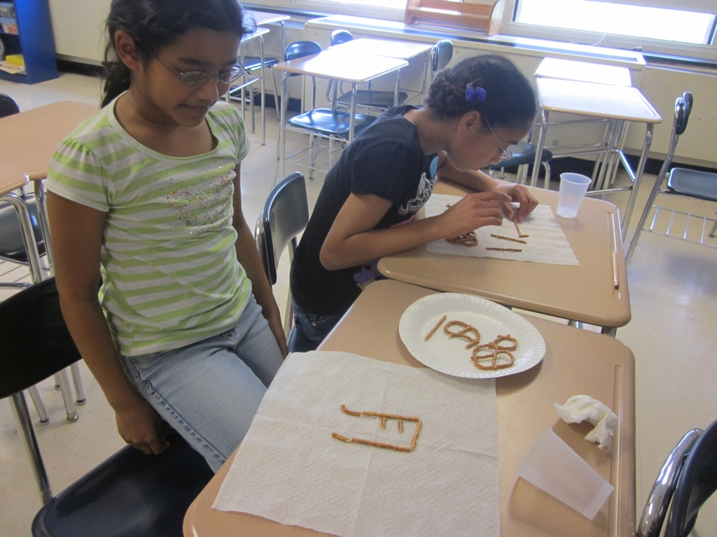
Pretzel characters
饼干字

Slide 26
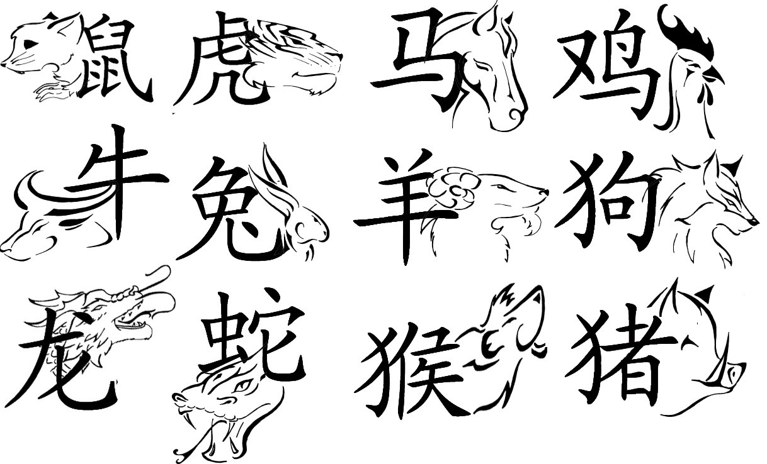

Slide 27
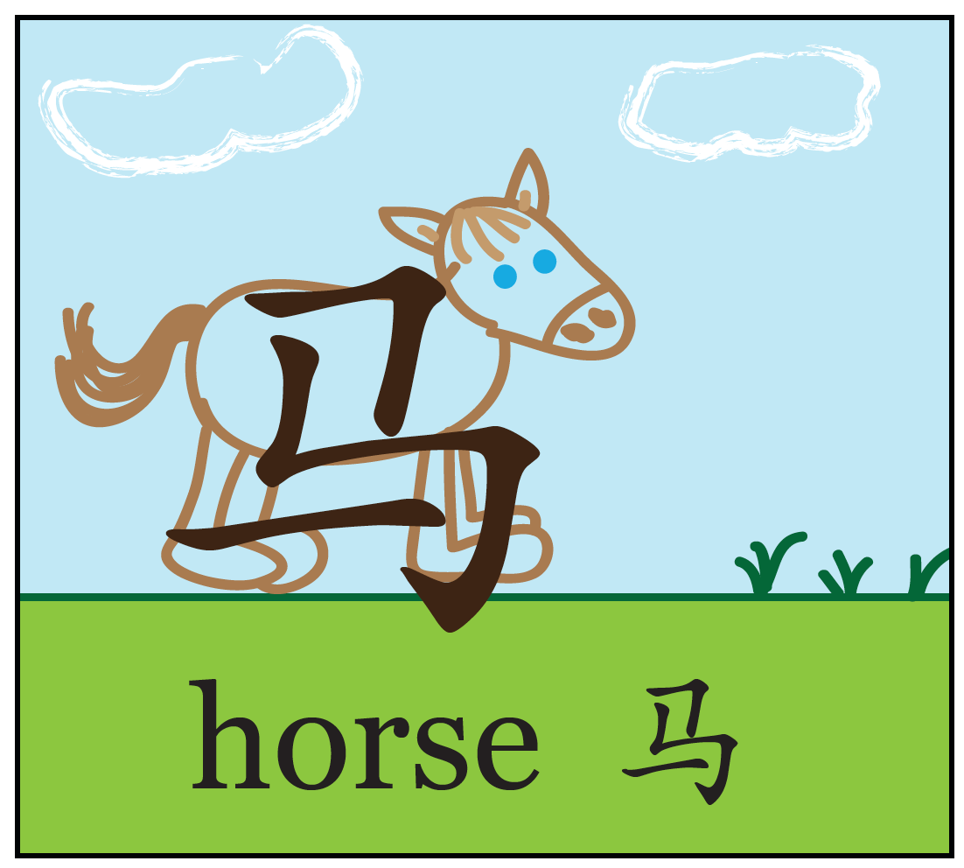
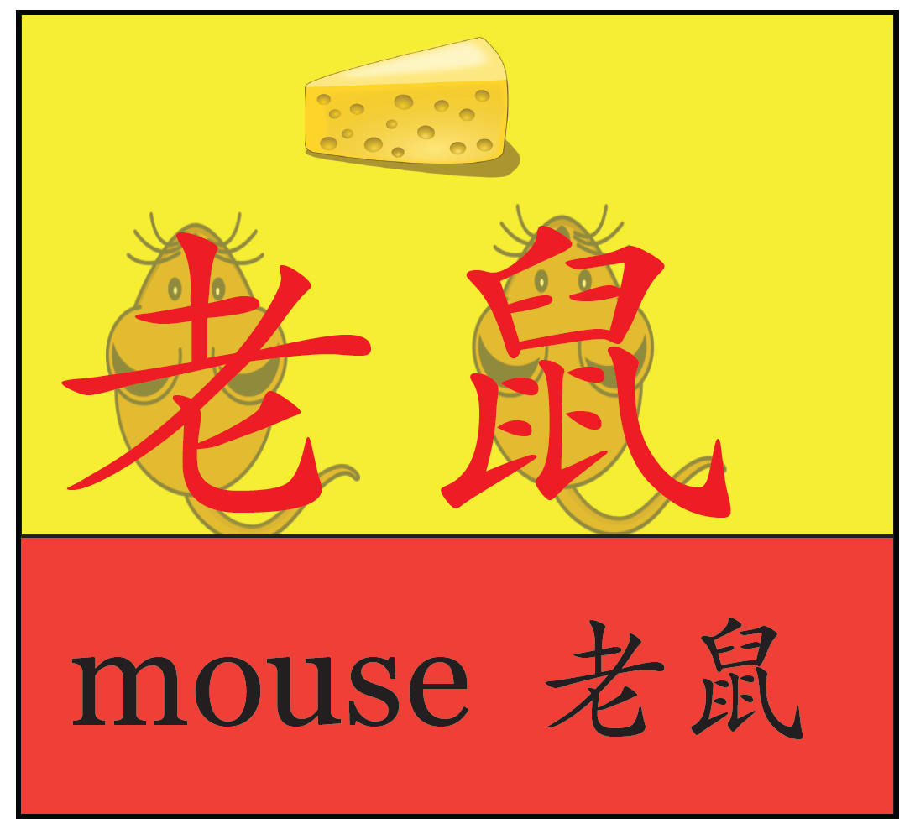
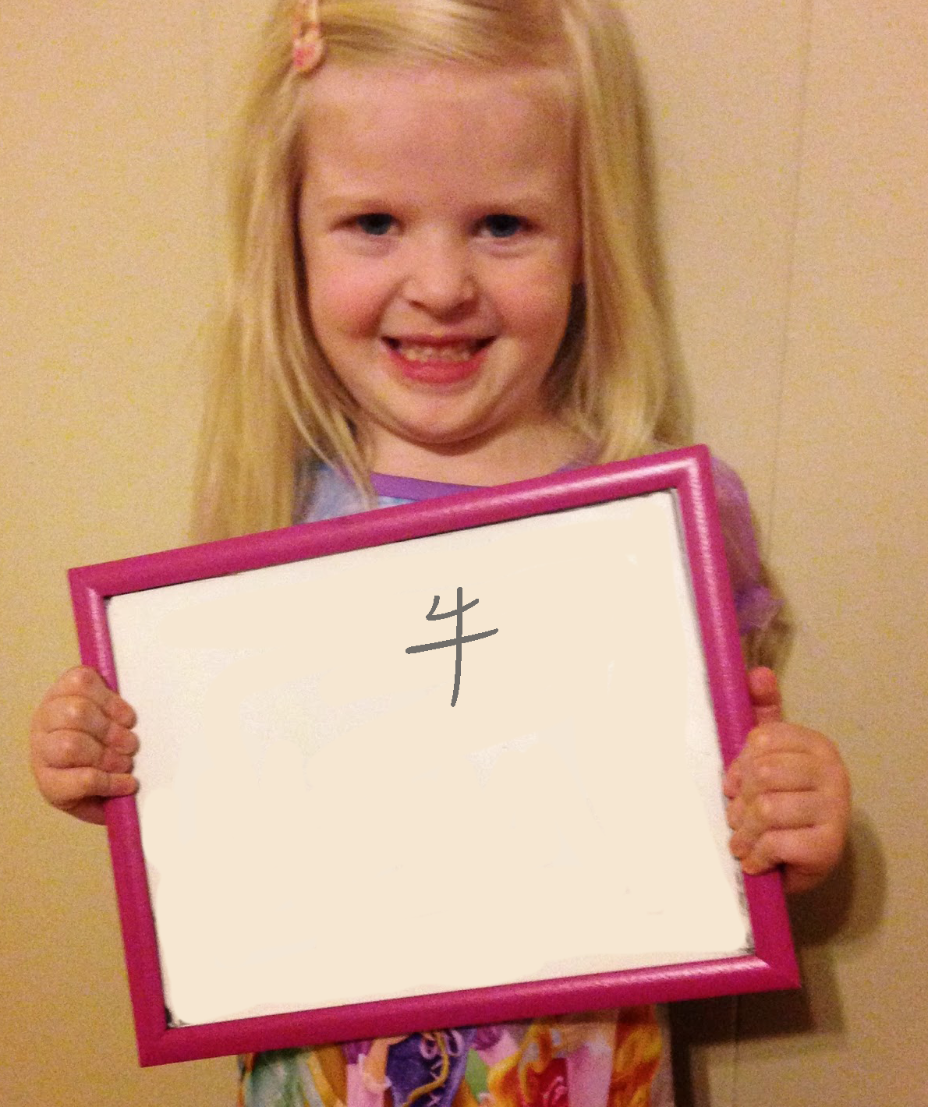

Slide 28
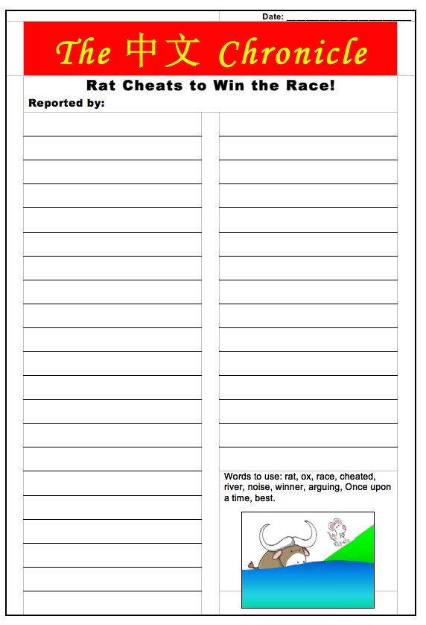
Integrate
Chinese New Year
into all
Subject Areas.

Slide 29
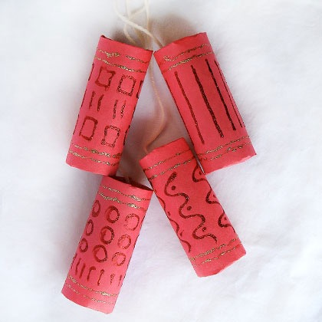
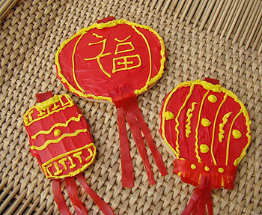
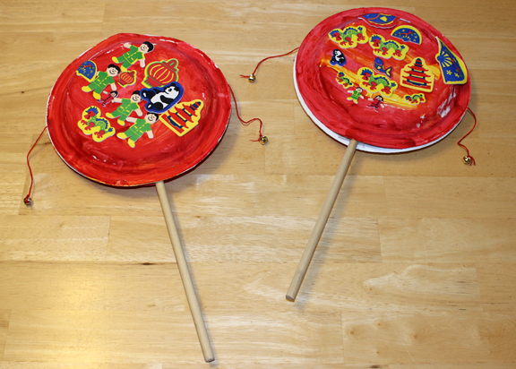
Noise!

Slide 30
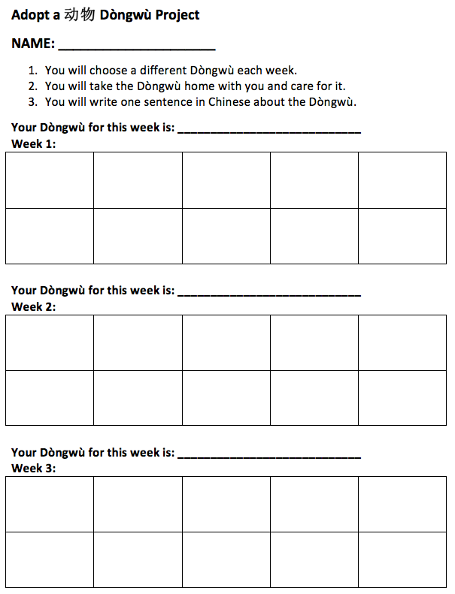
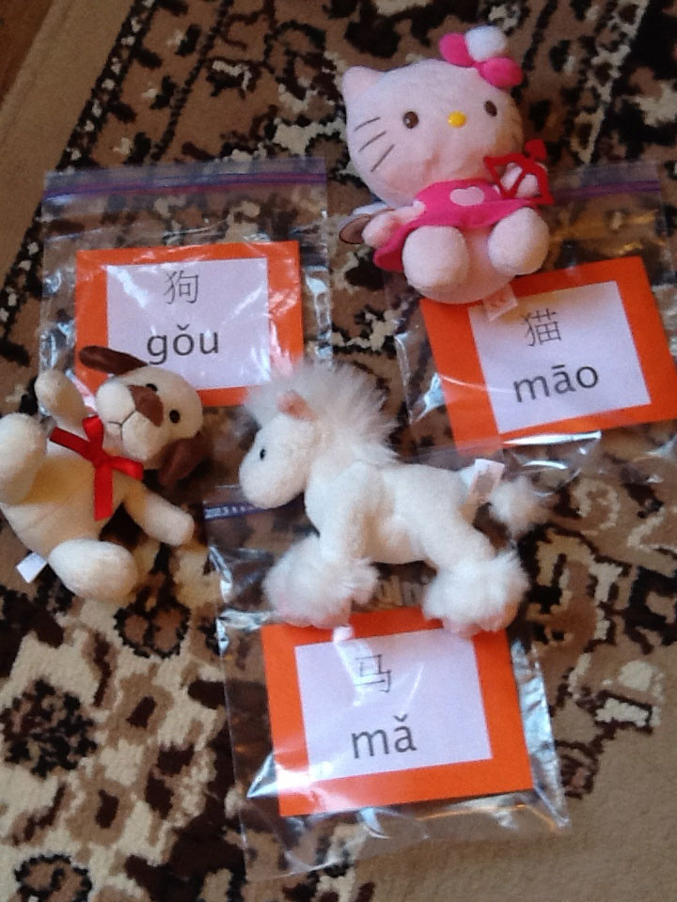
Adopt an Animal Project for 5 year olds
动物领养计划 - 五岁儿童
Notes:
During Chinese New Year I usually introduce the animals of the Chinese zodiac, and we have a project called ‘Adopt an Animal’.
Students adopt an animal each week and write a diary using Chinese characters.

Slide 31
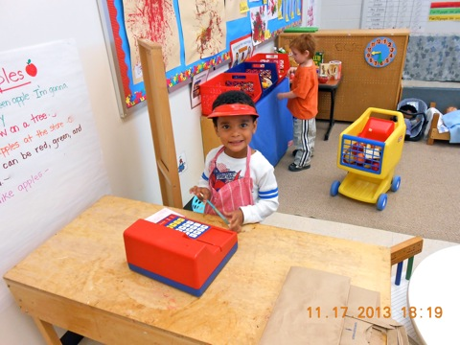
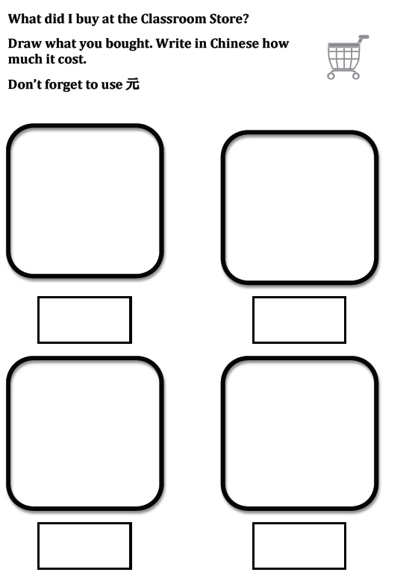
Class Pet Store
Students go to Pet Store to rehearse language: pets, shopping, numbers, money, descriptions etc.,

Slide 32
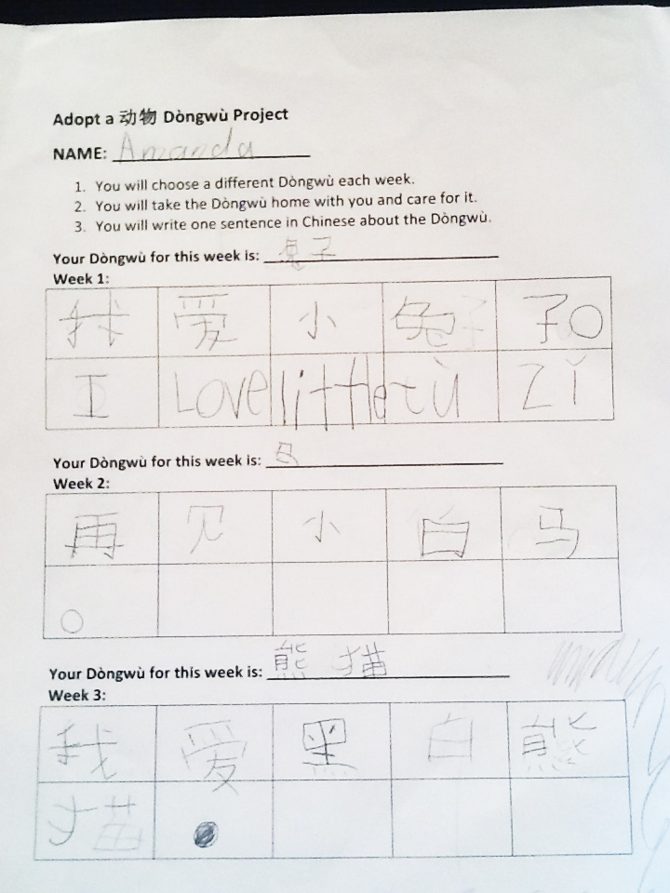

Slide 33
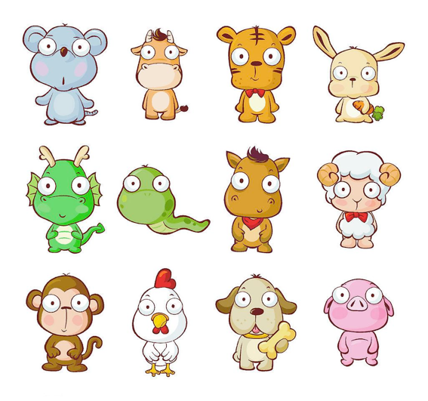
Puppets

Slide 34
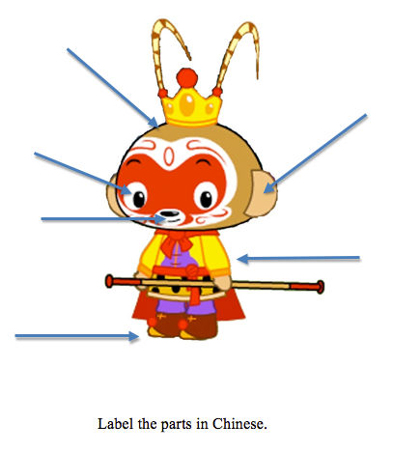
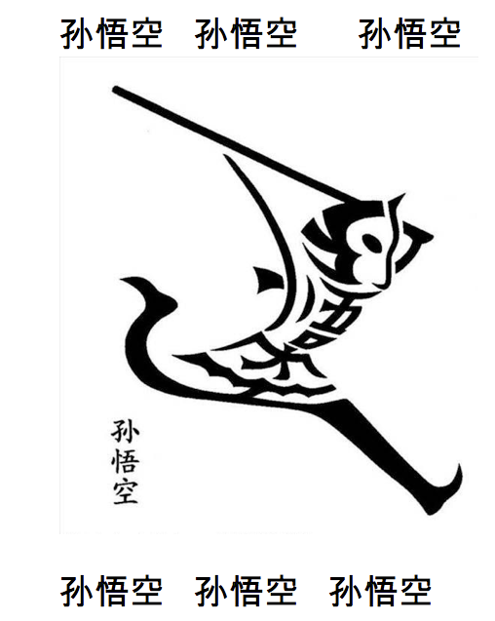

Slide 35
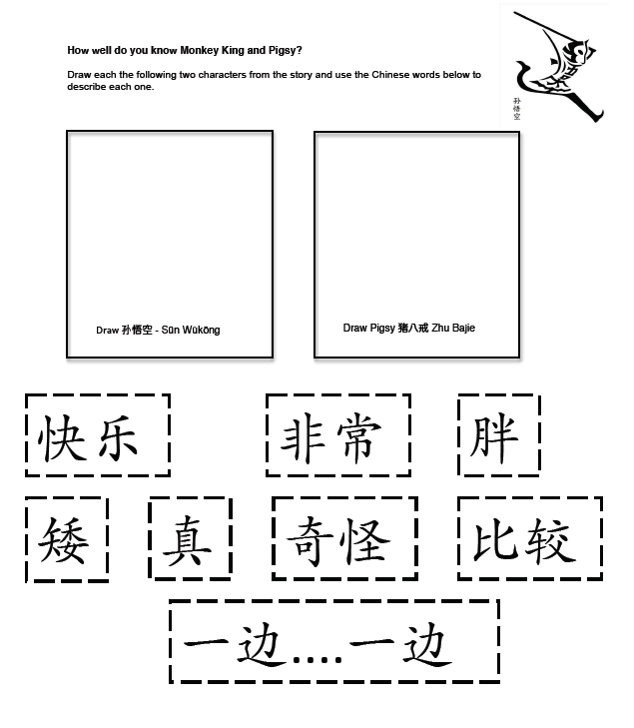
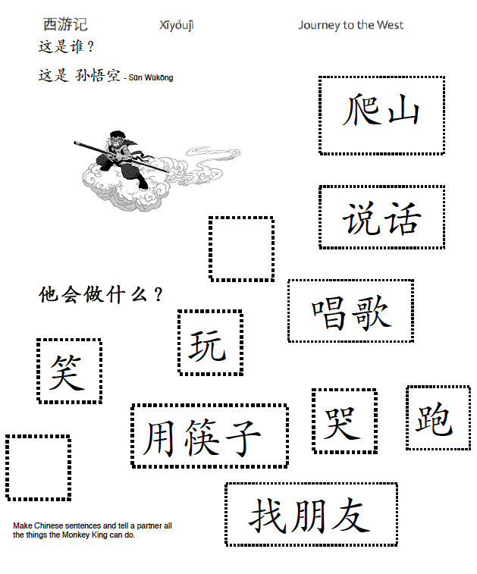

Slide 37
观点
Perspectives
culture
产品
做法
Products
Practices
Notes:
Important to remember these aspects of culture…
Sometimes we can focus on the products…paper cutting…making a lantern…and miss the opportunity to explore…perspectives and practices.
They are all interconnected.

Slide 38
shaz@creativechinese.com

