Slide 1
Strategies For Teaching Culture Through Language
Notes:
Let’s move onto how we infuse culture into our Chinese programs.
You probably already know that culture is a great way to deliver language as well.
But we want to infuse culture, not just have it as an add on.

Slide 2
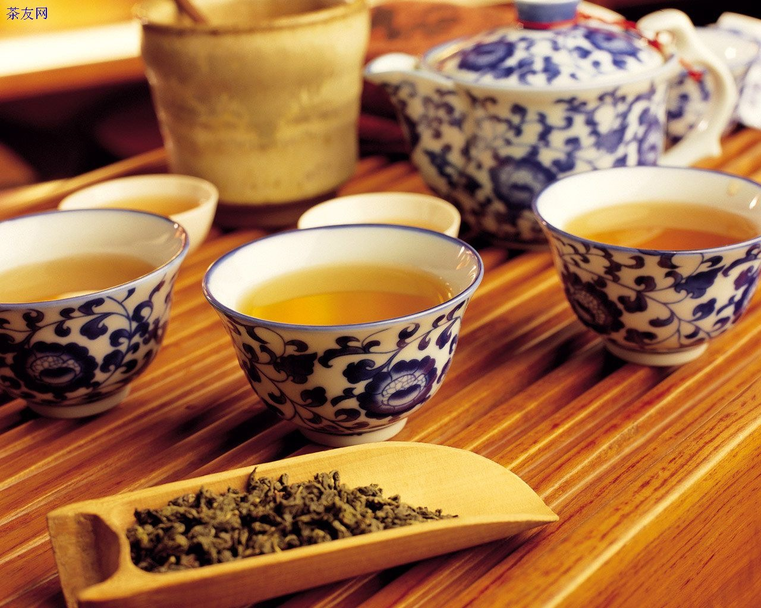
Infused Tea
Notes:
So, just as we make tea and infuse tea in the water...so must our teaching of culture.
It is not good enough to do paper cutting in isolation, the meaning, the purpose of it must be clear to students.

Slide 3
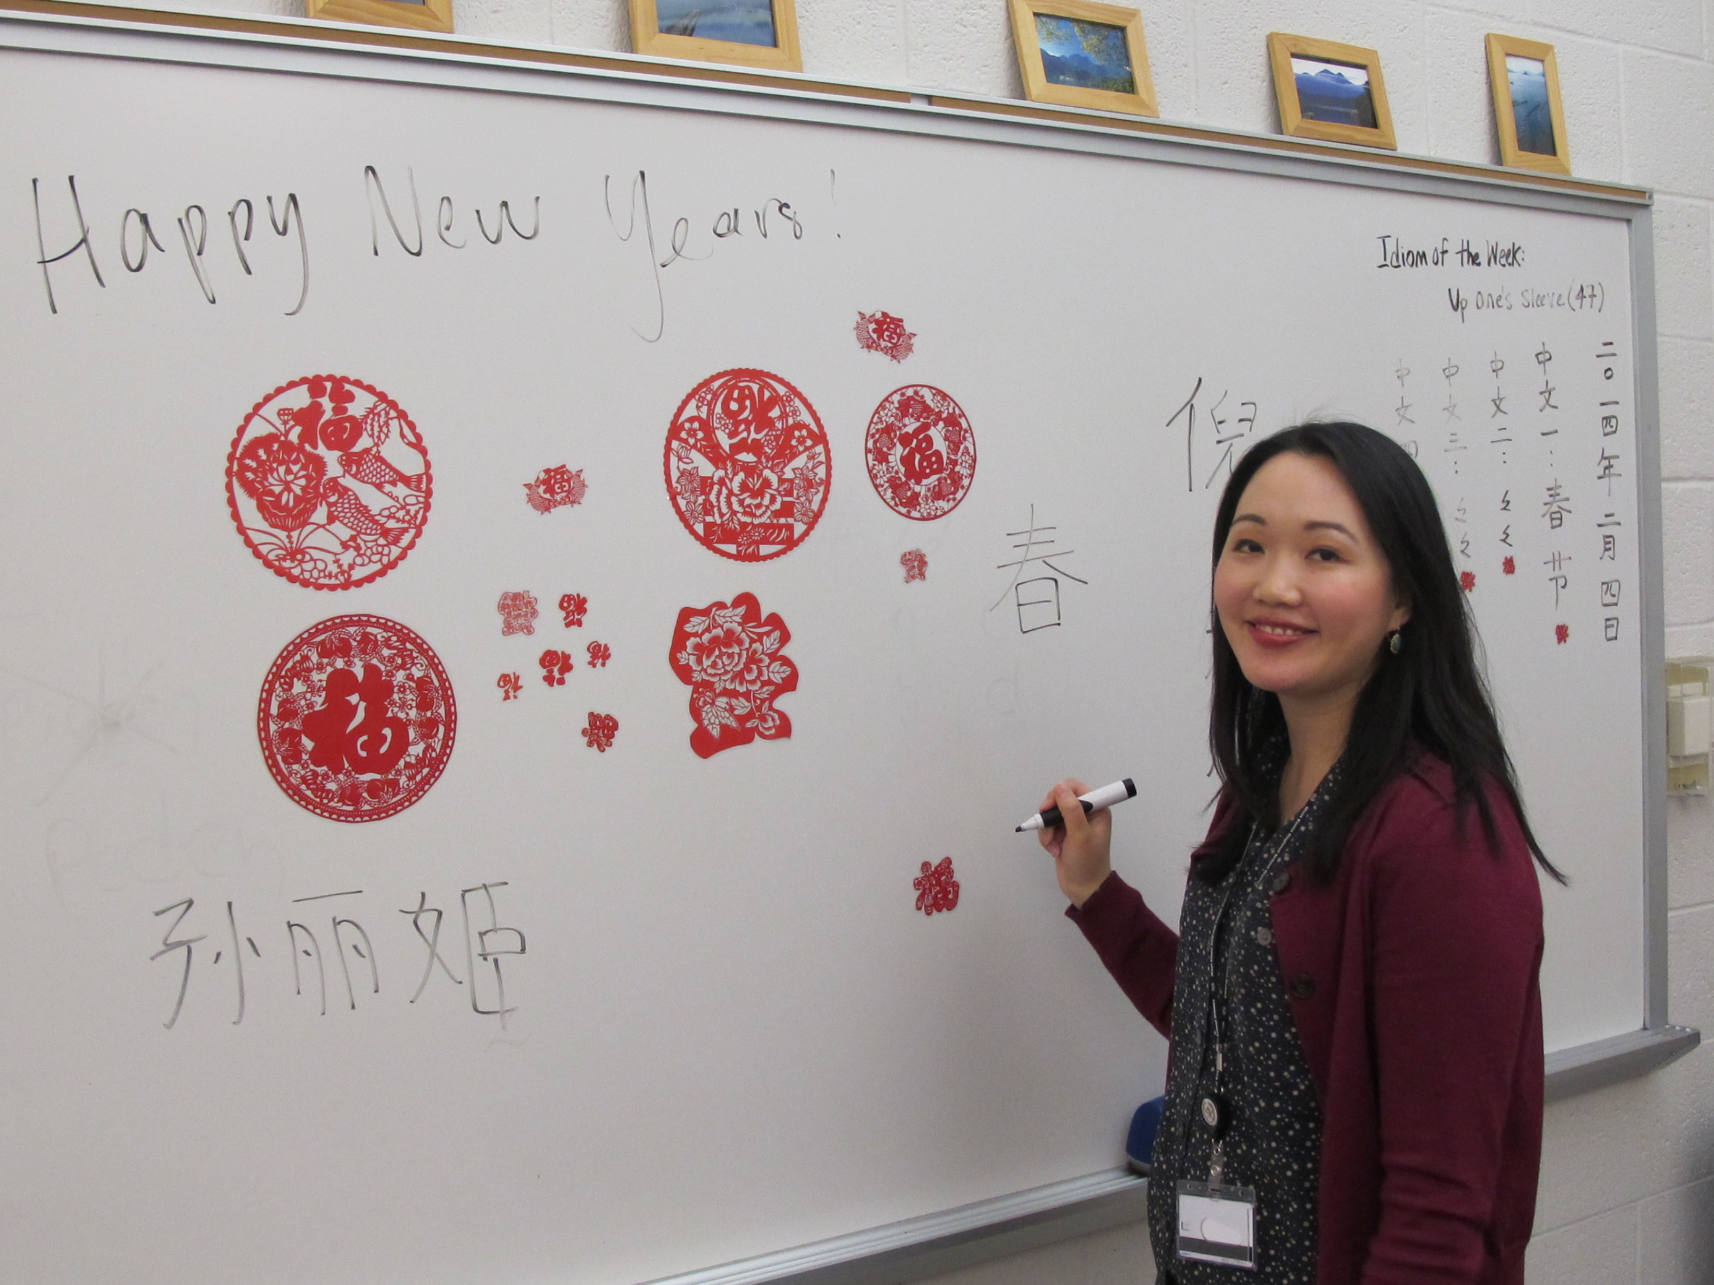
Many times, culture in the language classroom is…
Unrelated to previous knowledge
Added as an extra to language
Teacher-centered
Token culture
Facts about….

Slide 4
Cultural Infusion
Added as an extra to language
Complements and enriches the language
Notes:
Let’s look at what the infusion of culture is not...
It is not added on...like an after thought.
It enriches the language.

Slide 5
Token culture does not enrich learning.

Slide 6
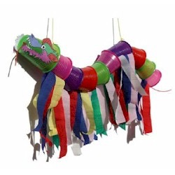
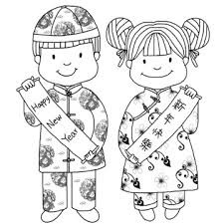
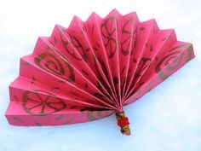
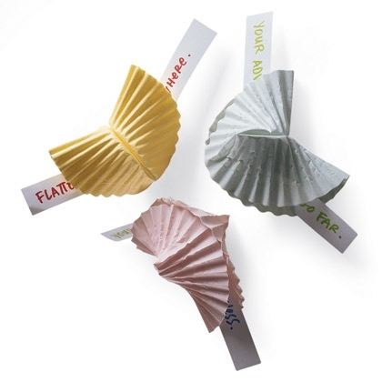
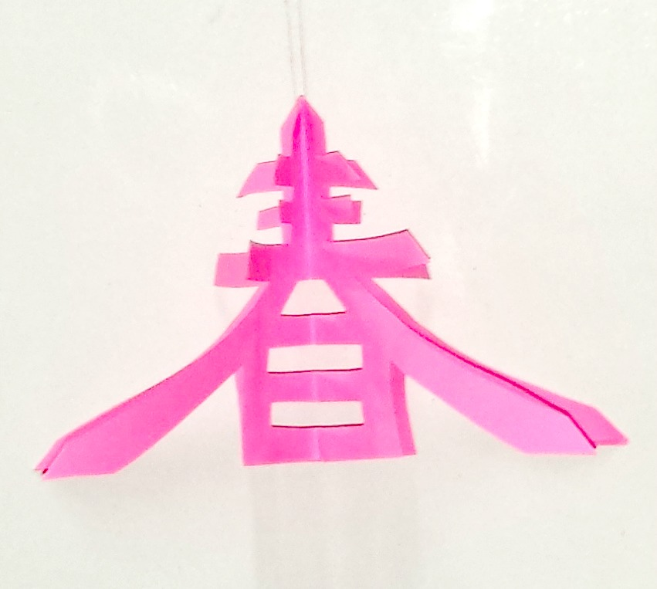
How is culture contributing to language acquisition?

Slide 8
Embed Culture in the Language
Integrated
Isolated topics
Notes:
Isolated topics have some merit…but the best combination is language+ culture
Culture and language are integrated.
That’s how the brain works...it seeks meaning...and if we can connect language and culture we will have more effective learning.

Slide 9
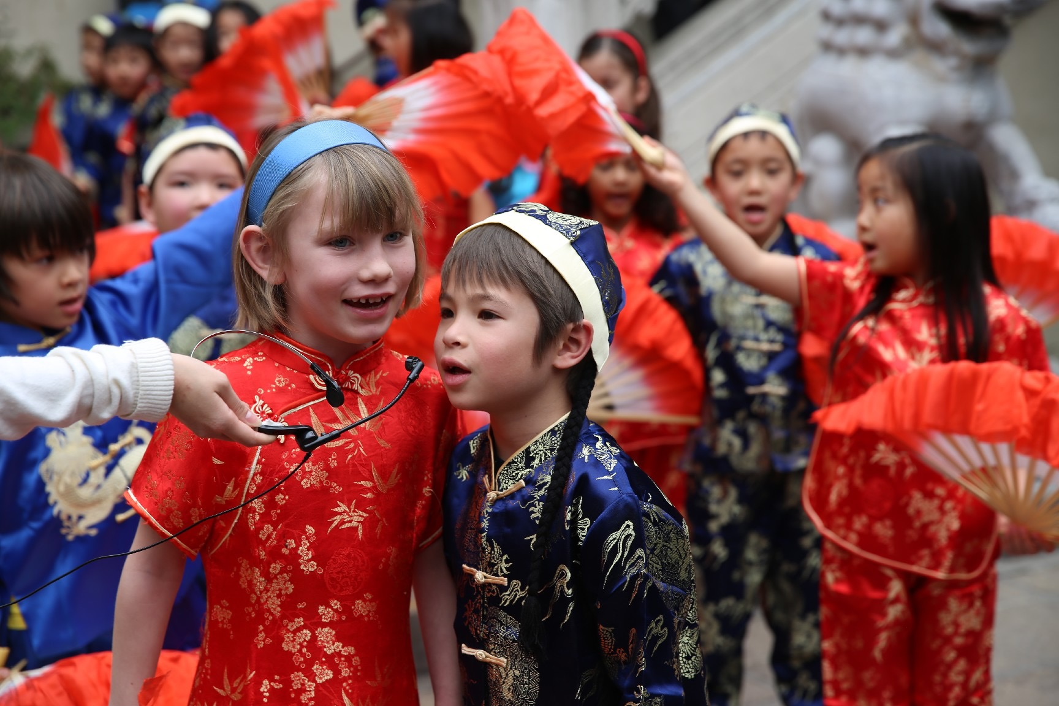
Culture needs to enrich the language.

Slide 10
Cultural Infusion
Limited relevance
Meaningful and Appropriate
Notes:
Some cultural activities have limited relevance to students.
So when choosing cultural activities choose ones that:
1. Are meaningful to students: teenagers - school, clothes, shopping, music, and extend their interests...calligraphy, geography..
2. Appropriate to grade level: Must be challenging to the age of the students.

Slide 11
Culture needs to be meaningful
Me
My Family
Friends
City
World

Slide 12
Cultural Infusion
Inquiry-based and active
Facts about….
Notes:
The day of teachers standing in front of the class…who is all knowing..is gone.
I strongly believe in the 80-20 principle….get the students working….let them research…don’t tell them…make them work for it.
Students using Inquiry-based research has been shown to retain information in the long-term.

Slide 13
How?
Why?
Where?
When?

Slide 14
Cultural Infusion
Unrelated to previous knowledge
Connects to previous knowledge
Notes:
We know that the brain seeks out connections…to strengthen pathways…to retain information…Memory is related to how strong the connections are.
So if we can connect language, culture and student’s previous knowledge….much more effective learning
Start off a cultural project with...What do you know about....? KWL worksheet

Slide 15
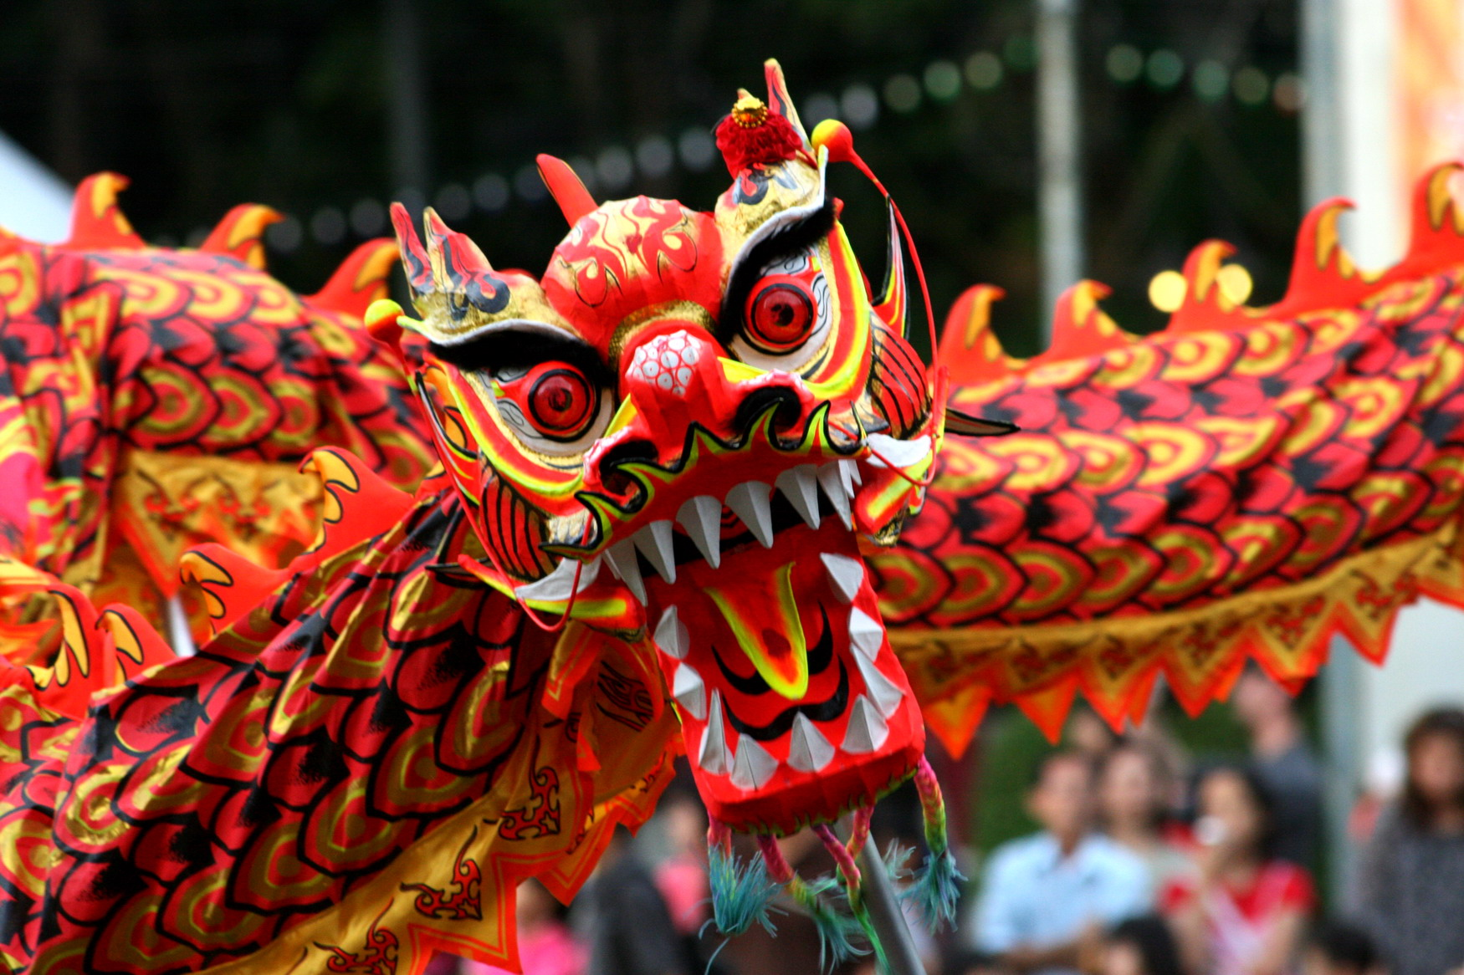
What is Culture?

Slide 16
What is Culture?
Think, Pair, Share
思考 , 互相交流, 分享
Sīkǎo, hù xiàng jiāoliú, fēnxiǎng

Slide 17
观点
Perspectives
culture
产品
做法
Products
Practices
Notes:
Important to remember these aspects of culture…
Sometimes we can focus on the products…paper cutting…making a lantern…and miss the opportunity to explore…perspectives and practices.
They are all interconnected.

Slide 18
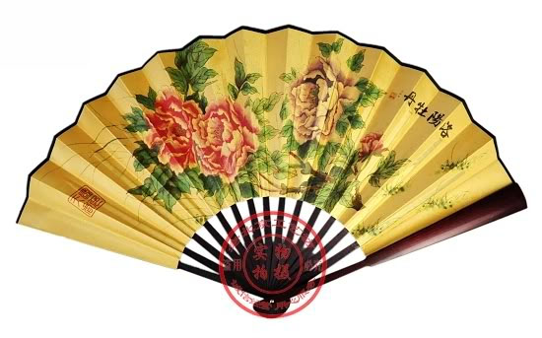
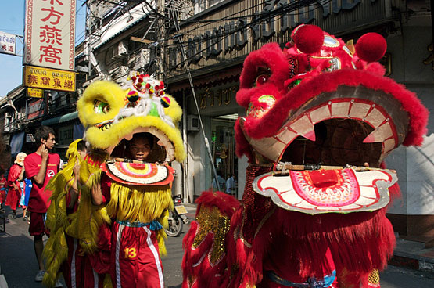
The way we see the world
Perspectives
culture
Products
Practices
Social interaction
Foods, buildings, music, tools, artwork etc.,
Notes:
Important to remember these aspects of culture…
Sometimes we can focus on the products…paper cutting…making a lantern…and miss the opportunity to explore…perspectives and practices.
They are all interconnected.

Slide 19
Why?
Culture
What?
When and How?

Slide 20
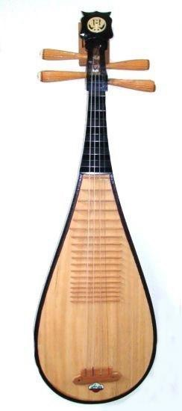
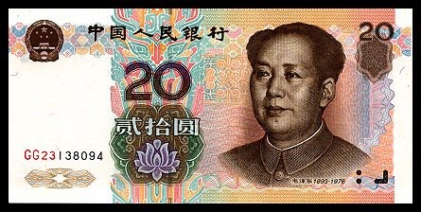
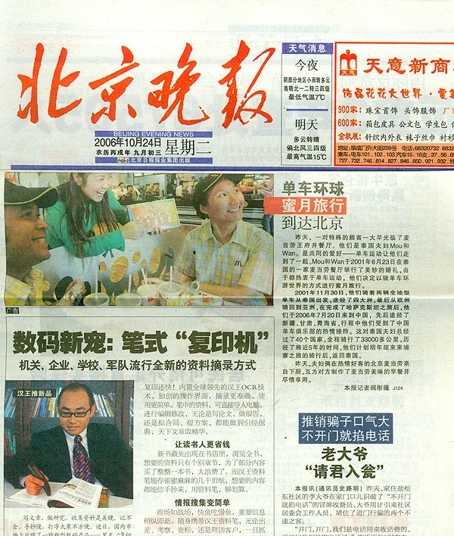
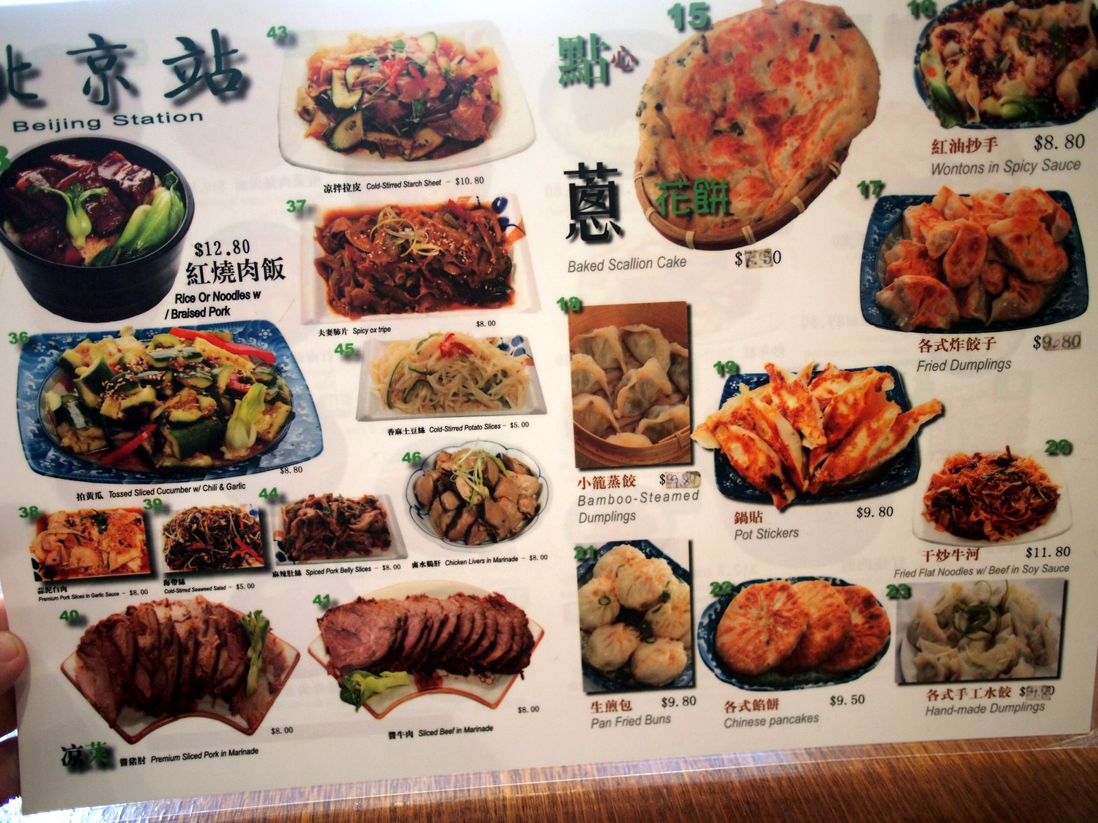
Authentic Materials
music
posters
signs
tickets
money
stamps
newspapers
menus
Notes:
3rd way of choosing which cultural experiences…
MEANINGFUL – real world contexts
Newspapers with my 1st graders

Slide 21
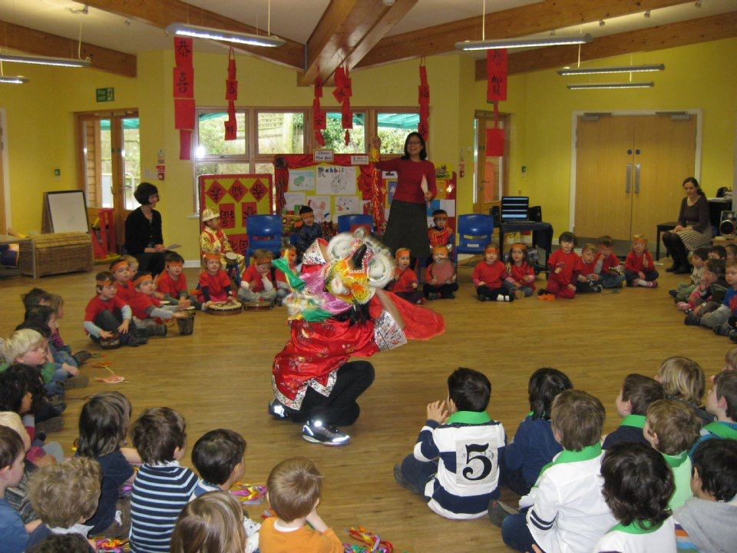
The School Community
Whole School - Chinese festival

Slide 22
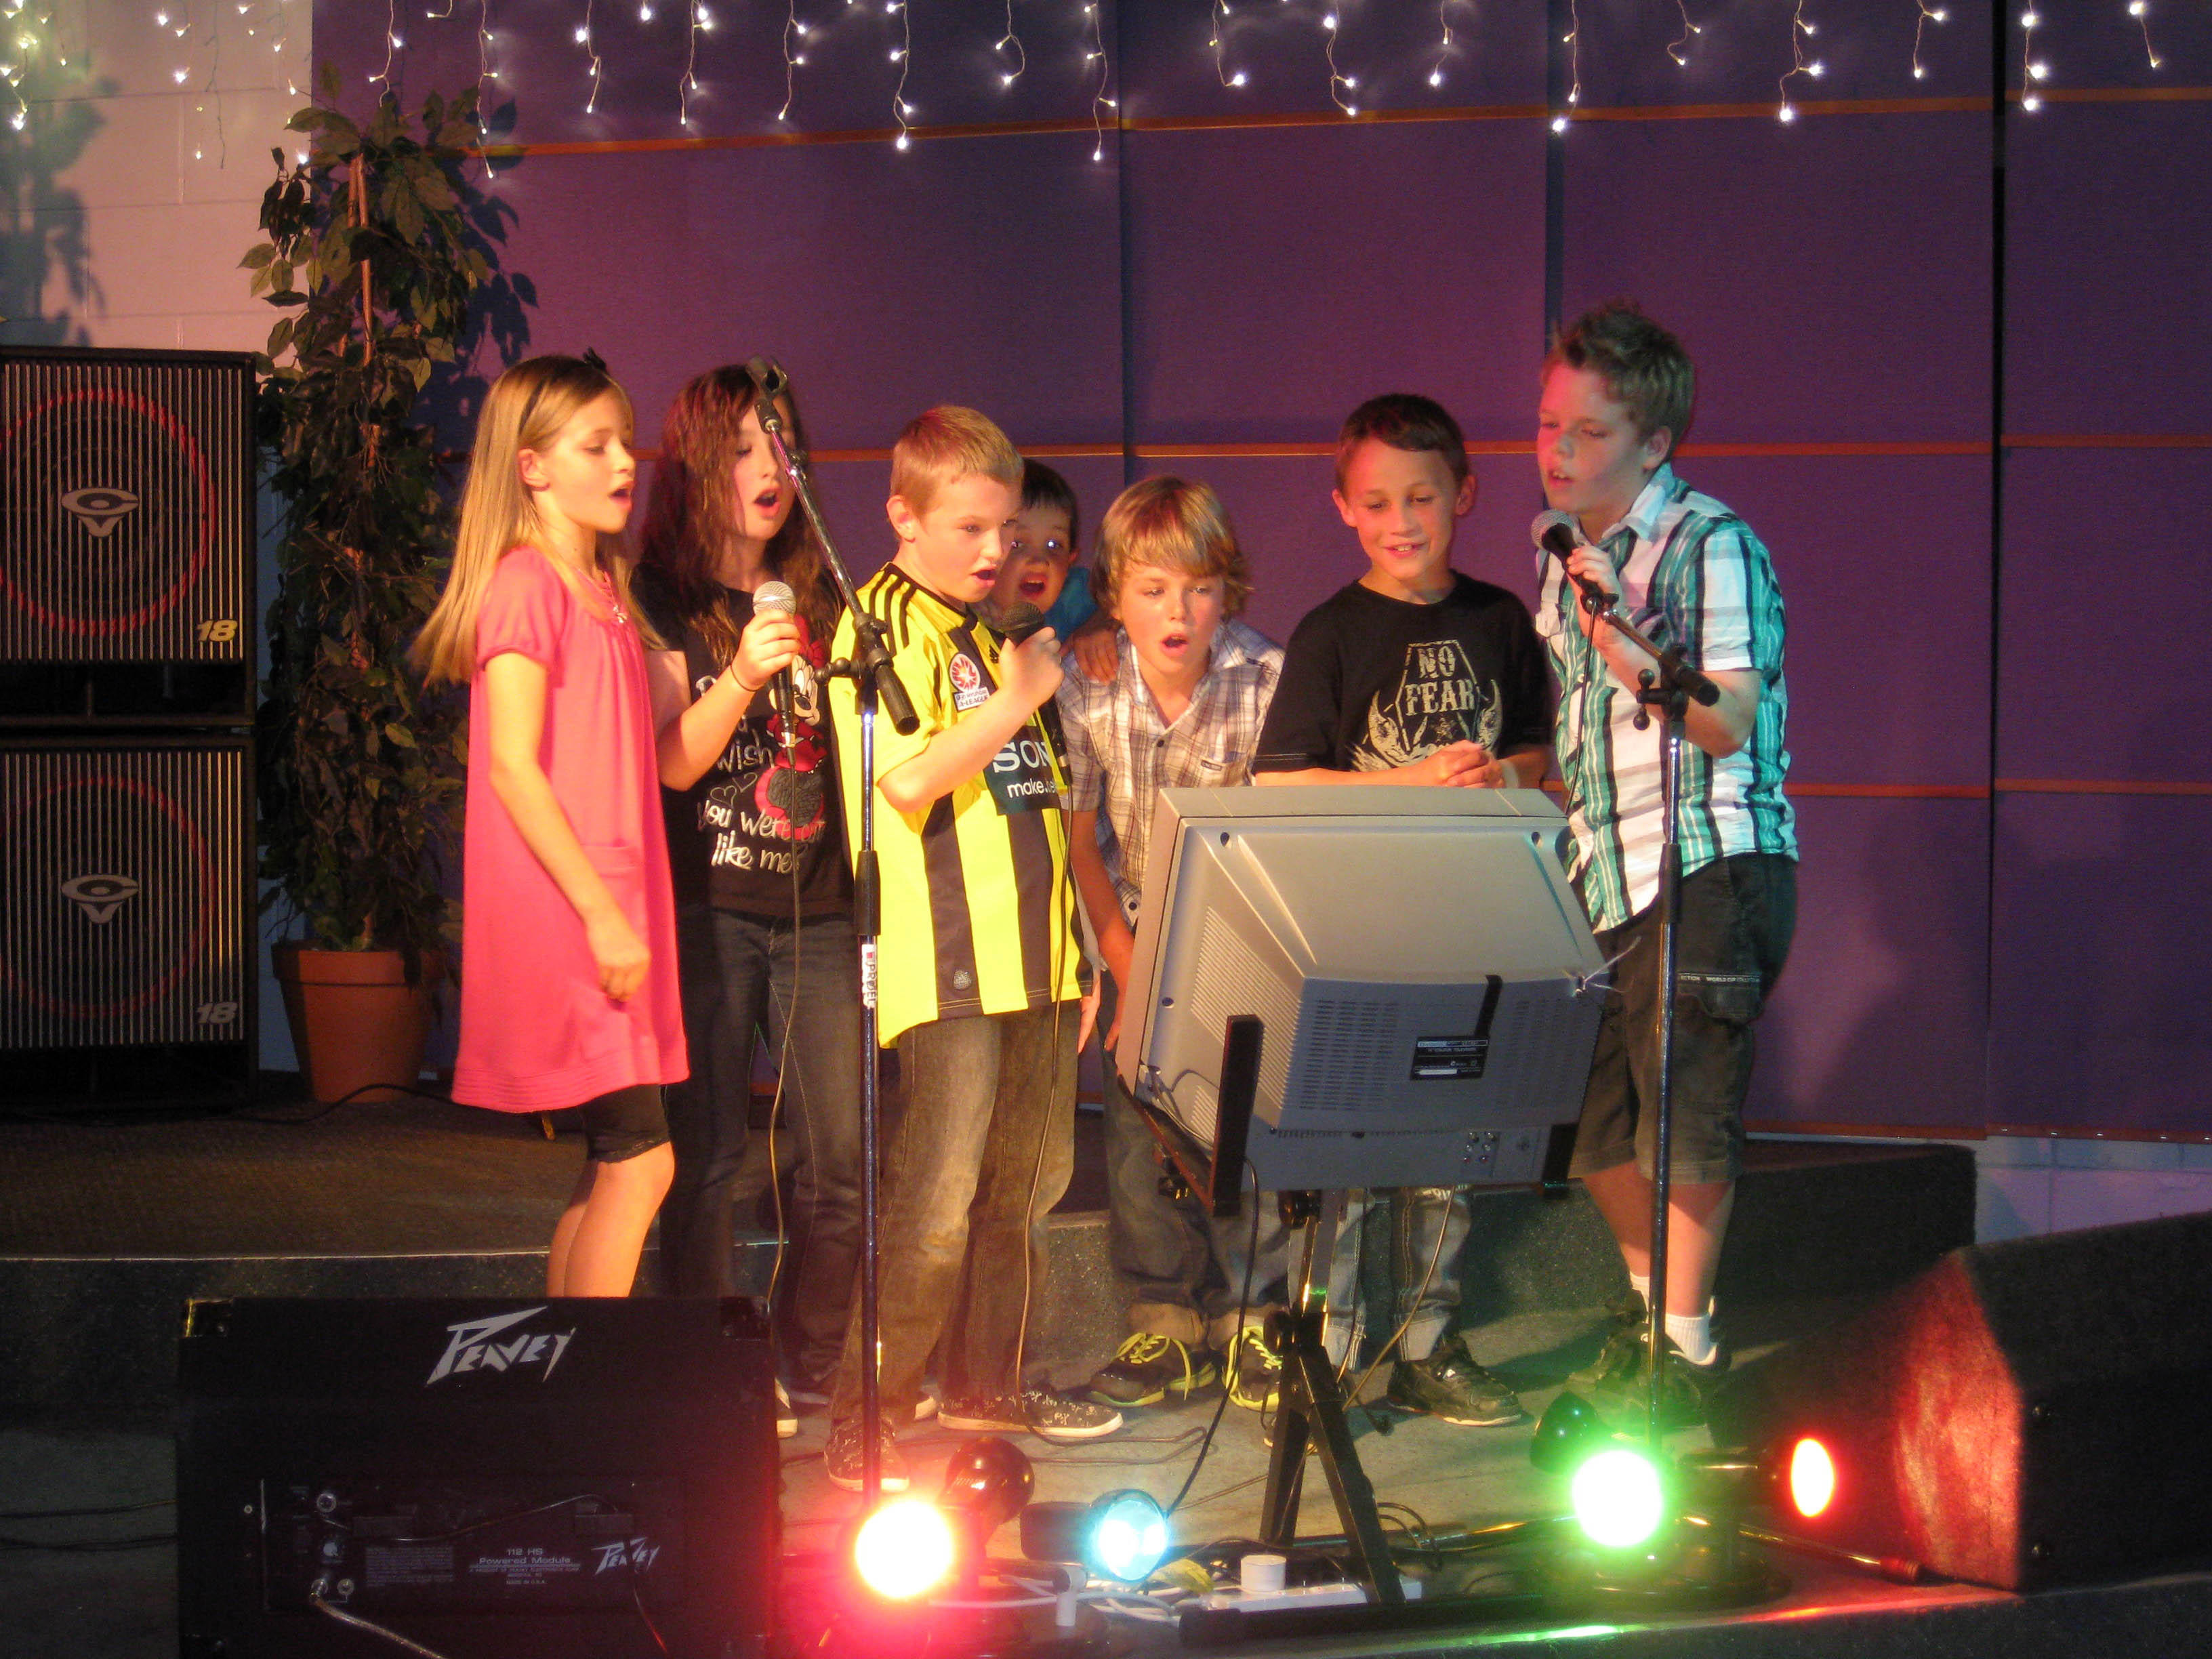
The School Community
Whole School – Karaoke Contest

Slide 23
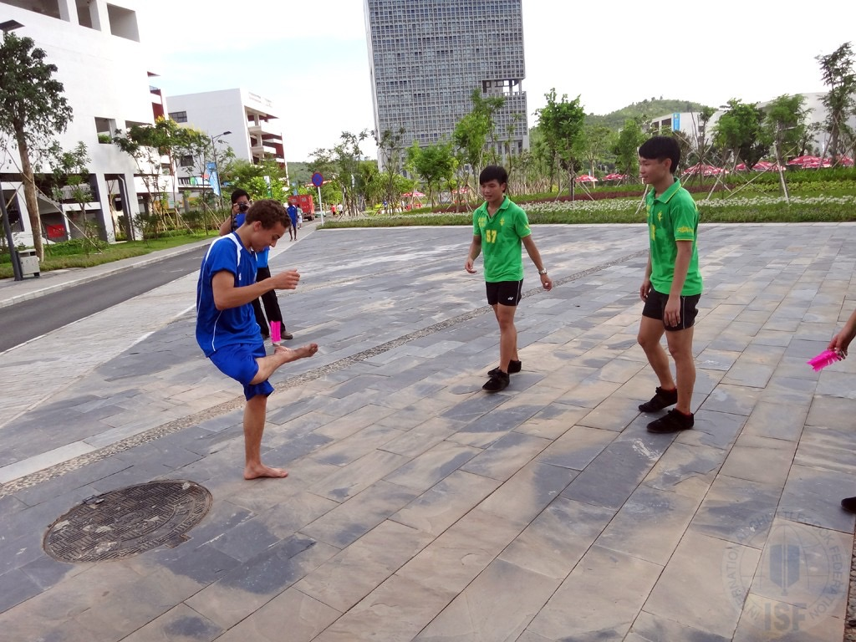
The School Community
Whole School - Challenge
踢毽子

Slide 24
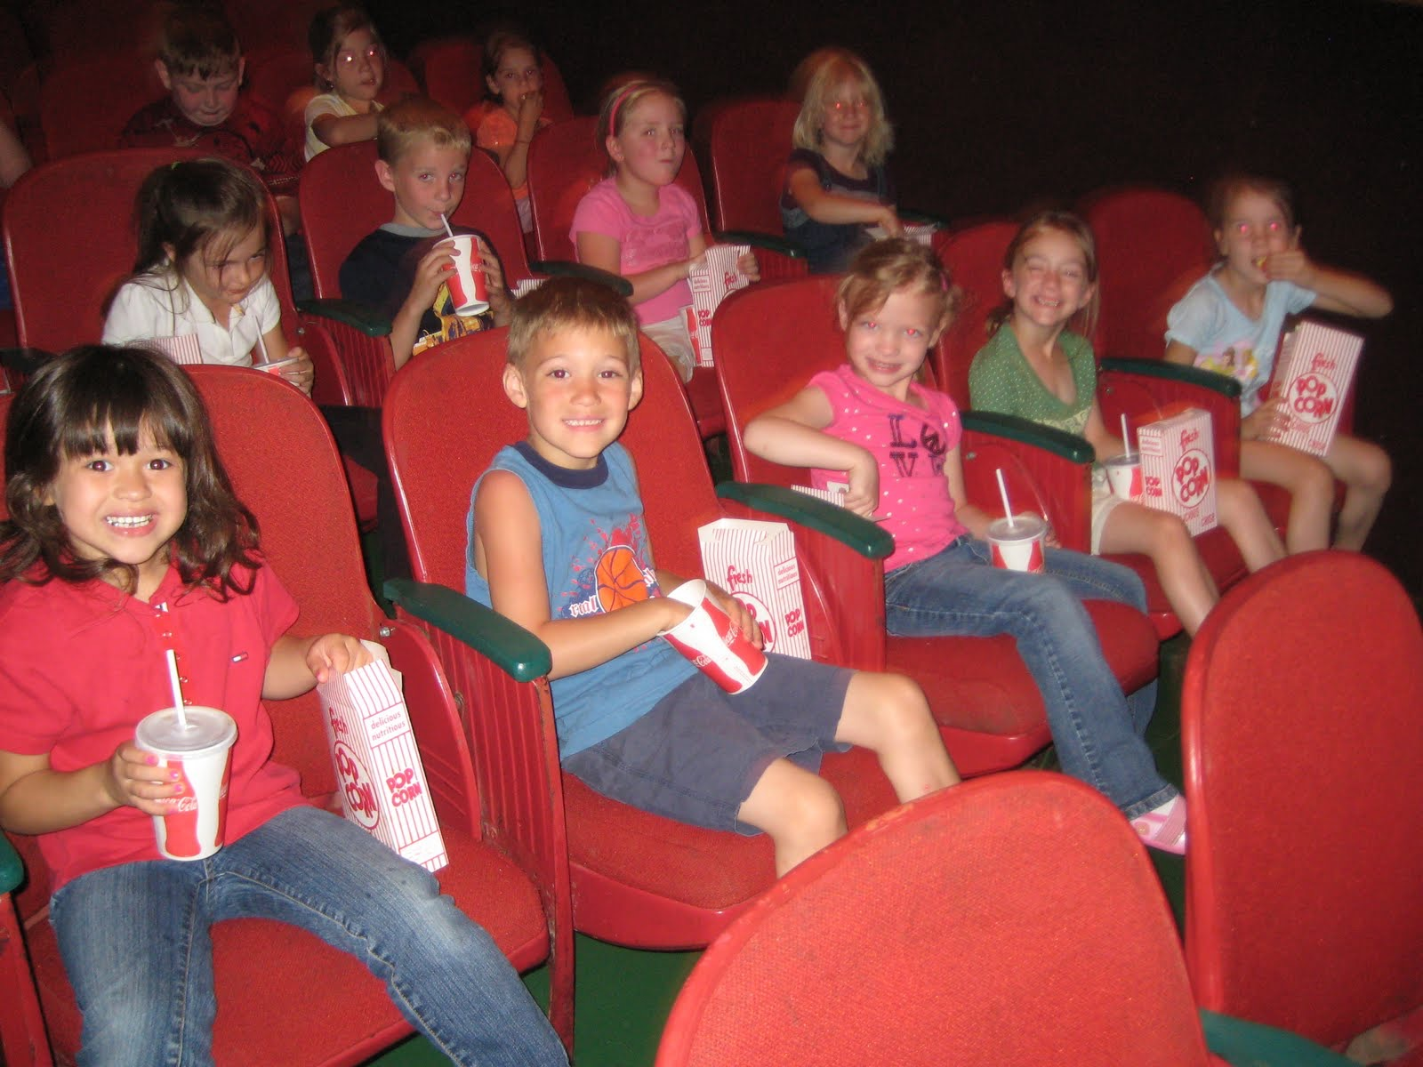
The School Community
Whole School - Monthly Chinese Film Night

Slide 25
Theme: What’s For Lunch?

Slide 26
Theme: What’s For Lunch?
LANGUAGE OUTCOMES
I can ask someone what they are eating?
I can identify popular food
I can give directions on making a sandwich.
I can express likes/dislikes

Slide 27
Theme: What’s For Lunch?
CULTURE
How to order?
How to pour tea?
How to handle chopsticks?
Don’t flip the fish?
How is food served?
How to pay the bill?
What food represents what?
How to show gratitude?
Compare
school lunches
Celebrations and
Food
History of
Eating utensils
Chinese Etiquette

Slide 28
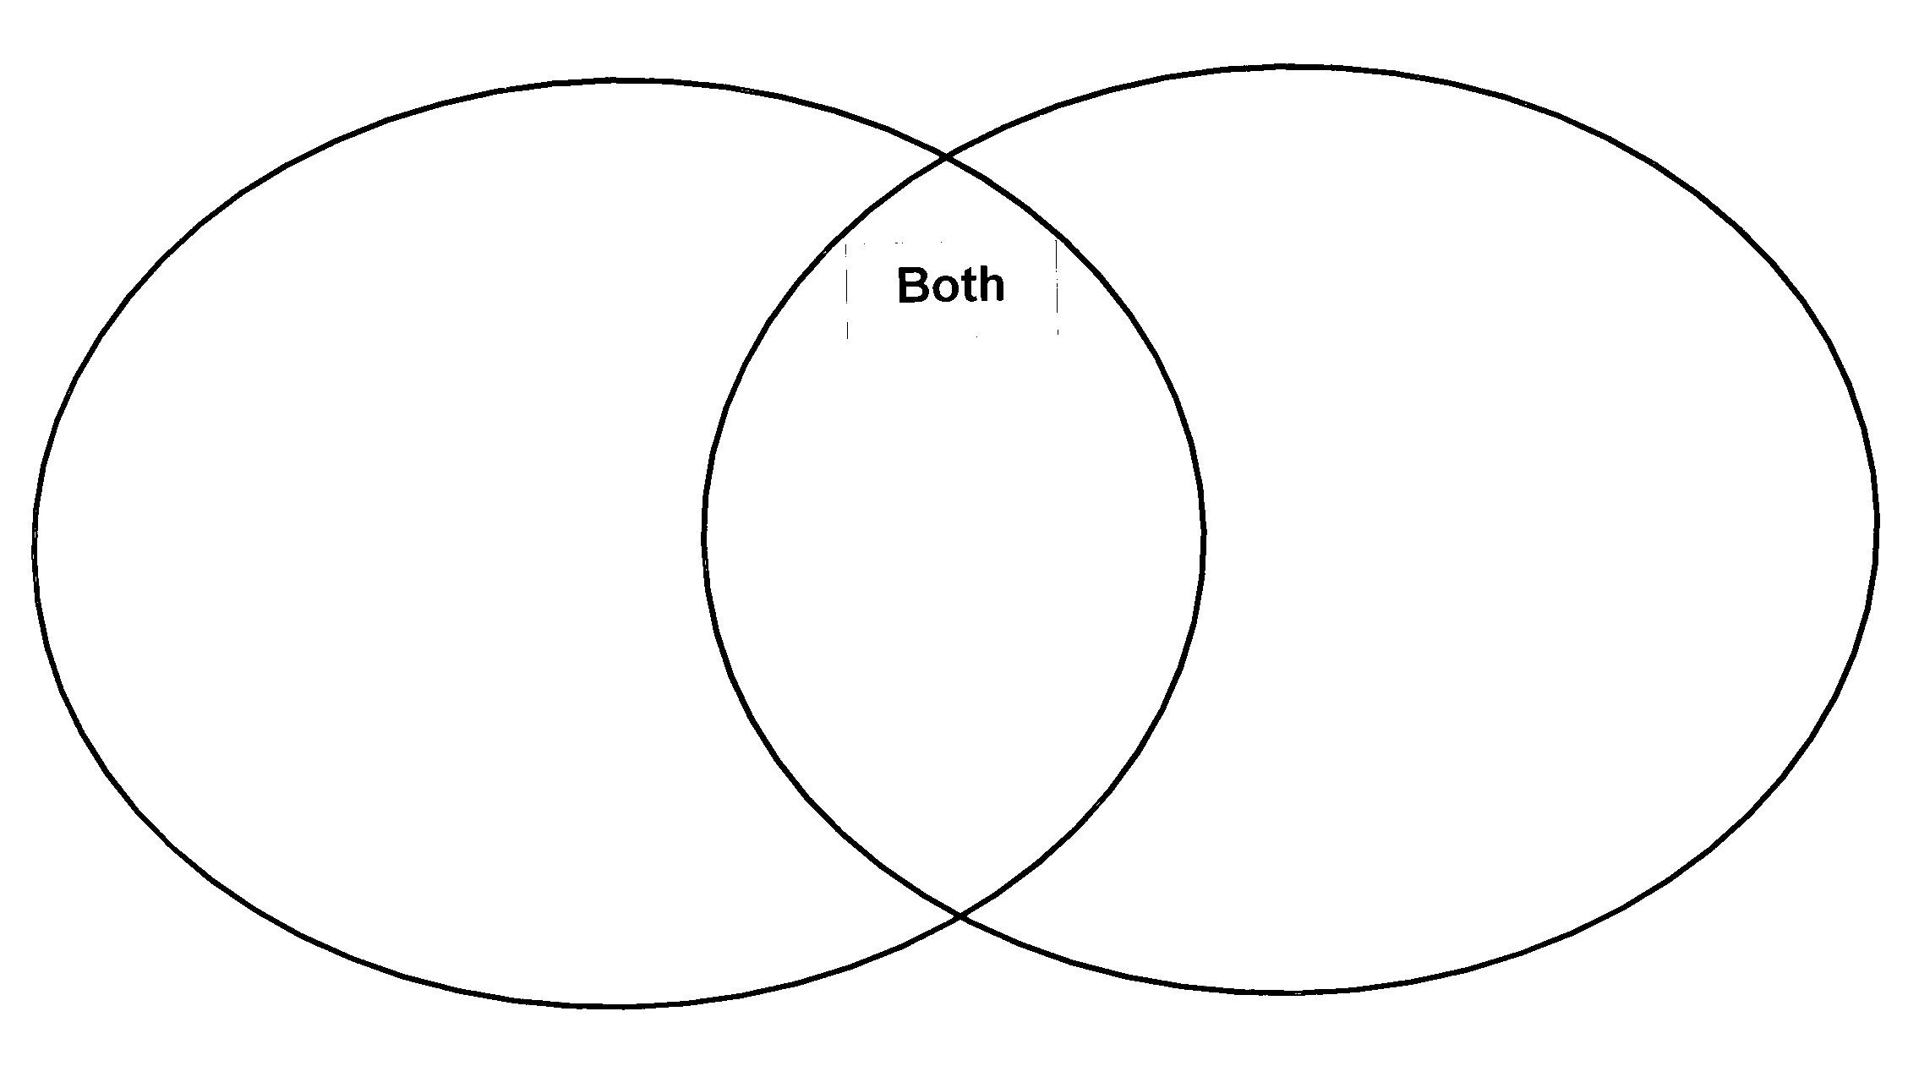
Theme: What’s For Lunch?
COMPARE AND CONTRAST

Slide 29
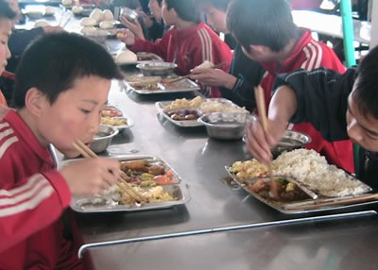
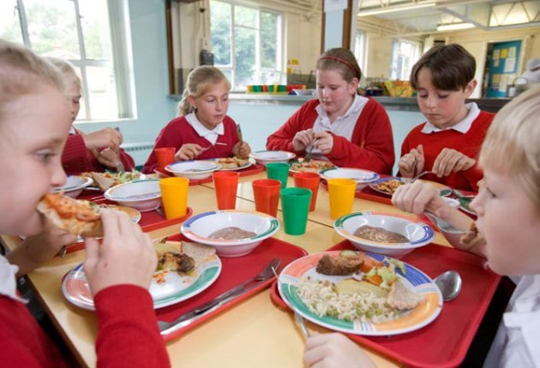
Language
Culture
Express likes and dislikes
Eating out at a restaurant
Ordering food
My favourite food
+
Compare school lunches
Celebrations and food
History of chopsticks
Design menus
Notes:
When doing a food topic..as well as language content..
Compare school lunches, chopsticks, celebrations and food, real menus

Slide 30
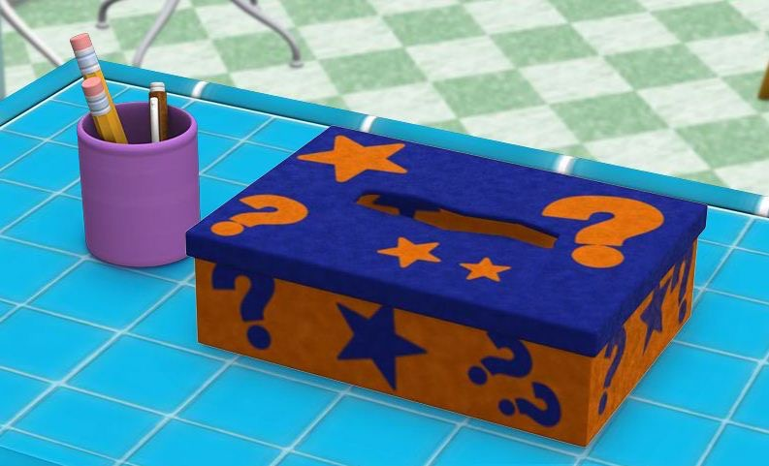
Culture as Inquiry
What do you want to
know about China?
Notes:
Now I am here to tell you that Goal setting by students really works.
It combines cultural and language content so flawlessly, but if you want another way to tap into students…
I use a question box in the classroom.
At the beginning of every school year…students write down questions about China that interest them……
Teachers should encourage questions…that are meaningful to students.

Slide 31
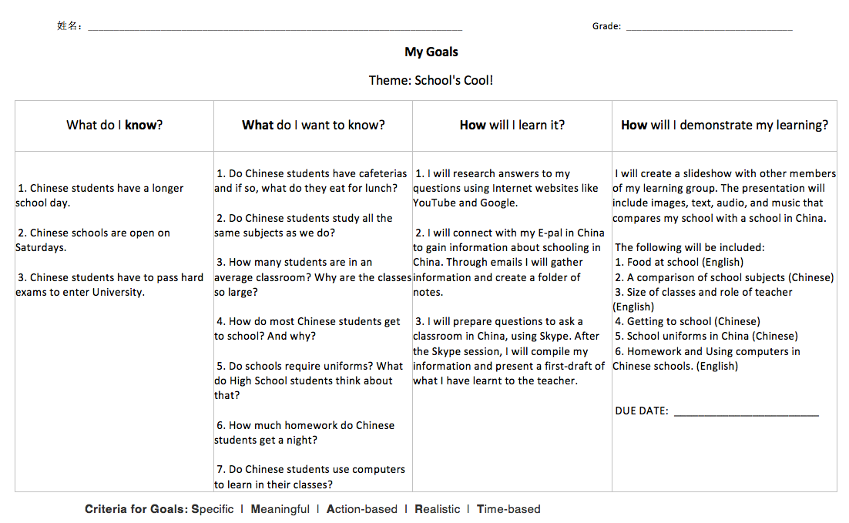
Include Students in the Planning Process
Notes:
I develop a Thematic Unit of work…where topics are learnt…for example.
In this theme – School’s Cool – the language content is generally….discussing school subjects, talking about their school lunch etc.,
But within the language content I embed KWL chart.
So the topic is defined…school related…students get into groups and brainstorm questions.

Slide 32
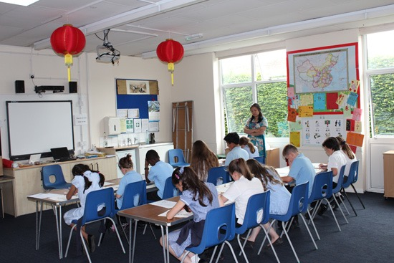
Theme: School’s Cool!
Students will be able to:
Express likes/dislikes of school subjects to a friend.
Help someone find their way around the school buildings.
Explain a student’s daily schedule to a Chinese exchange student.
Research Chinese school uniforms and design a new uniform.
Design your dream school and present information about buildings, subjects and uniform to the class.

Slide 33
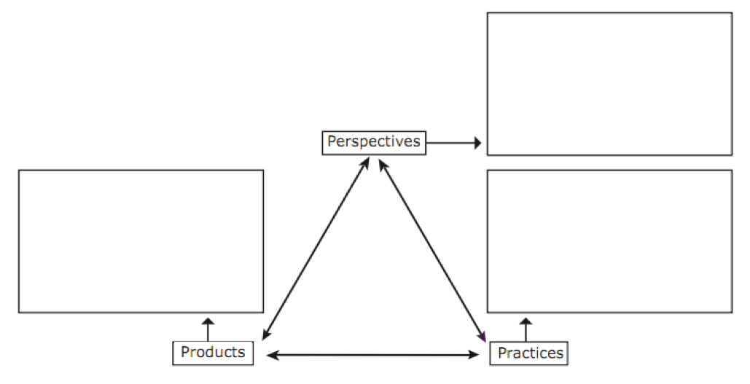
Planner
School
Life

Slide 34
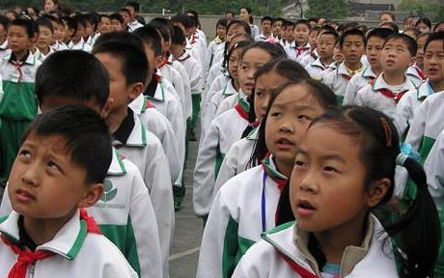
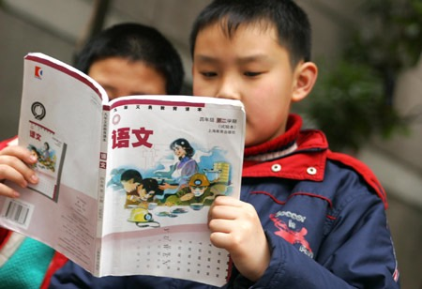
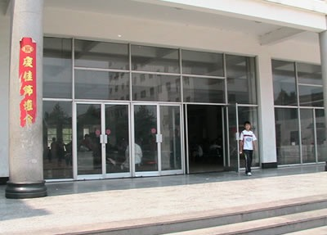
School Life
Products
School Uniforms
Timetables
Comparing Timetables
容易/ 比较 / 最/ 非常
Textbooks
Buildings

Slide 35
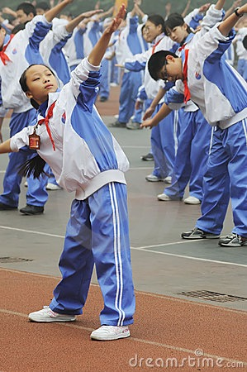
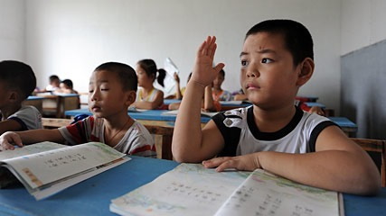
School Life
Practices
Daily routine
School regulations
Food / Lunches
Classroom behaviour

Slide 36
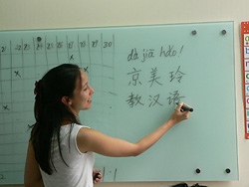
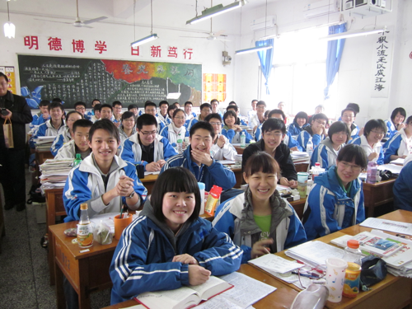
School Life
Perspectives – past/present
Role of teacher
Curriculum
Expectations for students
Success

