Slide 2
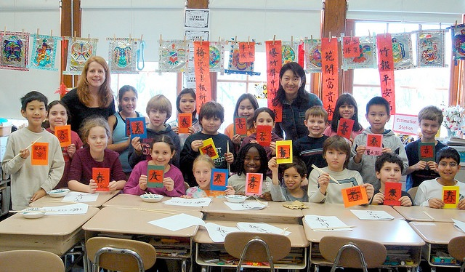
李莎荣
Shaz
Notes:
很高兴见到大家

Slide 3
我来自澳大利亚.

Slide 4
目前住在美国。

Slide 5
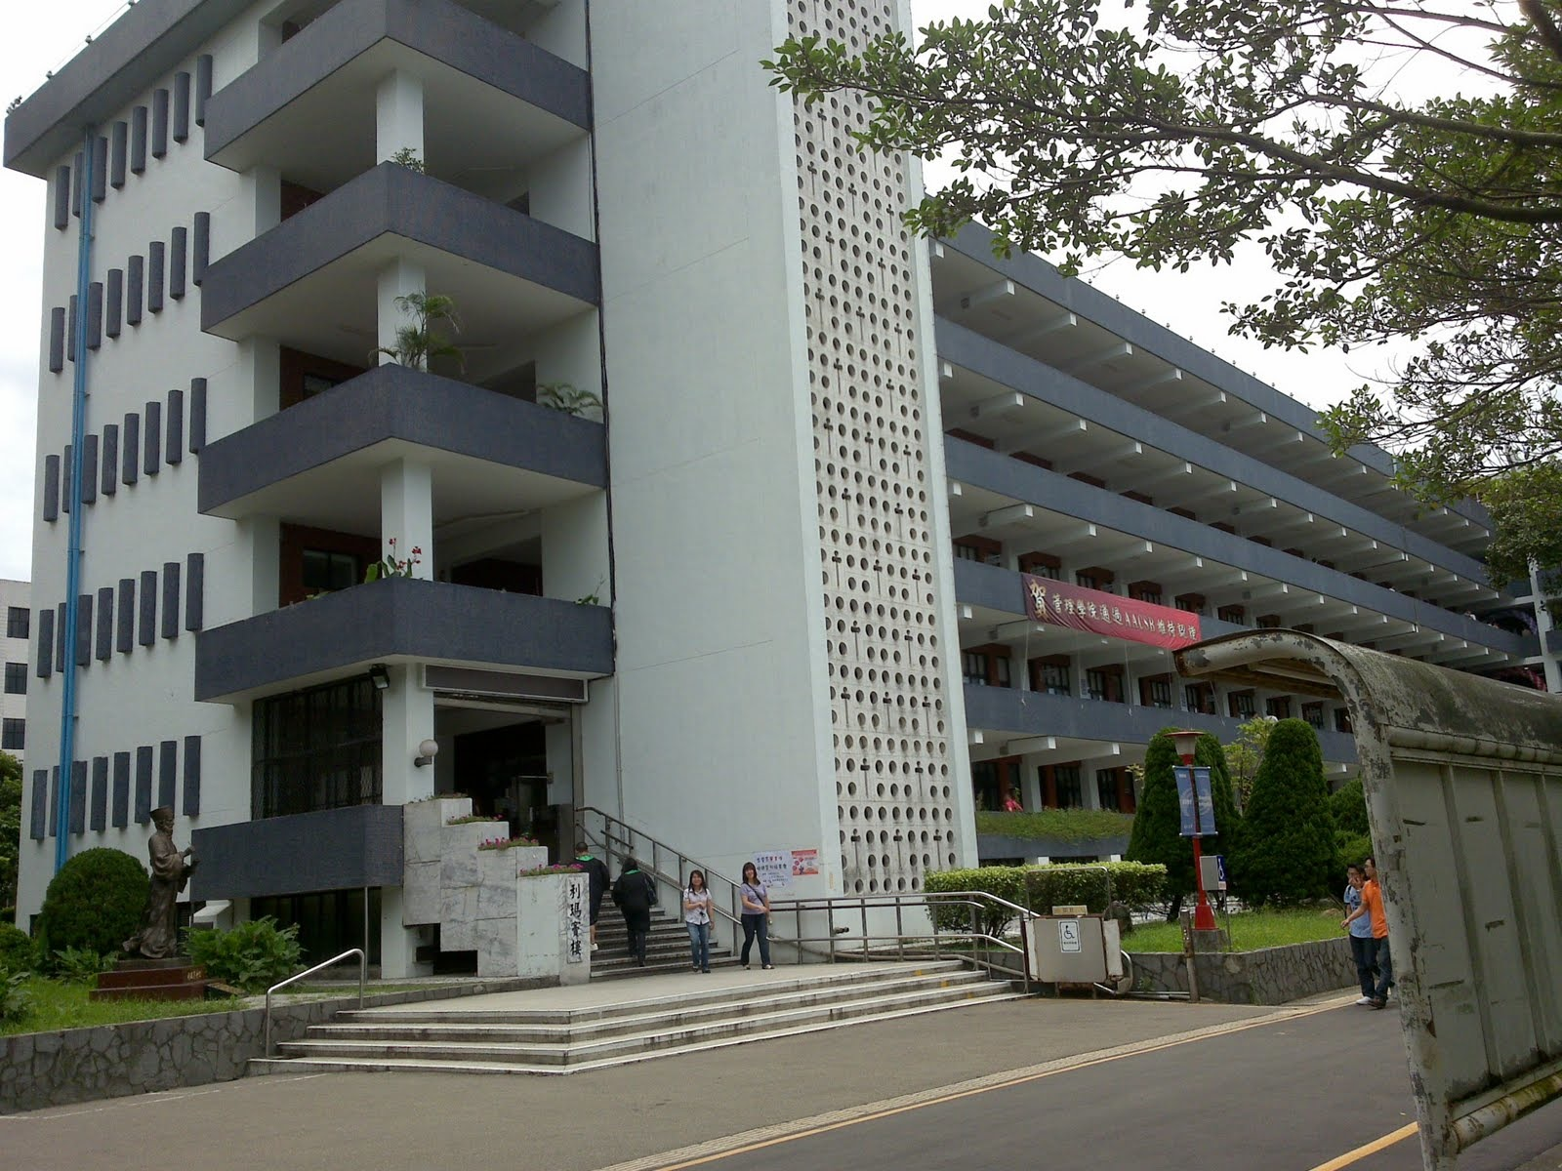
高中毕业以后，我到台湾的辅仁大学,学了两年中文。

Slide 6
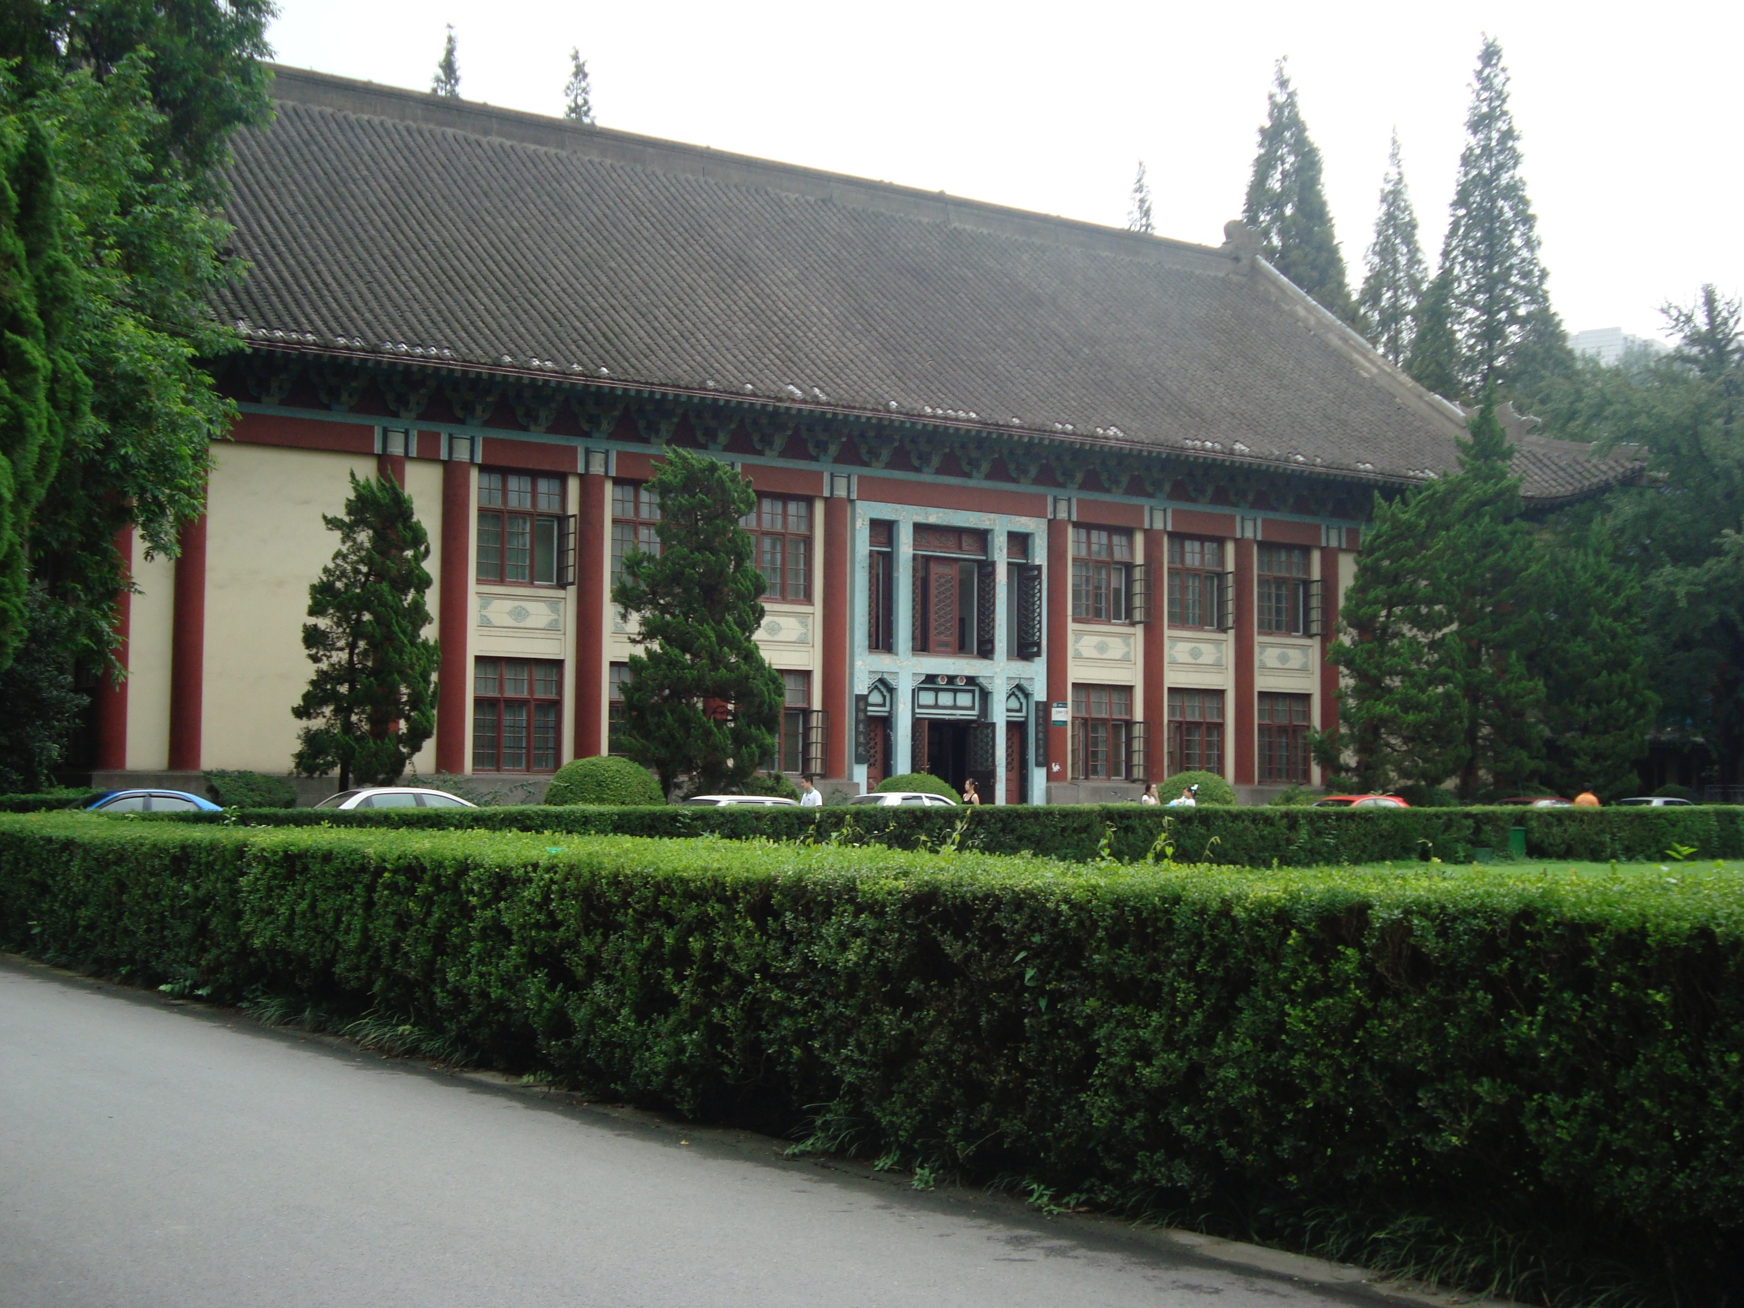
我也在南京师范大学,学过中文。

Slide 7
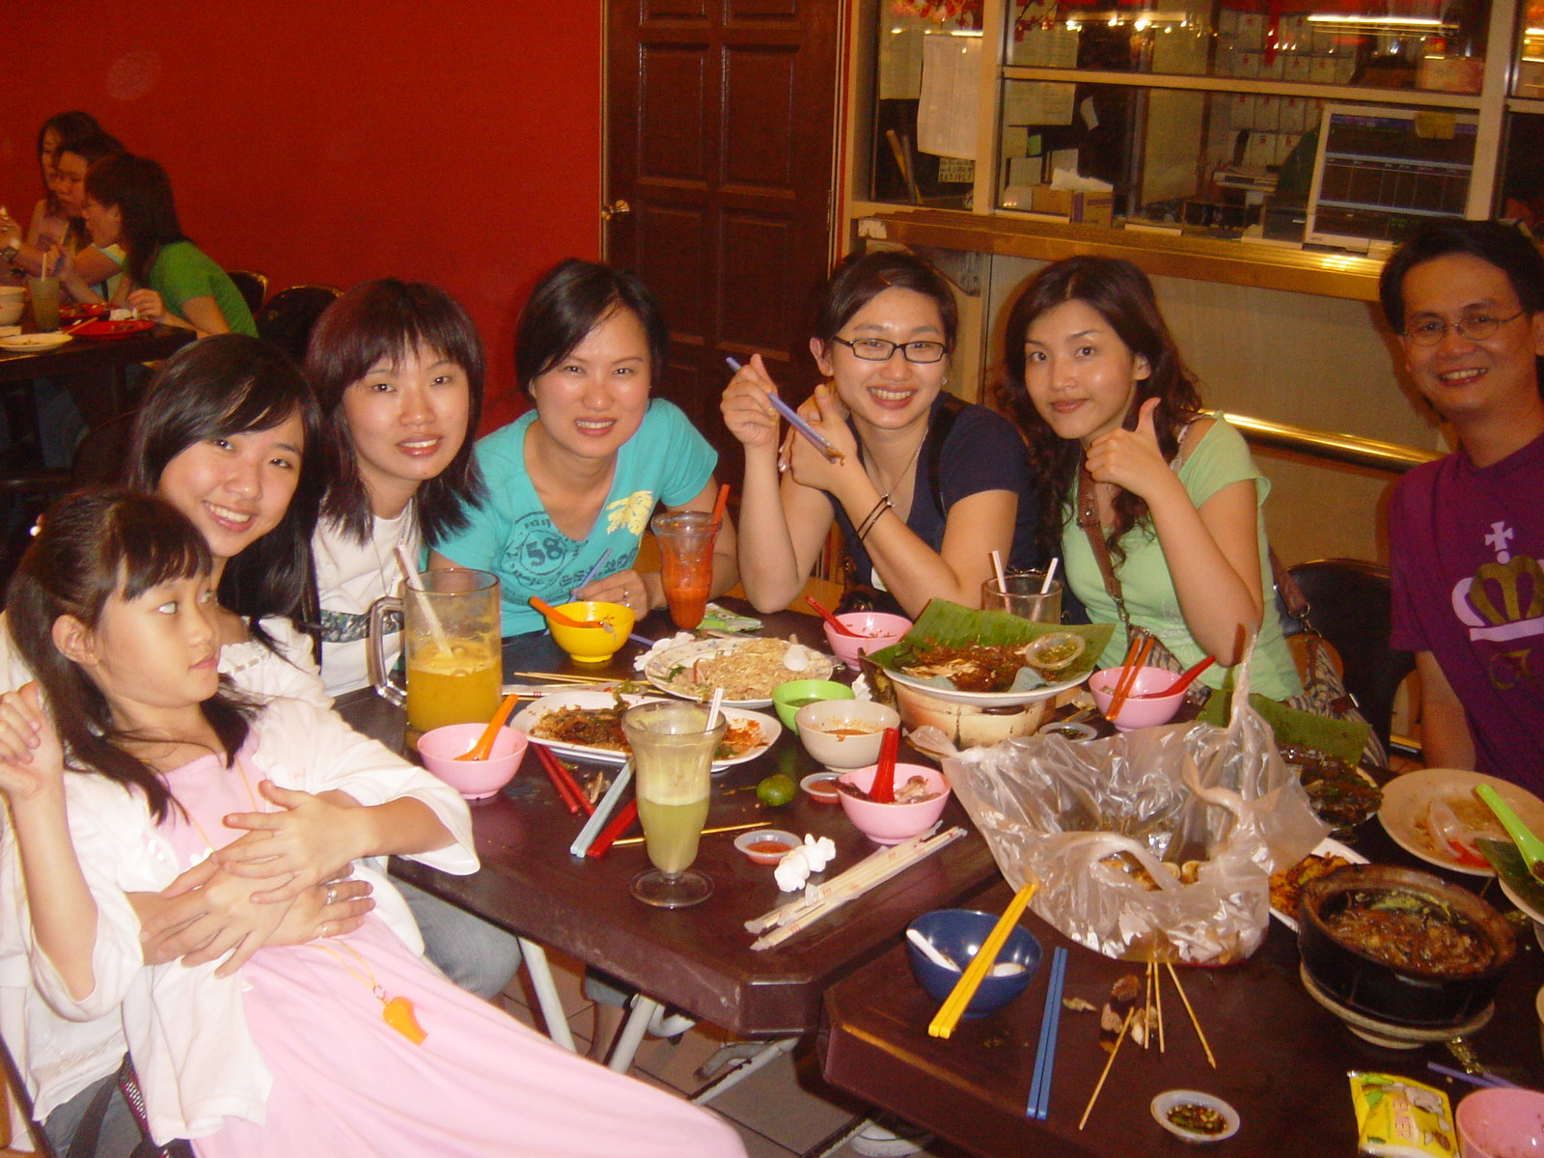
当我在台湾的时候， 我那里的朋友想给我起一个合适的中文名字。

Slide 8
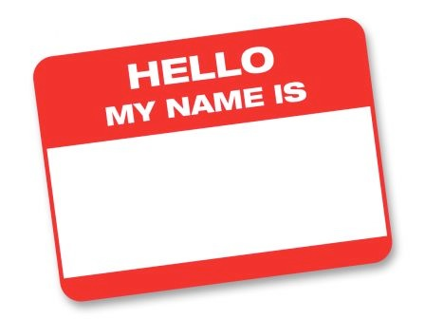
他们想了很久，
后来决定我的中文名字就叫：
李莎荣

Slide 9
我刚开始学中文的时候，对我来说，
很多字的发音听起来都是一样的。

Slide 10
所以当我听到他们说
“莎荣”的时候，

Slide 11
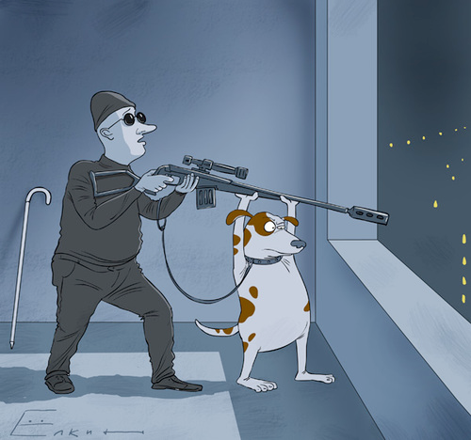
我还以为他们说“杀人.”
我说：“不好.”当然他们都笑我。
杀人

Slide 12
在一九八零年初，澳大利亚政府规定5到17岁的学生必须学习第二外语。

Slide 13
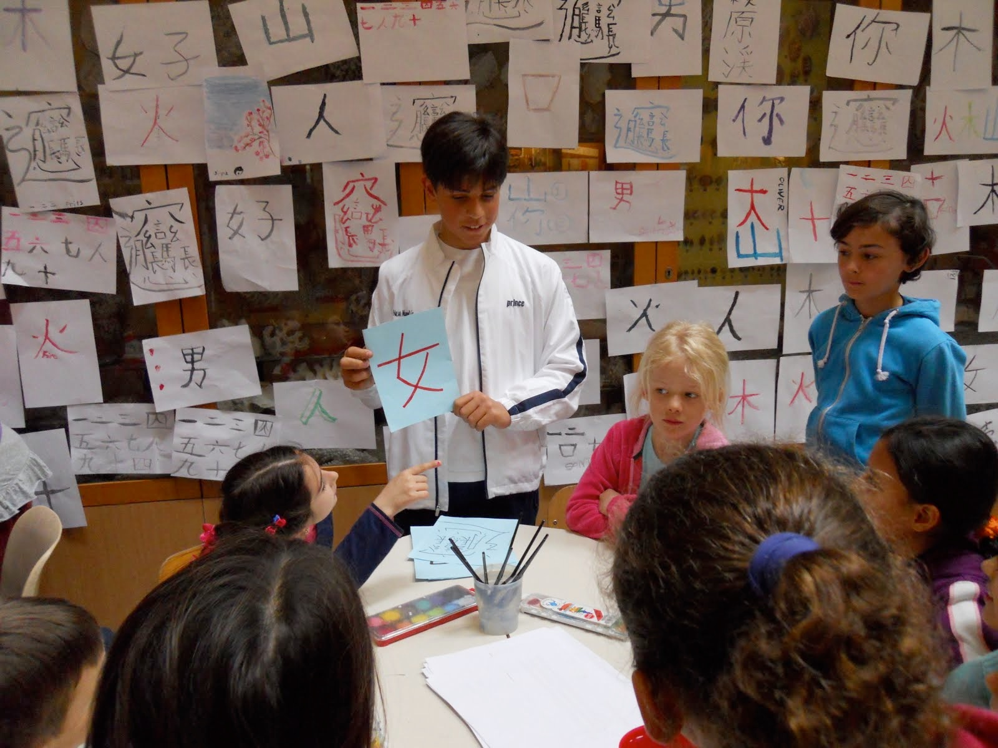
其实在澳大利亚的南部，
我是第一个教中文的老师。

Slide 14
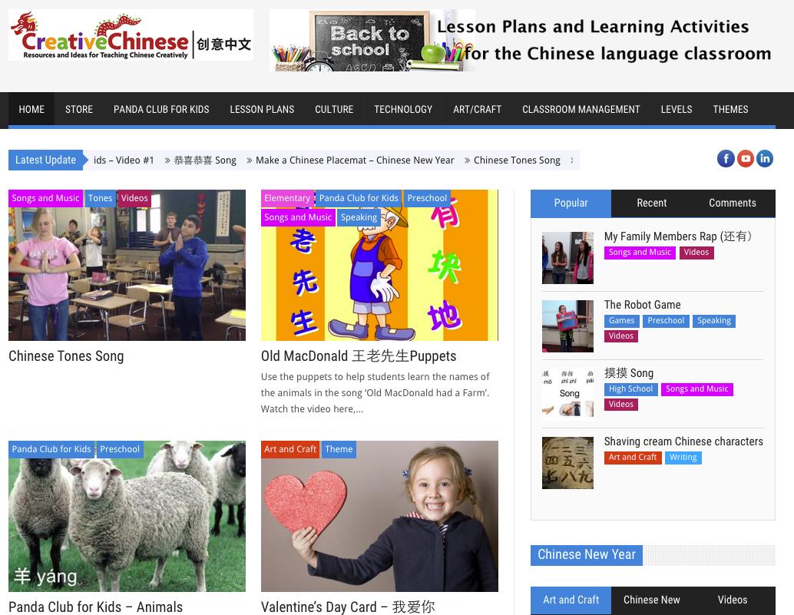
近几年，我有两个工作。一个是我自己创建网站: Creative Chinese 创意中文
向世界各地的老师分享一些教学的方法。

Slide 15
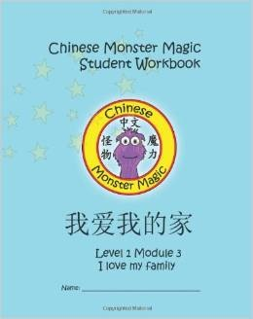
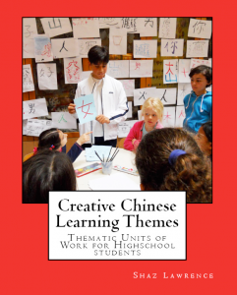
我同时也出版了二十余本中文教材.

Slide 16
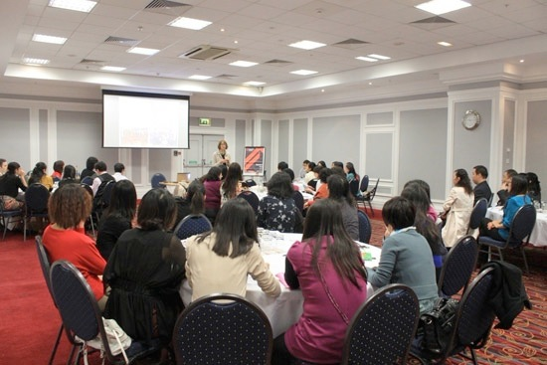
另一个工作是，培训中文老师.

Slide 17
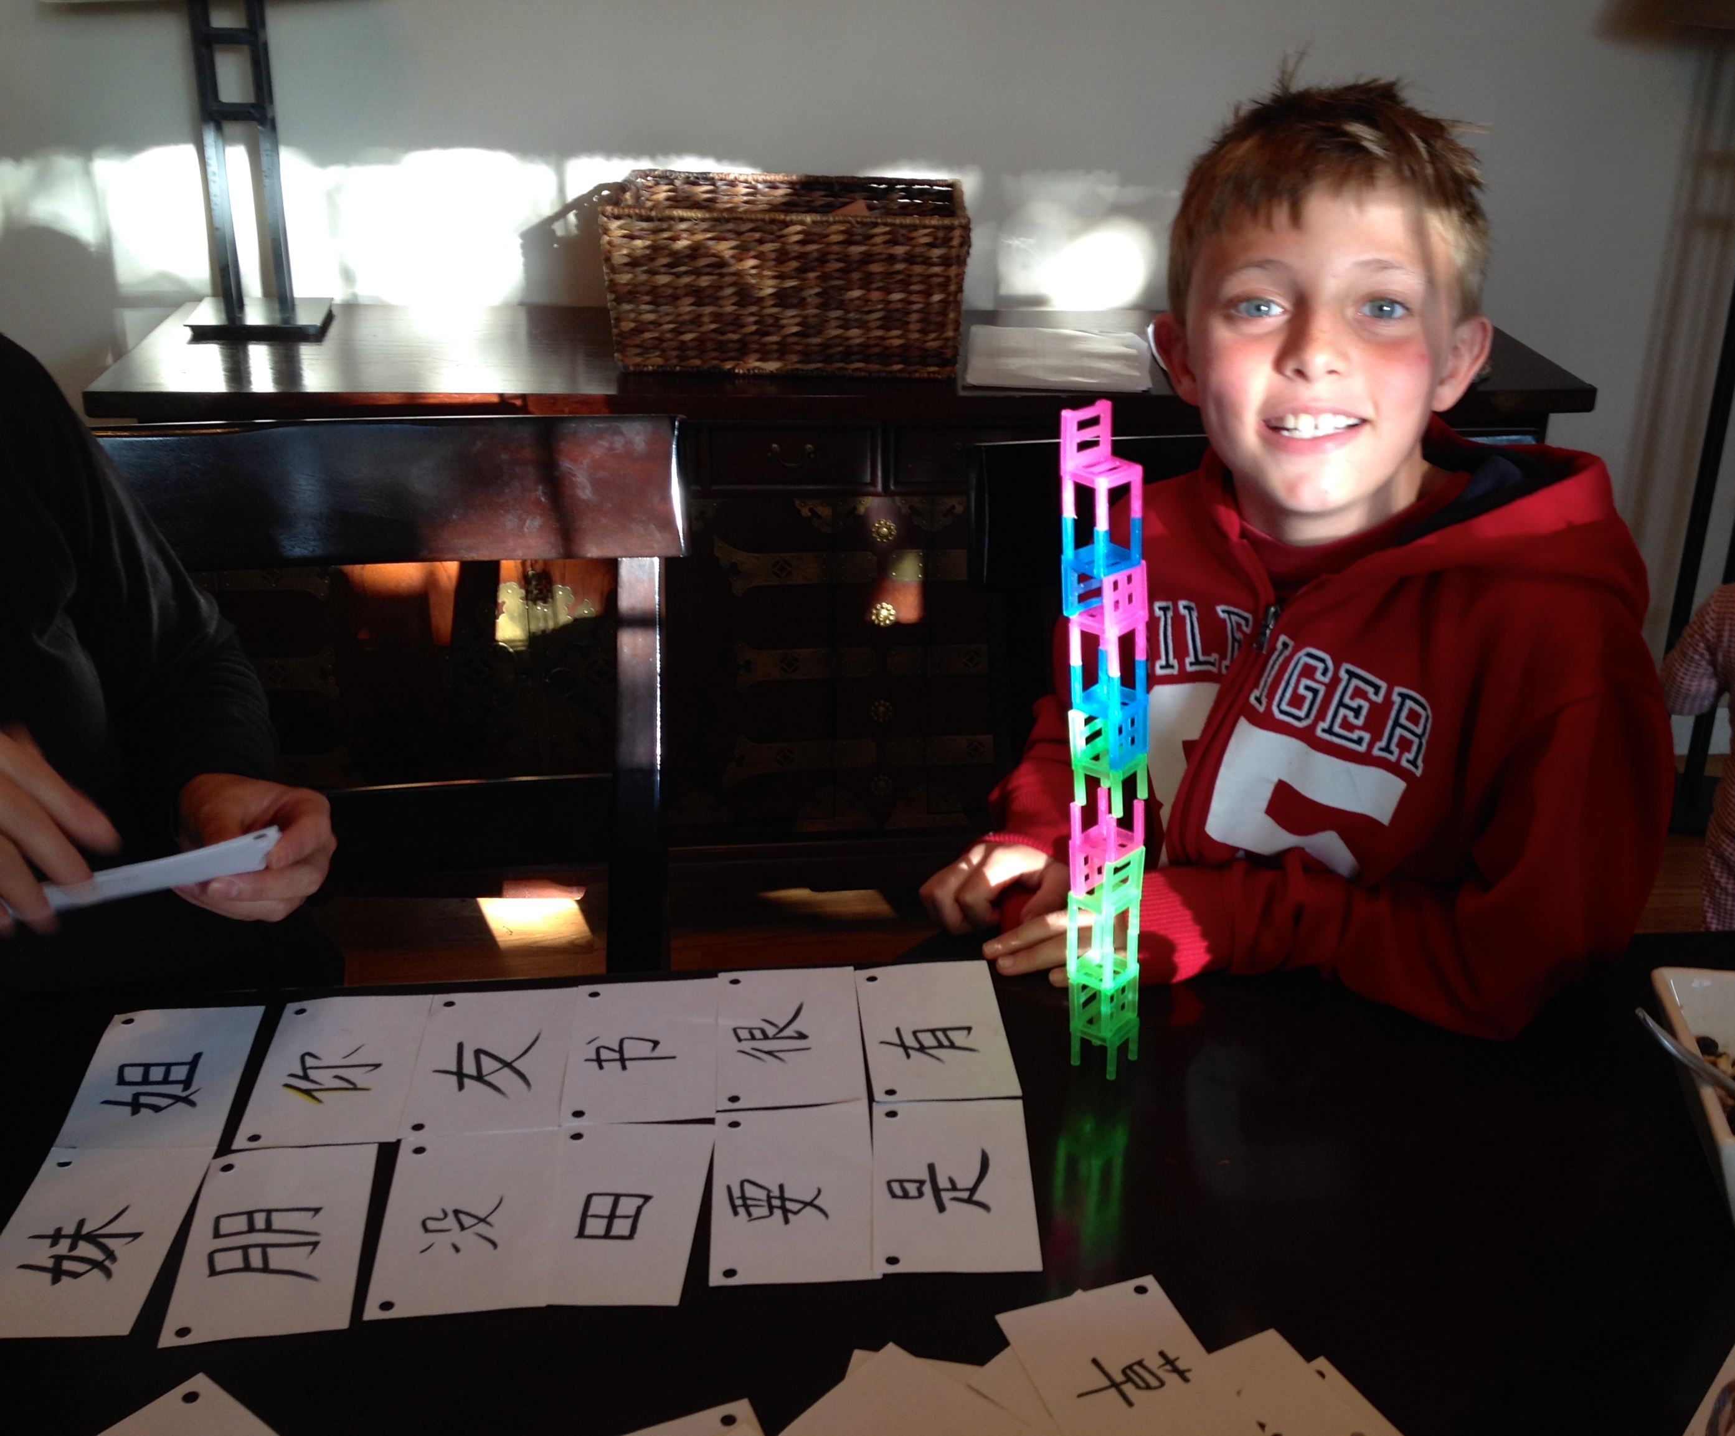
我觉得身为一个教师，我们可以用创新的思路，使学生学习中文时，有更多的乐趣，。

Slide 18
Assessment For Learning

Slide 19
What’s Happening?

Slide 20
Hi,
I’m Andy
the Alien.
Notes:
This is Andy the alien. He knows nothing about teaching Chinese. How would you explain to him how you assess your students. He sees you in the classroom, but is confused how you know they are learning.

Slide 21
How do you know what students are learning?
What do you assess?
When do you assess?
Notes:
So is Assessment is for learning...What do we assess?
Do we assess everything we teach?
Do we only assess

Slide 22
When do you assess?
End of Chapter Test
Speaking Test
Everything I teach
Test character writing
Weekly Test
Vocabulary

Slide 23
Assessment of Learning
What have students learnt?
No student involvement
No emphasis on improving learning
Teacher decides how learning will be assessed

Slide 24
Assessment For Learning?
What is

Slide 25
Assessment For Learning
Students are involved in process

Slide 26
Assessment For Learning
Teachers and students plan ways they will demonstrate their learning.

Slide 27
Assessment For Learning
Continuous process

Slide 28
Assessment For Learning
Peers, Teacher and student assess progress

Slide 29
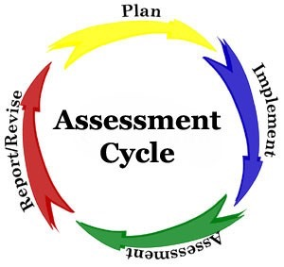
Assessment For Learning
Clear Learning Outcomes that students can verbalize.

Slide 30
Assessment For Learning
1.Why?
2.What?
3.When?
4.How?

Slide 31
Assessment For Learning
What?

Slide 32
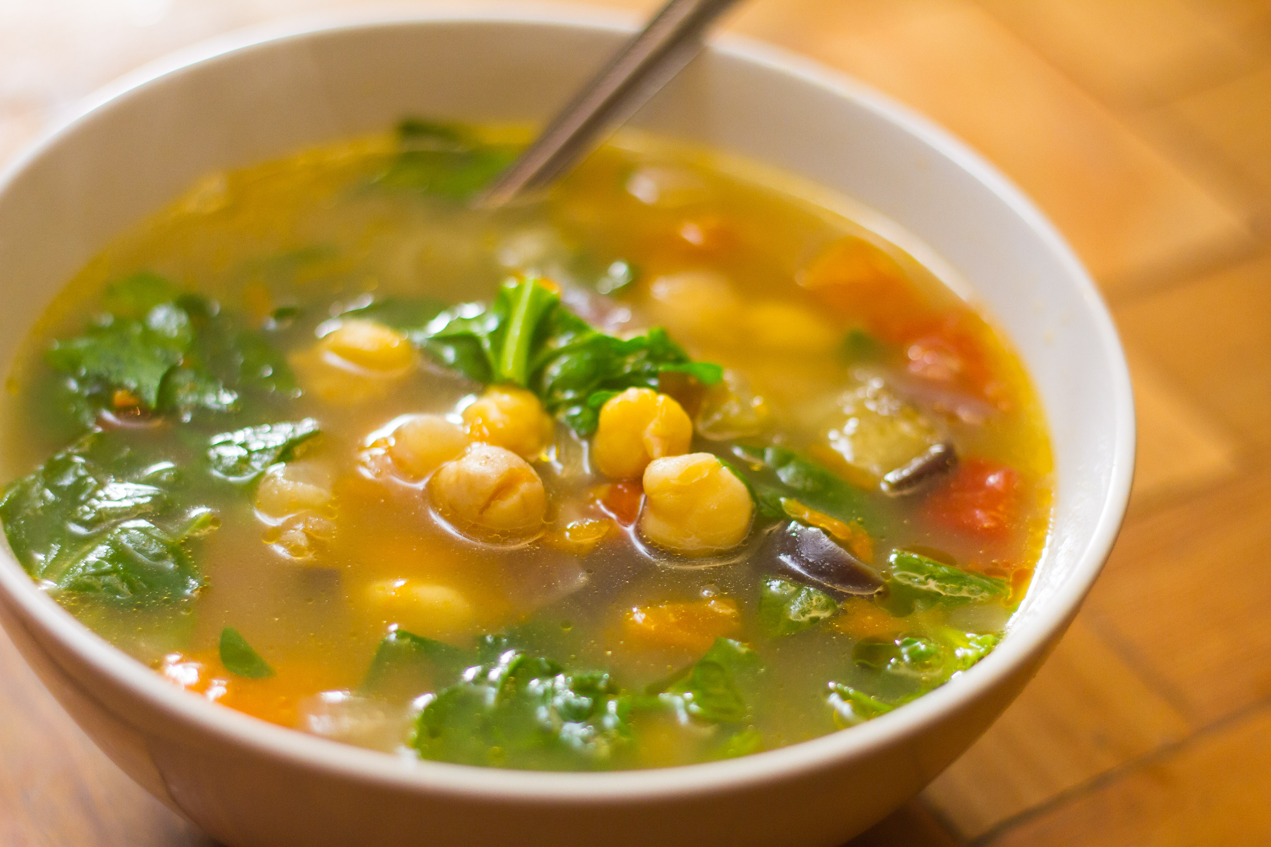
The goal is to make a delicious soup.

Slide 33
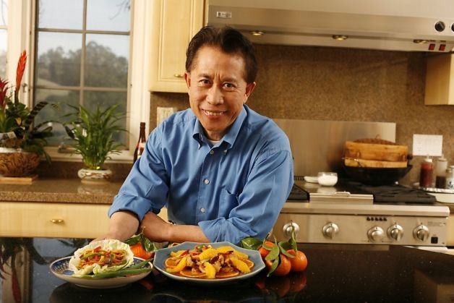
Martin Yan will judge my soup.

Slide 34
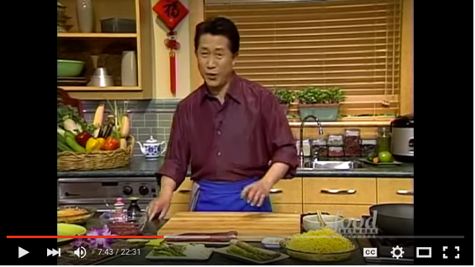
I learn how to make soup.

Slide 35
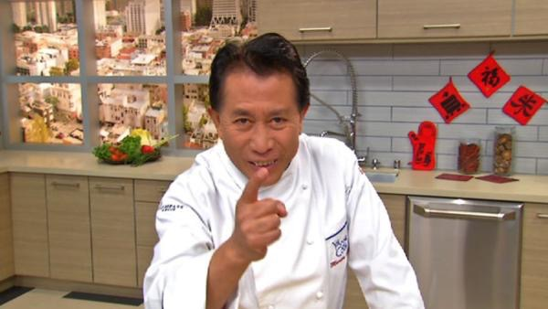
Fail! It tasted bland and was not good at all!
I give you a D!
Notes:
This is assessment of learning. It’s how most teachers assess students. You give students information, they learn it, and then you are tested.

Slide 36
Assessment For Learning

Slide 37
The goal is to make a delicious soup.

Slide 38
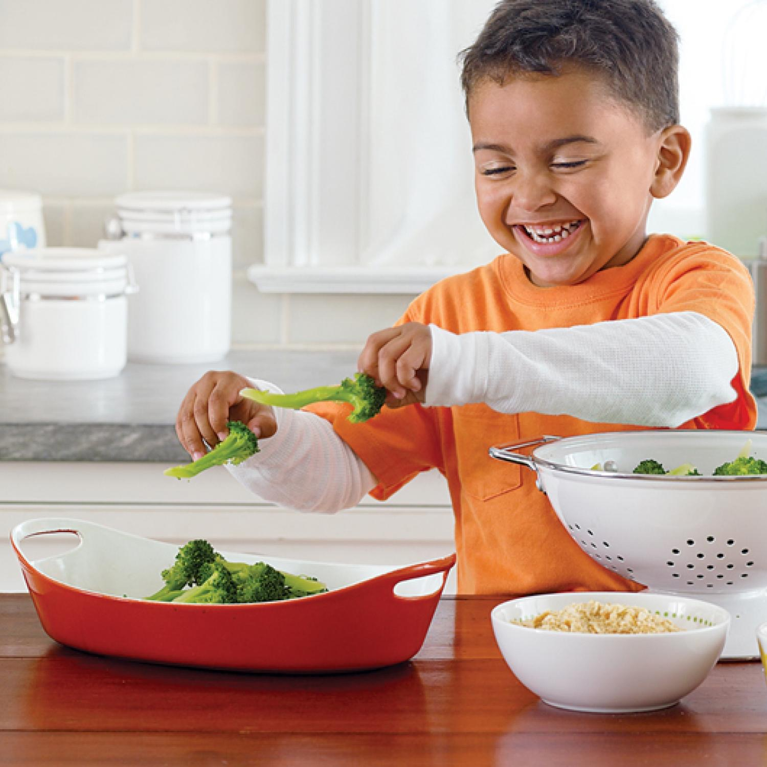
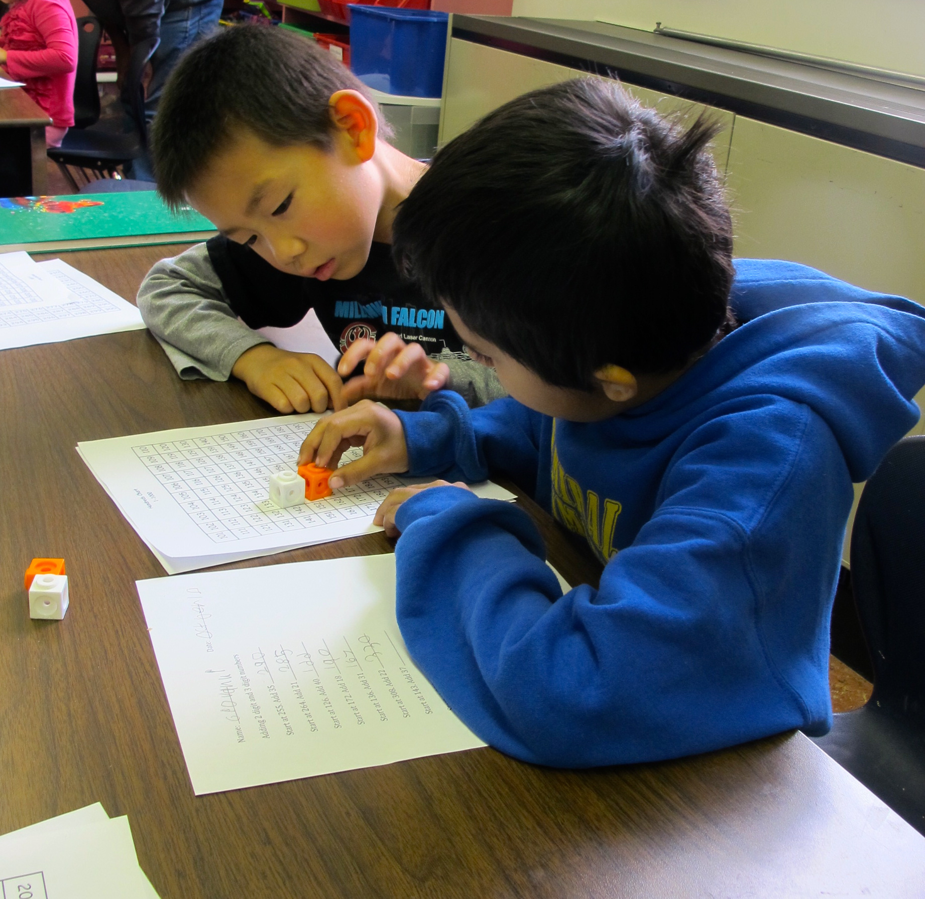
Martin Yan will judge my soup.
Who will assess my ability
to make soup?
I will judge my soup.
Peers will judge my soup.

Slide 39
I learn how to make soup.

Slide 40
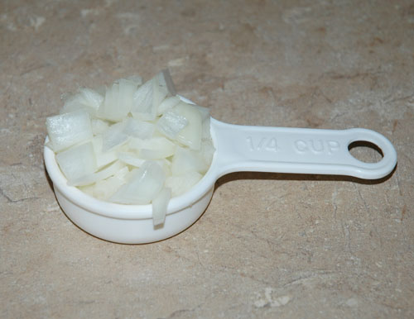
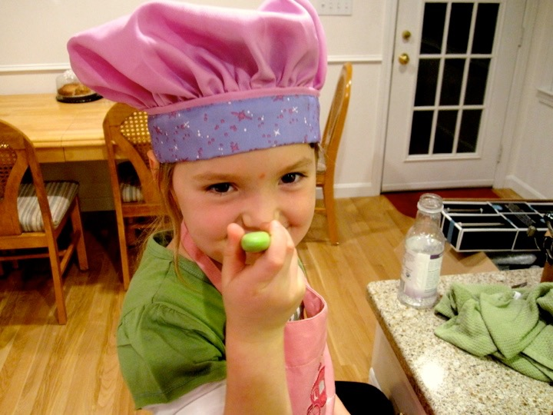
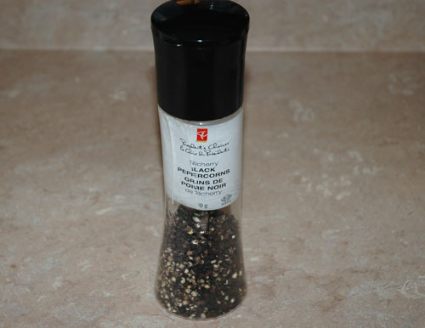
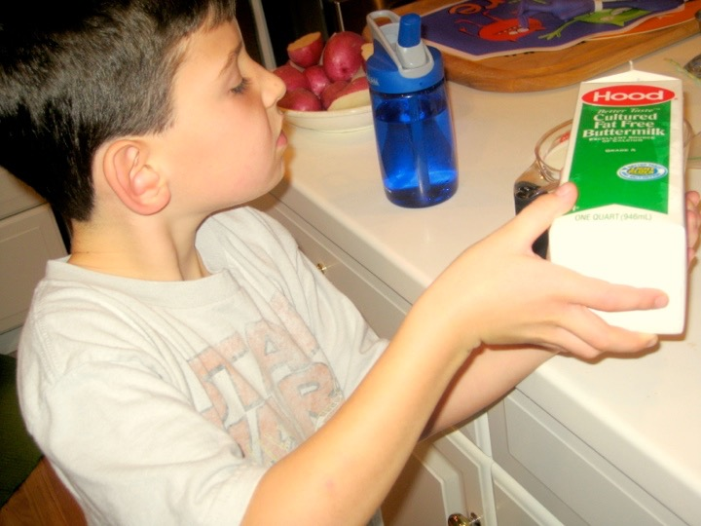
feedback
moves the learner forward to the Goal

Slide 41
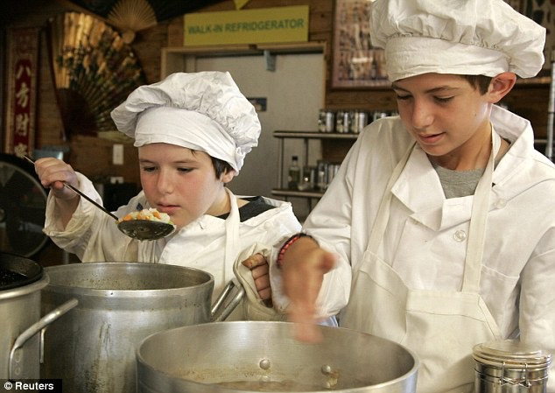

Slide 42
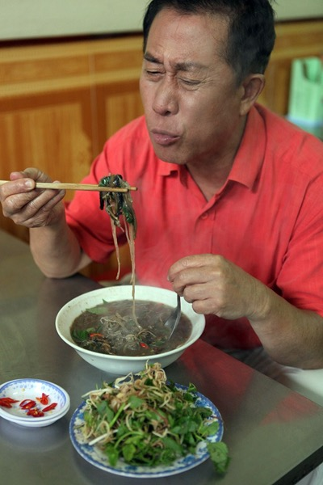

Slide 43
Assessment of my soup is a continuous process.
You may want to practice cutting vegetables correctly.
GOAL
feedback
It’s needs more
salt.
feedback
I try it, but it needs
more flavor.
I will go back and
watch the video.
feedback

Slide 44
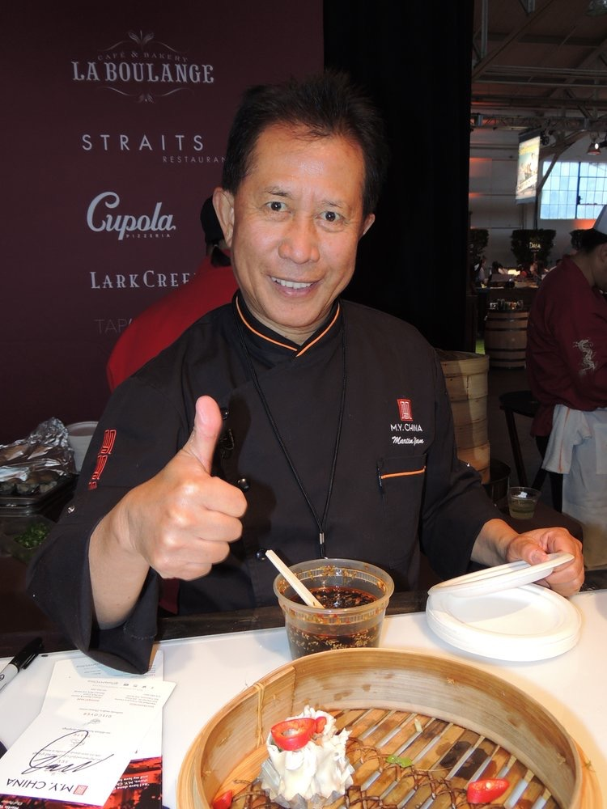

Slide 45
Assessment For Learning
is
Continuous Assessment

Slide 46
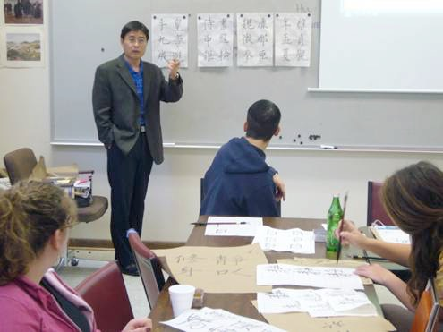
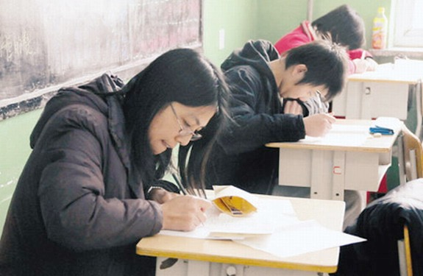
The Traditional Model Of Assessment
Teach Test Move on

Slide 47
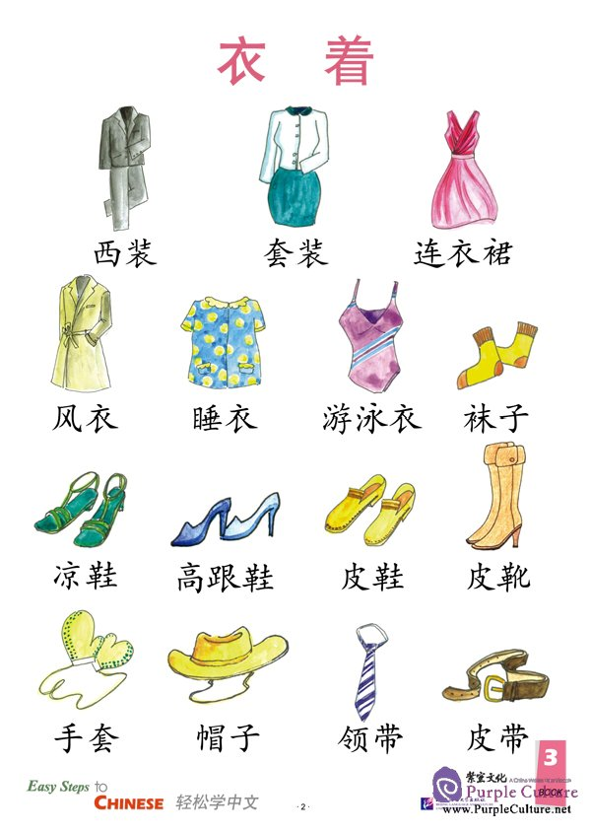
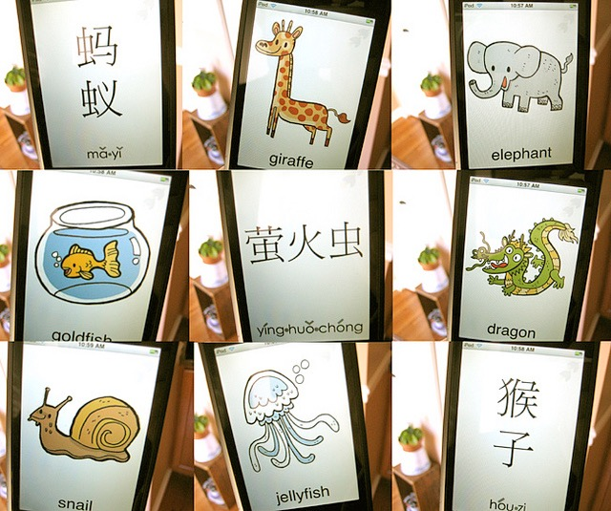
Teach - Test - Move on
Assessment OF Learning Model

Slide 48
Assessment For Learning Model
Check in with students
Target
Notes:
Just overview:
Learning target
Building blocks
Knowledge or subskills
Critical junctures
Assessment for learning

Slide 49
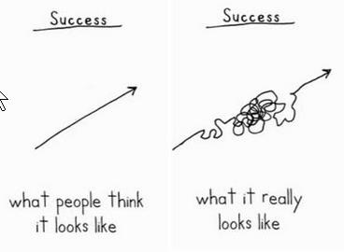
Assessment For Learning
Notes:
Put this in your classroom.
Remind students that learning is a process...a bit forward...back..forward again.

Slide 50
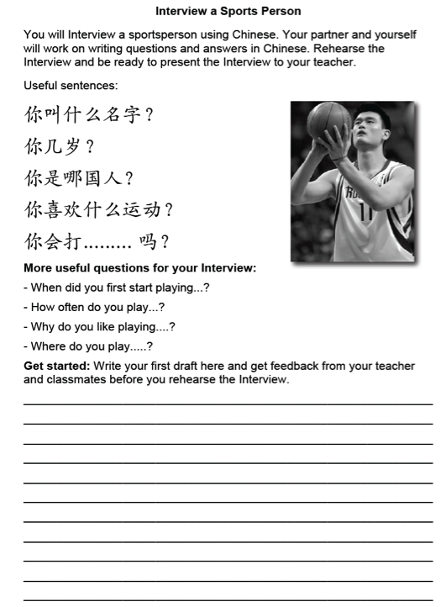
Goal
Outcome: I Can Interview A Sports Person
Interview a Sports Person
Assessment
Assessment
Assessment
Assessment
Listening Quiz
Role-play with partner
Label sports/match sentences
Informal checklist

Slide 51
Why?
Notes:
It seems obvious really. We assess to find out what students know..
Well...

Slide 52
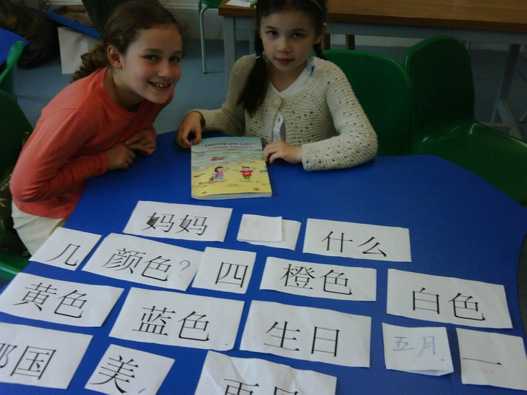
Assessment for Learning improves learning for all students.
Notes:
Our aim as teachers is to maximize learning...
So many teachers think that preparing students for tests is the sole aim of assessment.
They are missing a large part of the learning process.
Imagine, aliens landed....Using hands, what do you think learning looks like?

Slide 53
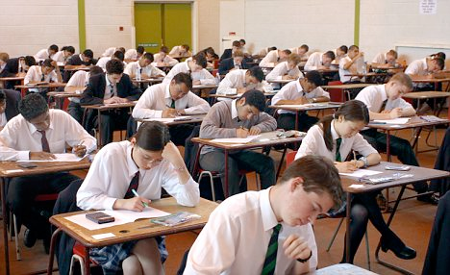
Using Assessment for Learning techniques, students made almost twice the progress over a year.
(William, Lee, Harrison and Black - 2004)

Slide 54
I learn best when I am given feedback about the quality of my work, and what I can do to improve it.

Slide 55
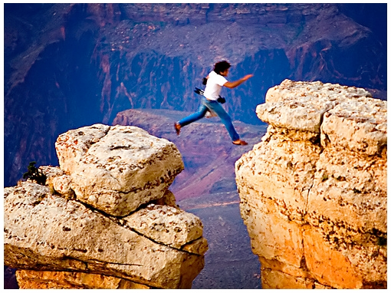
feedback
provides the learner information with:
Where I want to be
Where I am

Slide 56
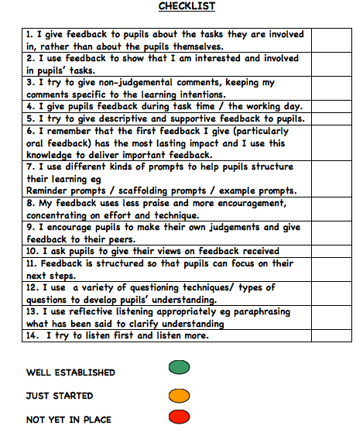
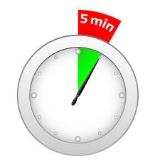

Slide 57
Let’s give some Feedback

Slide 58
When?

Slide 59
Student-Friendly Learning Goals
Provide students with a clear and understandable vision of the learning target.
I can.....
I can tell...
I can read..
I am able to .....
I can write...
I know.....
I will be able to .....
I am learning how to.....
Notes:
Not having targets is like...running a race and not knowing the destination...

Slide 60
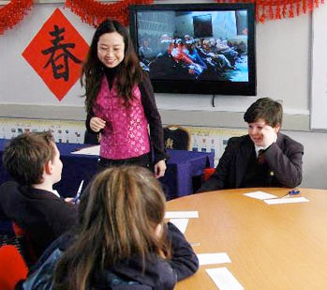
Learning Goals - S.M.A.R.T
Small
Measurable
Achievable
Realistic
Time limited

