Slide 1
Week 5

Slide 2
Learning Outcomes
Review Nationalities
Explore languages
Express languages I can speak

Slide 3
你是 哪国 人？
Nǐ shì nǎ guó rén?
What is your nationality?

Slide 4
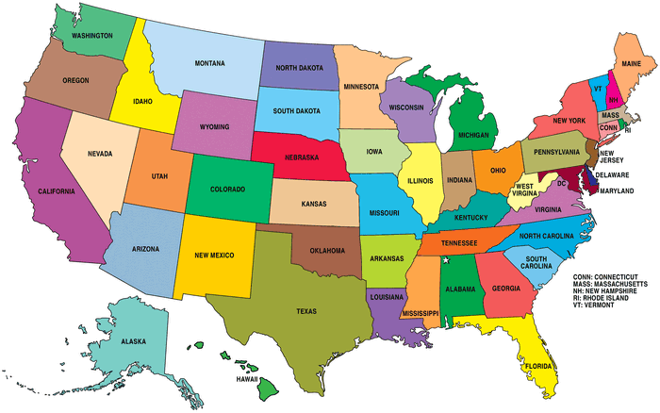
美国
美国人
Měi guó
Měi guó rén

Slide 5
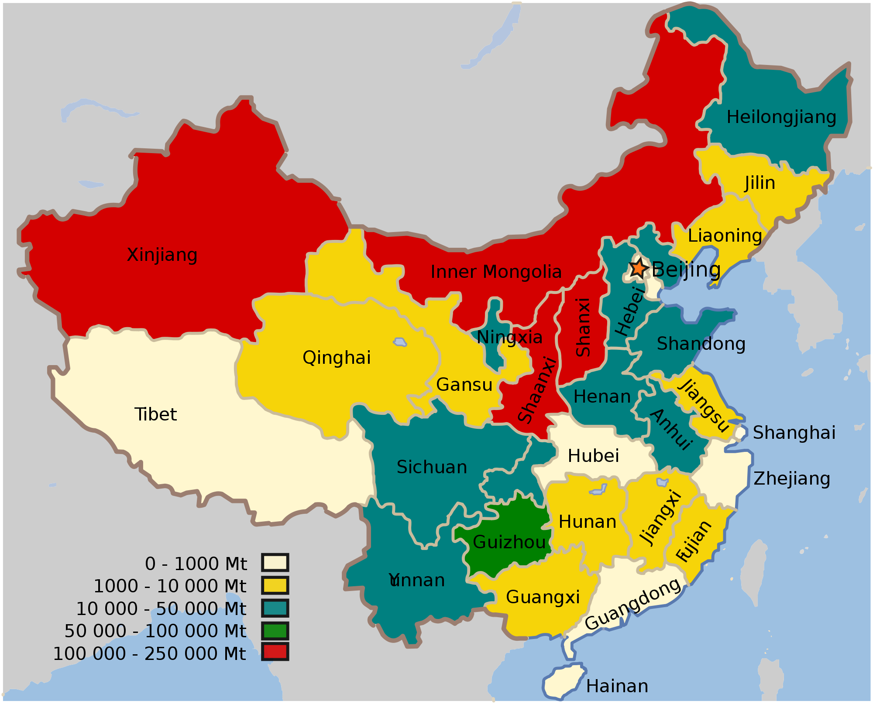
中国
中国人
Zhōng guó
Zhōng guó
rén

Slide 6
英国
Yīngguó
英国人
Yīngguó
rén

Slide 7
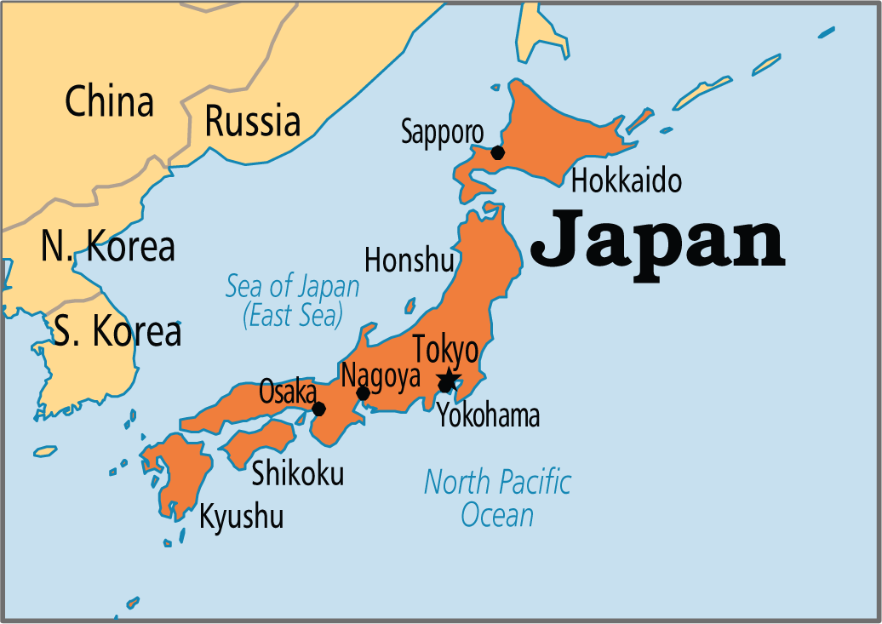
日本
Rì běn
日本人
Rì běn rén

Slide 8
你是 哪国 人？
Nǐ shì nǎ guó rén?
我是 人
Wǒ shì rén.

Slide 9
人
rén

Slide 10
I am American.
人
I am English.
人
I am Chinese.
人
I am Japanese.
人

Slide 11
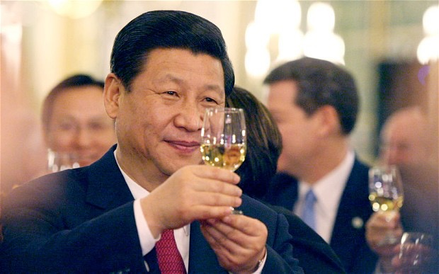
我是中国人
Zhōng guó
rén

Slide 12
我说中国话
Wǒ shuō zhōng guó huà

Slide 13
说
shuō

Slide 14
I speak
You speak
我说
你说
Wǒ shuō
Nǐ shuō

Slide 15
话
huà
language
language
language
language

Slide 16
I speak Chinese
我说中国话
Wǒ shuō zhōng guó huà

Slide 17
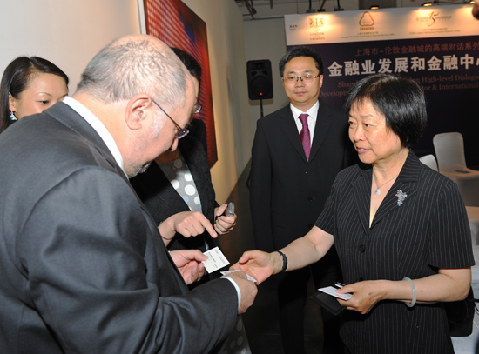
I speak Japanese
我说日本话
Wǒ shuō rì běn huà

Slide 18
I speak Chinese
I speak English
I speak Japanese

Slide 19
I am English.
I am American.
I am Chinese.
I am Japanese.
I speak Japanese
I speak English.
I speak Chinese.

Slide 20
Country
Nationality
Language
China
Chinese
中国话
USA
American
英文
Japan
Japanese
日本话
England
English
英文

Slide 21
Country
Nationality
Language
人
China
Chinese
中国话
I am a Chinese person. I speak Chinese.

Slide 22
Country
Nationality
Language
人
USA
American
英文
I am an American. I speak English.

Slide 23
Country
Nationality
Language
人
Japan
日本
日本话
I am a Japanese person.

Slide 24
Country
Nationality
Language
English
人
England
英文
I am an English person. I speak English.

Slide 25
名片
míng piàn
business card
name card
My name is ….
My nationality is….
I speak…….

Slide 26
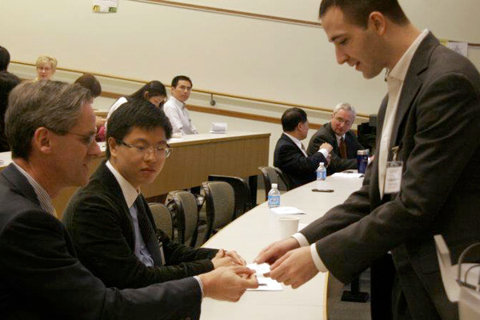
Hello!
My name is ….
My nationality is….
I speak…….

Slide 27
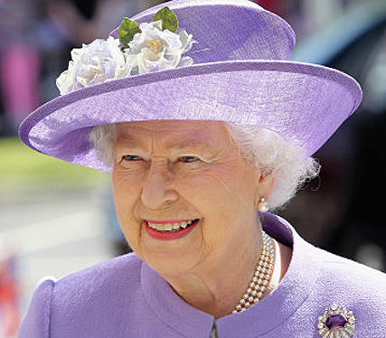
Hello!
My name is ….
My nationality is….
I speak…….

Slide 28
Hello!
My name is ….
My nationality is….
I speak…….

Slide 29
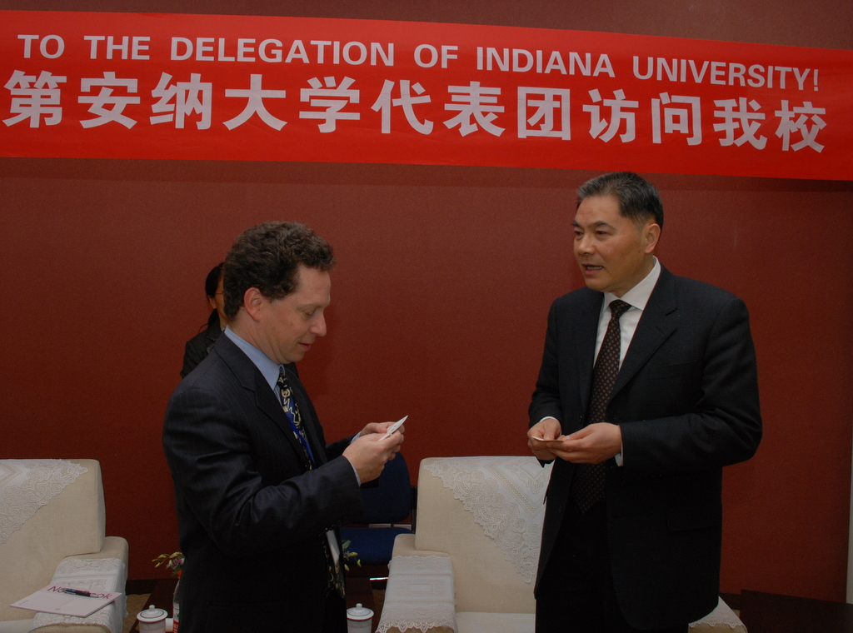
This is my business card.
Thanks.

Slide 30
I don’t
understand.

Slide 31
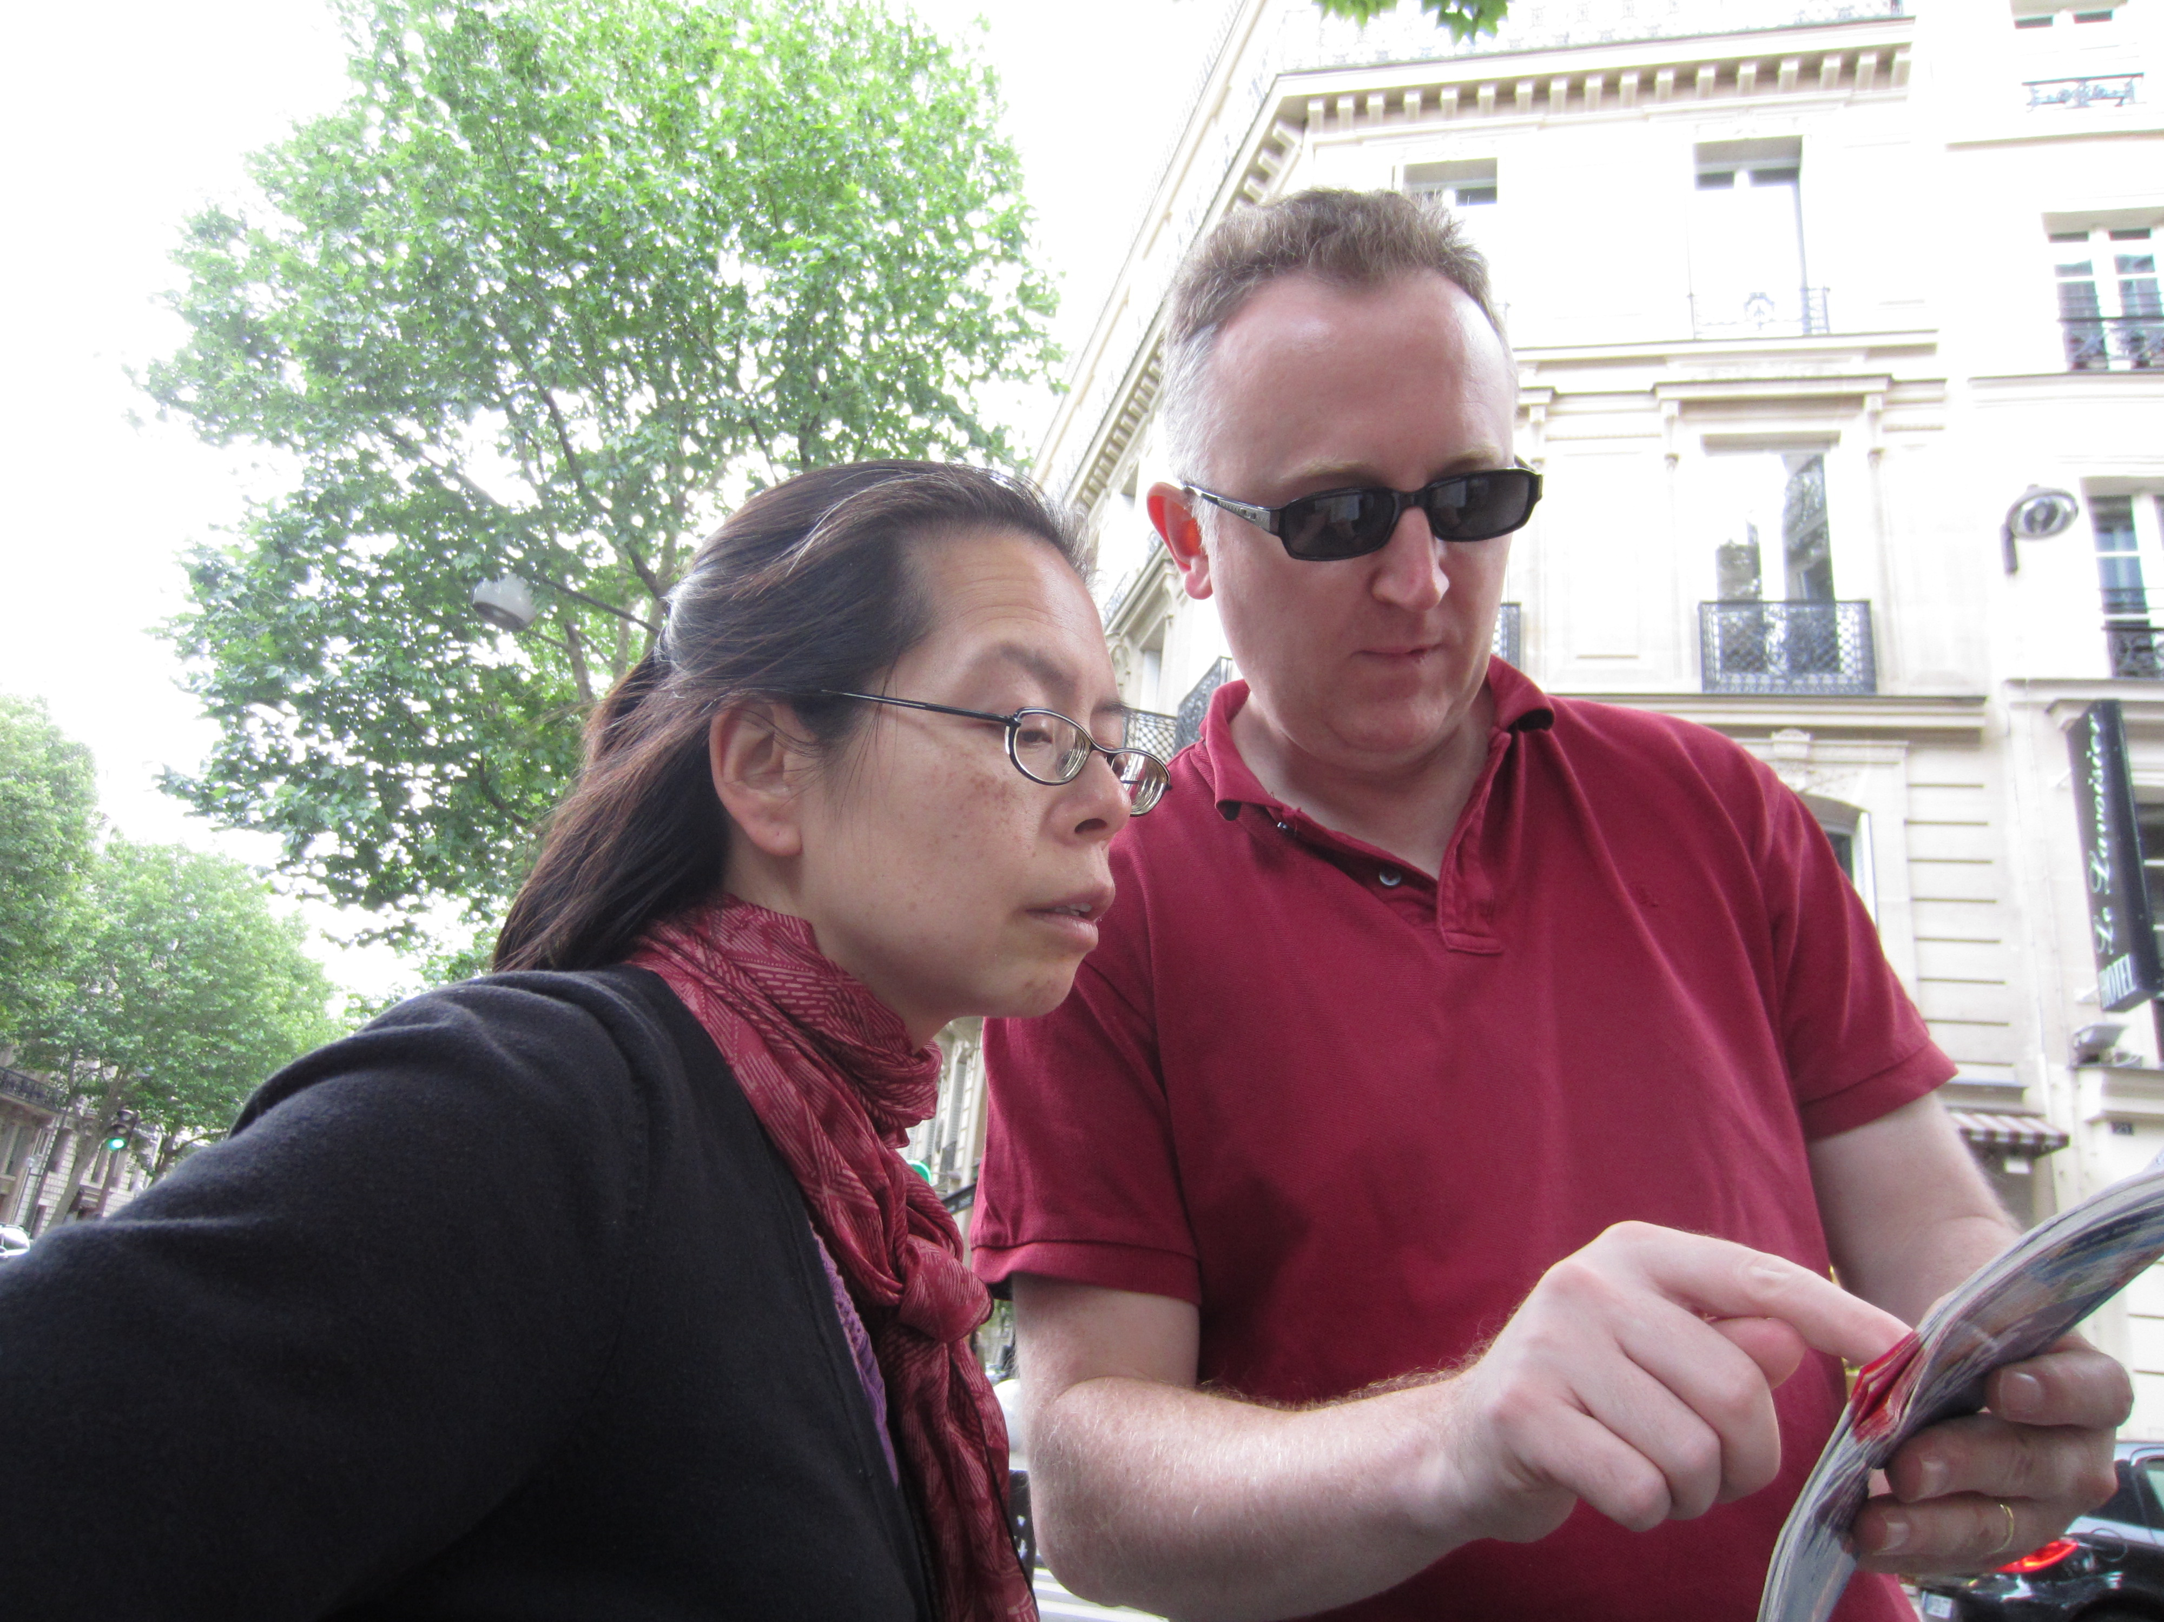
Hello.
Excuse me.

Slide 32
Conversation
Hello | 你好
Excuse me | 请问
What’s your last name? | 您贵姓
My last name is... | 我姓...
I am (nationality)
I speak (language)
What about you?

