Slide 1
Learn Chinese the Fun Way!

Slide 2
PART 3
1. Express thanks
2. Respond to thanks
3. Express you are sorry
4. Express ‘no problem’

Slide 3
Lesson 3

Slide 4
谢谢
Thanks
Xiè xiè

Slide 5
谢谢
你
Thank you
Xiè xiè

Slide 6
不客气
Bù kèqì
no problem!

Slide 7
no
不
don’t
bù
negative

Slide 8
不客气
Bù kèqì
谢谢
Xiè xiè

Slide 9
对不起
Duì bù qǐ
sorry!

Slide 10
没关系
That’s ok.
Méi guān xì
No problem

Slide 11
Conversation
Hello | Nǐ hǎo Qǐngwèn Nǐ jiào shénme míngzì? Wǒ jiào Nǐ ne? Wǒ bù dǒng Xièxiè Duìbùqǐ Méiguānxì Zàijiàn
Excuse me
What’s your name?
My name is...
And you?
I don’t understand
Thank you
Sorry
That’s ok
Goodbye

Slide 12
Hello. What’s your last name?

Slide 13
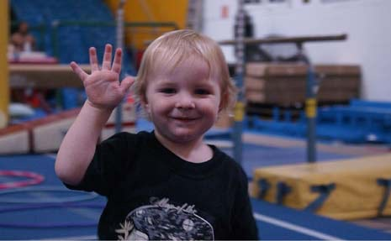
Thank you. Goodbye.

Slide 14
Thanks! No problem!

Slide 15
Sorry!

Slide 16
My name is…

Slide 17
Goodbye!

Slide 18
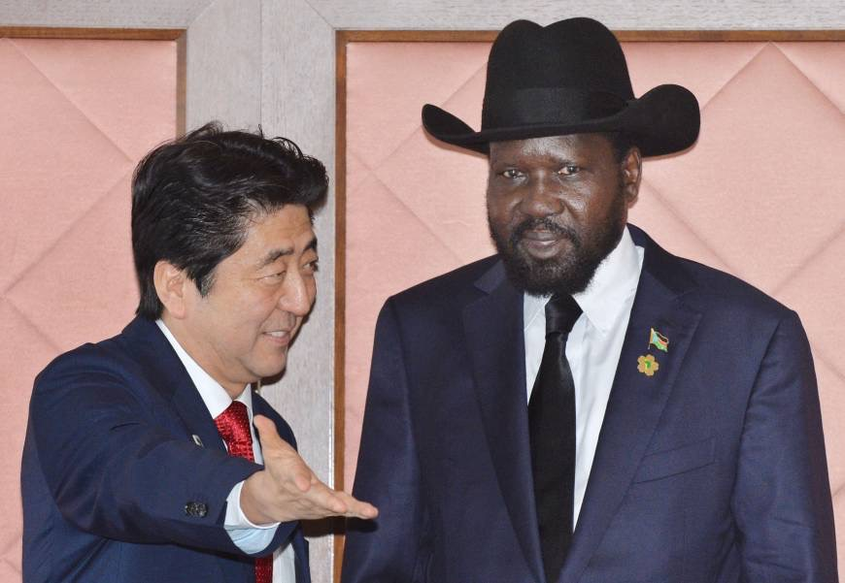
and you?

Slide 19
I don’t understand!

Slide 20
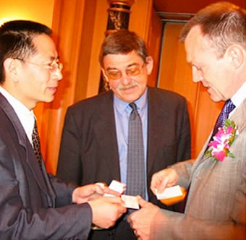
Excuse me.
What’s your name?

Slide 21
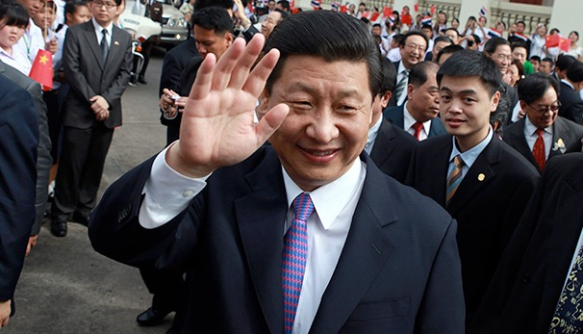
Hello. Sorry, I don’t understand.

Slide 22
Hello. What’s your surname?
And you?

Slide 23
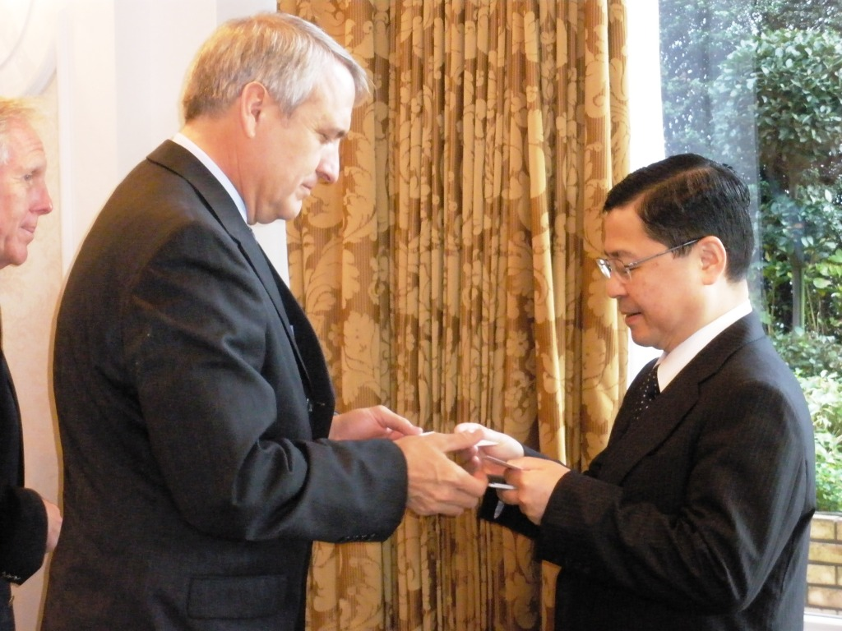
Next week
Nationalities
I am American.
Are you Chinese?
Do you have a Business card?
Yes. Here’s my Business Card.

