Slide 1
Learn Chinese the Fun Way!

Slide 2
PART 2
1. Ask ‘What is your name?’
2. Respond ‘My name is...’
3. Ask ‘And you..?’
4. Indicate ‘I don’t understand’.

Slide 3
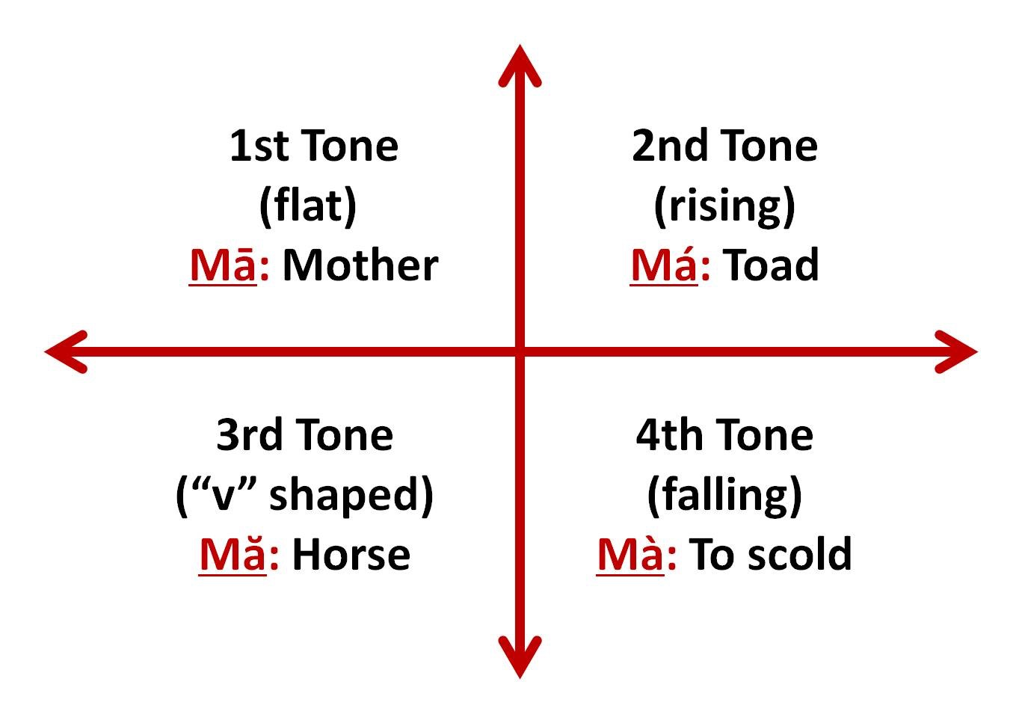

Slide 4
你叫 什么 名字？
Nǐ jiào shénme míngzì?

Slide 5
你
Nǐ

Slide 6
叫
Jiào

Slide 7
什么
Shén me

Slide 8
名字
Míng zì

Slide 9
你叫 什么 名字？
Nǐ jiào shénme míngzì?

Slide 10
您
Nín
你叫 什么 名字？
Nǐ jiào shénme míngzì?
贵 姓?
Guì xìng?

Slide 11
hello
name
called
you
I
excuse me
and you?
goodbye
what

Slide 12
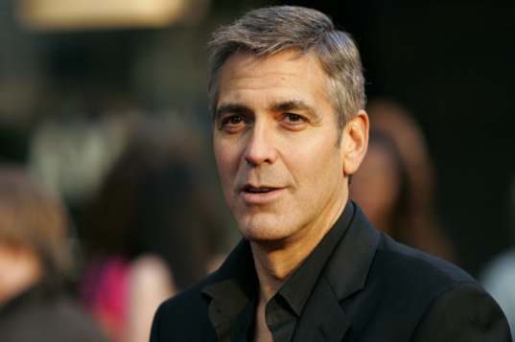
我叫 George Clooney
jiào

Slide 13
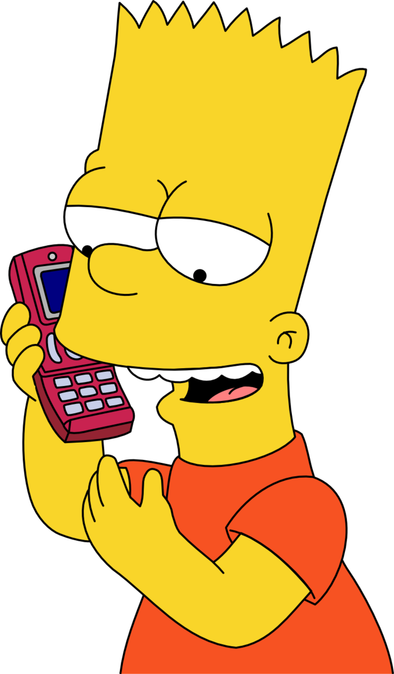
你叫 什么 名字？
Nǐ jiào shénme míngzì?
我叫 Bart.
jiào

Slide 14
你叫 什么 名字？
Nǐ jiào shénme míngzì?
我叫 Homer.
jiào

Slide 15
我不懂
Wǒ bù dǒng

Slide 16
我不懂
Wǒ bù dǒng
我
不
懂
Wǒ
bù
dǒng
I
don’t
understand

Slide 17
Let’s Review
Hello
Excuse me
What’s your name?
My name is….
What’s your last name?
My last name is….
And what about you?
I don’t understand.
Goodbye!

Slide 18
Conversation
Hello | Nǐ hǎo Qǐngwèn Nǐ jiào shénme míngzì? Wǒ jiào Nǐ ne? Wǒ bù dǒng
Excuse me
What’s your name?
My name is...
And you?
I don’t understand

