Slide 2
What will you learn?
1. Say Hello and Goodbye
2. Ask someone’s last name
3. Respond with last name
4. Respond with ‘And you?’
5. Use ‘Excuse me’.

Slide 3
What are Tones?

Slide 4
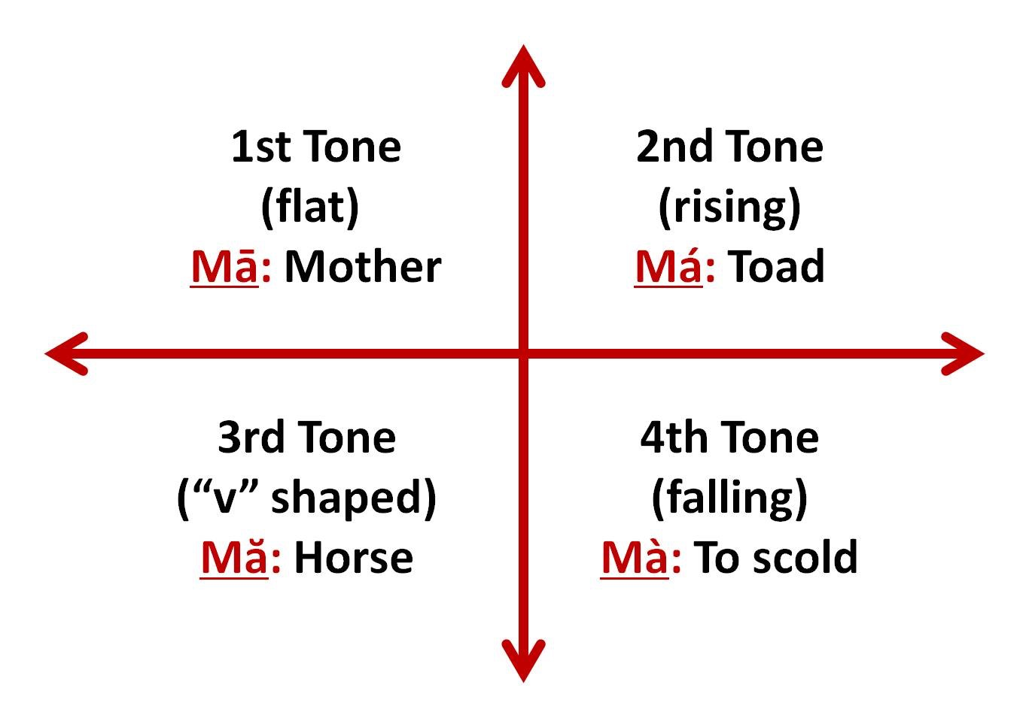

Slide 10
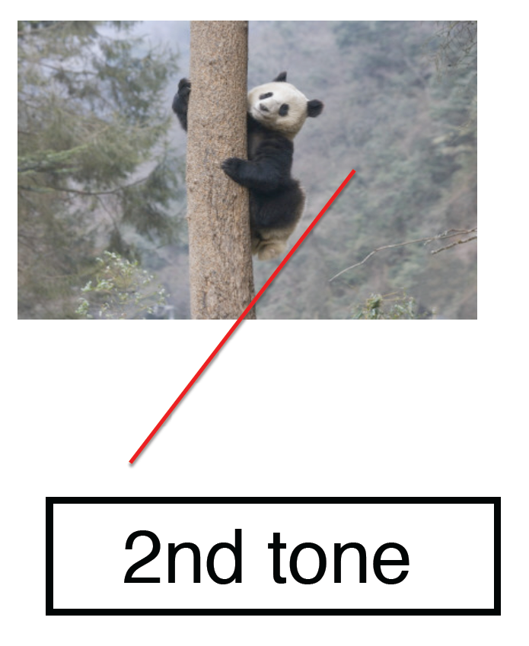

Slide 11
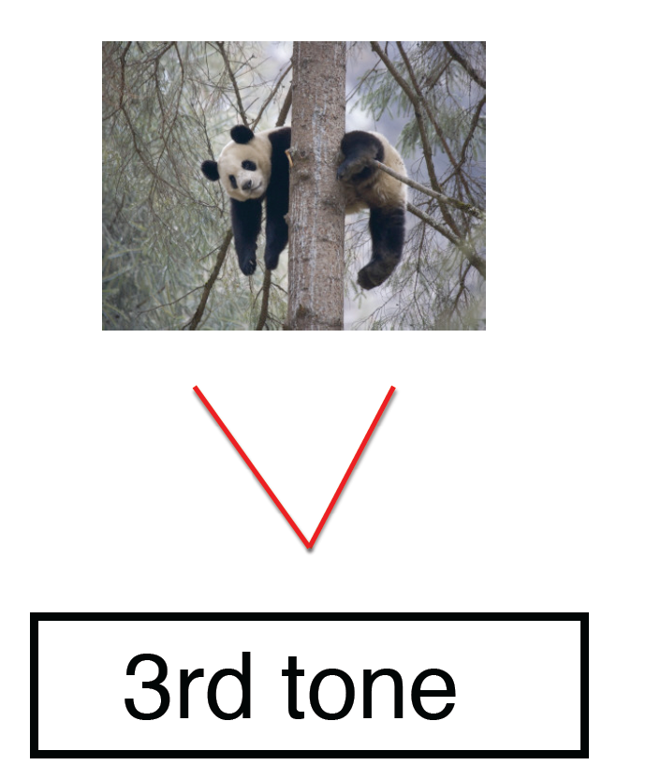

Slide 14
Getting to know someone

Slide 15
你好
Nǐ hǎo
Hello

Slide 16
你
Nǐ
You

Slide 17
好
hǎo
good

Slide 18
你好
Nǐ hǎo
Hello

Slide 19
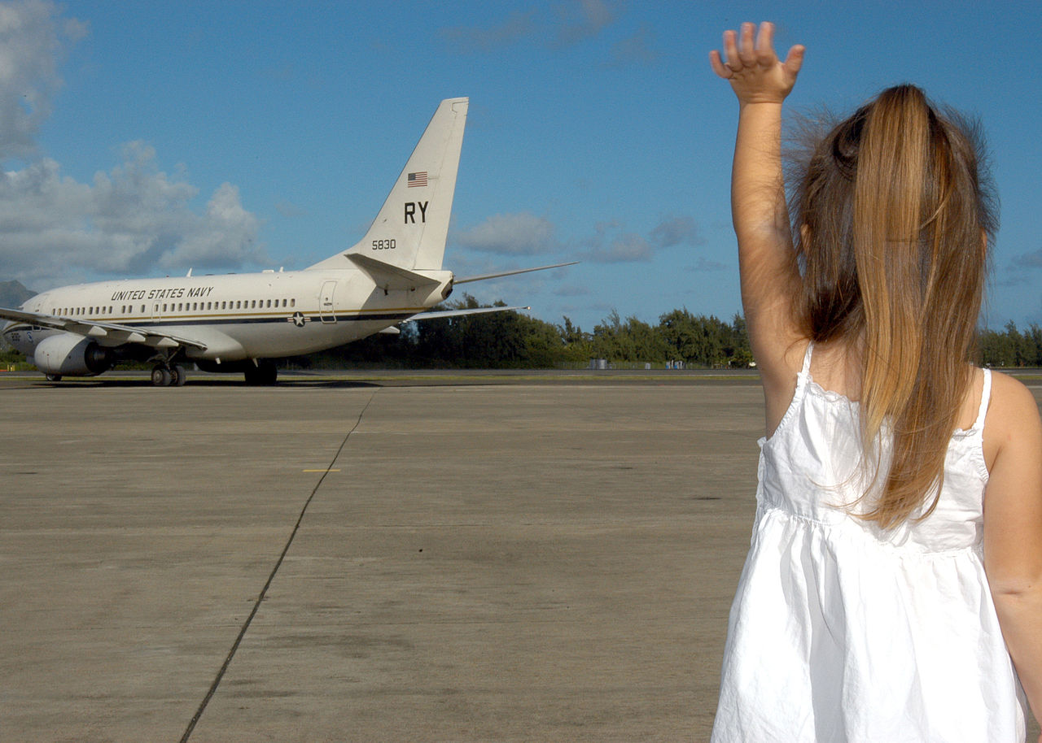
再见
Goodbye
Zài jiàn

Slide 20
再
Zài jiàn
见
Again
See

Slide 21
你好
Nǐ hǎo
再见
Zài jiàn

Slide 22
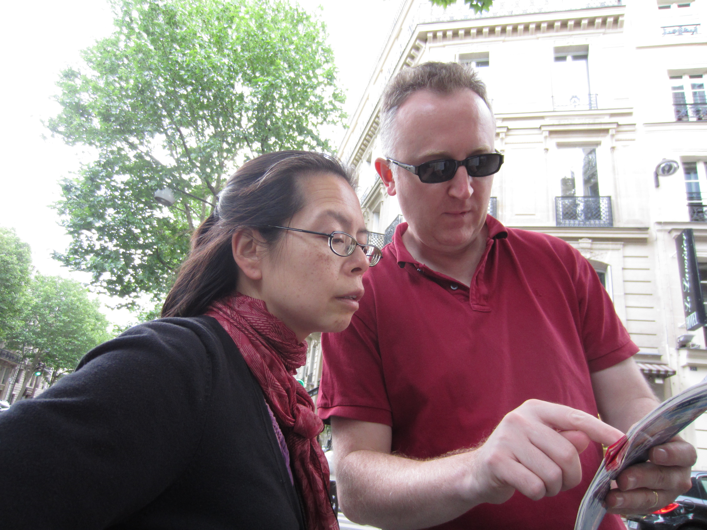
请问
qǐng wèn
Excuse me

Slide 23
请
Qǐng

Slide 24
问
wèn
Ask

Slide 25
请问
Qǐngwèn
Excuse me

Slide 26
您
Nín
you (polite)

Slide 27
贵 姓
Guì xìng
last name

Slide 28
您
Nín
贵 姓?
Guì xìng?

Slide 29
您
Nín
贵 姓?
Guì xìng?

Slide 30
您
Nín
你好
Nǐ hǎo
贵 姓?
Guì xìng?

Slide 31
您
Nín
贵 姓?
Guì xìng?
请问
Qǐngwèn

Slide 32
您
Nín
请问
Qǐng wèn
贵 姓?
guì xìng?
你好
Nǐ hǎo

Slide 33
pinyin
q
ch
x
sh

Slide 34
Hello
Excuse Me
What’s your last name?

Slide 35
?????

Slide 36
我
Wǒ
I / Me

Slide 37
姓
xìng
Wǒ
我
Wǒ
My last name is....

Slide 38
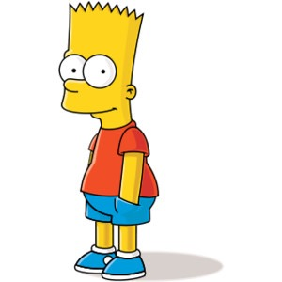
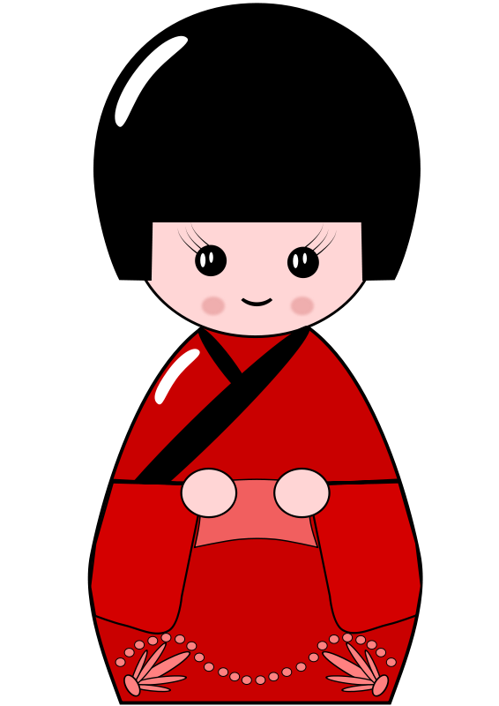
姓 Simpson
xìng
Wǒ
您
Nín
我
Wǒ
贵 姓?
guì xìng?
My last name is....

Slide 39
姓 Clooney
xìng
Wǒ
您
Nín
我
Wǒ
贵 姓?
guì xìng?
My last name is....

Slide 40
姓 Winfrey
xìng
Wǒ
您
Nín
贵 姓?
guì xìng?
我
Wǒ
My last name is....

Slide 41
您
Nín
我
Wǒ
姓 xìng
请问
Qǐng wèn
贵 姓?
guì xìng?
你好
Nǐ hǎo
Ma

Slide 42
What’s your
last name?
Excuse
me
My last
name is
Jones.
hello

Slide 43
你 呢?
Nǐ ne?
and what about you?
?
?
?

Slide 44
你
Nǐ
What about you?
呢?
ne?
You
？

Slide 45
你 呢?
Nǐ ne?
and what about you?
我
Wǒ
姓 xìng
我
Wǒ
姓 xìng
我
Wǒ
姓 xìng
Lu
Han
Li

Slide 46
Let’s Review
Hello
You
You (polite)
I / me
Good
Goodbye
What’s your last name?
My last name is…
Please
Ask
Excuse me
And what about you?

Slide 47
Meeting someone new
Hello | 你好
Excuse me | 请问
What’s your last name? | 您贵姓
My last name is... | 我姓...
And you? | 你呢？
Goodbye | 再见

